Slide 1
CS150A Database Course Review
Dec. 22, 2022
Notes:
课程期末考试的具体安排如下：
考试时间：1月3日（周二），10:30--12:10；
考试地点：腾讯会议；
考试范围：本学期所有讲授的内容；
考试题型：选择题，判断题，填空题，计算题等，共十二道大题；
考试要求：闭卷，两张A4大小的cheatsheet（可以手写或者复印）。

Slide 2
Database
SQL
Disk, Buffers and Files
Index and B+ Trees
refinement
Buffer Manager
Relational Algebra
Sorting and Hashing
Iterations and Joins
Query Optimization
Transactions and Concurrency
Recovery
ER Modeling & FD
Parallel Query Processing
Distributed Transactions
NoSQL
MapReduce & Spark
DM & ML
Data Warehouse / Lake
Machine Learning
k-means
Linear Regression

Slide 3
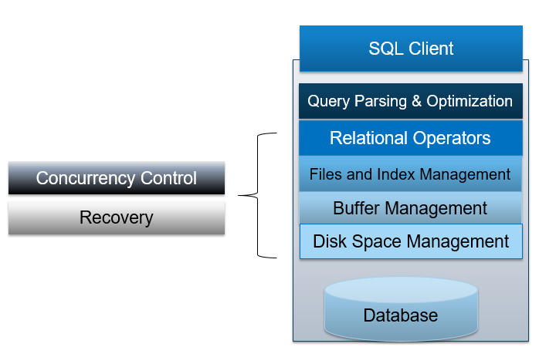
1. SQL

Slide 4

Relational Terminology
Database: Set of named Relations
Relation (Table):
Schema: description (“metadata”)
Instance: set of data satisfying the schema
Attribute (Column, Field)
Tuple (Record, Row)
ssn integer | first text | last text
123456789 | wei | jones
987654321 | apurva | lee
543219876 | sara | manning
543219876 | sara | manning

Slide 5
SQL Language
Two sublanguages:
DDL – Data Definition Language
Define and modify schema
DML – Data Manipulation Language
Queries can be written intuitively.
RDBMS responsible for efficient evaluation.
Choose and run algorithms for declarative queries
Choice of algorithm must not affect query answer.
Declarative!

Slide 6
The SQL DDL: Primary Keys
sid | sname | rating | age
1 | Fred | 7 | 22
2 | Jim | 2 | 39
3 | Nancy | 8 | 27
CREATE TABLE Sailors (
sid INTEGER,
sname CHAR(20),
rating INTEGER,
age FLOAT
Primary Key column(s)
Provides a unique “lookup key” for the relation
Cannot have any duplicate values
Can be made up of >1 column
E.g. (firstname, lastname)

Slide 7
SQL DML: Basic Single-Table Queries
SELECT [DISTINCT] <column expression list> FROM <single table> [WHERE <predicate>] [GROUP BY <column list> [HAVING <predicate>] ] [ORDER BY <column list>] [LIMIT <integer>];
Arithmetic Expressions

Slide 8
Combining Predicates
Subtle connections between:
Boolean logic in WHERE (i.e., AND, OR)
Traditional Set operations (i.e. INTERSECT, UNION)
Set: a collection of distinct elements
Standard ways of manipulating/combining sets
Union
Intersect
Except
Treat tuples within a relation as elements of a set

Slide 9
Nested Queries
Names of sailors who’ve reserved boat #102:
SELECT S.sname
FROM Sailors S
WHERE S.sid IN
(SELECT R.sid
FROM Reserves R
WHERE R.bid=102)
SELECT S.sname
FROM Sailors S
WHERE EXISTS
(SELECT R.sid
FROM Reserves R
WHERE R.bid=102)
We’ve seen: IN, EXISTS
Can also have: NOT IN, NOT EXISTS
Other forms: op ANY, op ALL
subquery

Slide 10
Join Variants
SELECT <column expression list>
FROM table_name
[INNER | NATURAL | {LEFT |RIGHT | FULL } {OUTER}] JOIN table_name
ON <qualification_list>
WHERE …
INNER is default
Inner join what we’ve learned so far
Same thing, just with different syntax.

Slide 11
Brief Detour: Null Values
Field values are sometimes unknown
SQL provides a special value NULL for such situations.
Every data type can be NULL
The presence of null complicates many issues. E.g.:
Selection predicates (WHERE)
Aggregation
But NULLs comes naturally from Outer joins
NULL op NULL is NULL
WHERE NULL: do not send to output
Boolean connectives: 3-valued logic
Aggregates ignore NULL-valued inputs

Slide 12
2. Disk, Files and Buffers

Slide 13
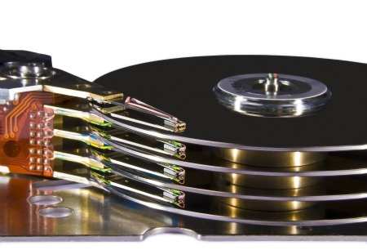
Components of a Disk
Spindle
Disk head
Platters spin (say 15000 rpm)
Arm assembly moved in or out to position a head on a desired track
Tracks under heads make a “cylinder”
Only one head reads/writes at any one time
Block/page size is a multiple of (fixed) sector size
Sector
Platters
Arm movement
Tracks
Arm assembly
Key to lower I/O cost:
reduce seek time and rotational delays
Reading/writing to “far away” blocks on disk requires slow seek/rotation delay
Disk Platters
Notes:
A sector is pie shaped piece of a cycle; in terms of disk drive, a sector is the part of a track that intersects with one of these sectors
In this fig, the thick black arc is a sector; a sector is fixed size, with fixed amount of data
The block or page size that we transferred to and from the disk is some multiple of the sector size, that configured by the OS when we format the disk

Slide 14
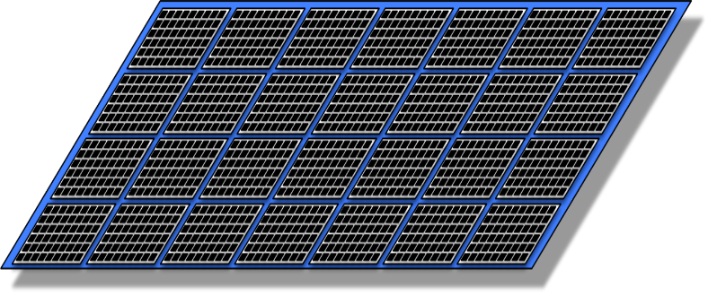
Notes on Flash (SSD)
Issues in current generation (NAND)
Fine-grain reads (4-8K reads), coarse-grain writes (1-2 MB writes)
Only 2k-3k erasures before failure, so keep moving hot write units around (“wear leveling”)
Write amplification: Writing 2 “far away” blocks on SSD can require writing multiple much larger units
Can be 1-10x the bandwidth (bytes/sec) of ideal HDD #s
Note: Ideal HDD #s hard to achieve.
Expect 10-100x bandwidth for non-sequential read.
Notes:
Talk a bit about Flash Memory, sometimes called solid state disks (SSD). Flash memories combined together into disk drives → SSD
Current generation in 2018 of flash technology is called NAND flash. It has some unusual properties that you need to be aware.
It allows fine-grain reads, so you can read pretty small amounts of data (4-8KB at a time). So you can point to a location on the flash disk, and read as little as 4K;
But writes actually are bigger, coarse-grained. You can write in units of 1-2MB;

Slide 15
Arranging Blocks on Disk
Disk head
Spindle
‘Next’ block concept:
sequential blocks on same track, followed by
blocks on same cylinder, followed by
blocks on adjacent cylinder
Arrange file pages sequentially by ‘next’ on disk
minimize seek and rotational delay.
For a sequential scan, pre-fetch
several blocks at a time!
Read large consecutive blocks
Arm movement
Tracks
Arm assembly
Random vs. sequential disk access (10x)
Notes:
When we talk about blocks on disk, it is important to have notion of how close they are to each other, and so we will define a notion of “Next”
What is the next block on disk after the one we have. So the next block concept sequential blocks on the same track are considered to be very close. You can think of the next block being the one that will rotate under the head.
When we are done looking at all the blocks on a particular track, then the blocks on the same cylinder would be the next closest, because we don’t have to move the disk arm to switch from one disk head to another, so we are just going to a different platter keeping the disk arm fixed. So that is block on the same cylinder but a different platter
Across cylinders, there are blocks on adjacent cylinders where we only have to move the disk head just a little bit, to get from one track to the next
Sequentially arrange: it allows us to scan a file following the next block concept, so that scanning the file will be as fast as possible, minimizing …..;
Moreover, when we do sequential scans, we are going to prefetch several blocks at a time, so as that tract spins under the head even though we may have only asked for one block so far, we will transfer say a whole tract worth of blocks or maybe even a whole cylinder, so we are going to read large consecutive chunks of blocks, whenever we get a request

Slide 16
Files of Pages of Records
DB FILE: A collection of pages, each containing a collection of records.
API for higher layers of the DBMS:
Insert/delete/modify record
Fetch a particular record by record id …
Record id is a pointer encoding pair of (pageID, location on page)
Scan all records
Possibly with some conditions on the records to be retrieved
Could span multiple OS files and even machines
Or “raw” disk devices
Heap Files
Sorted Files
Index Files: B+ Trees, Hashing

Slide 17
Page Basics: The Header
Page Header
Header may contain:
Number of records
Free space
Maybe a next/last pointer
Bitmaps, Slot Table
Options for Page Layouts depend on
Record length (fixed or variable)
Page packing (packed or unpacked)

Slide 18
Fixed Length Records: Unpacked
Record id:
(Page 2, Record 4)
Bitmap
Page Header
Record
Record
Bitmap denotes “slots” with records
Record id: record number in page
Insert: find first empty slot
Delete: Clear bit
Record
Record
Record
Record
Record

Slide 19
Variable Length Records -- Slotted Page
Record
Record
Introduce slot directory in footer
Pointer to free space
Length + Pointer to beginning of record
reverse order
Record ID = location in slot table
from right
Delete?
e.g., 4th record on the page
Record
Record
Record
Footer
18
12
32
24
16
Slot Directory
Record Id:
(Page 2, Record 4)

Slide 20
Record Formats: Variable Length
What happens if fields are variable length?
Introduce a record header
Direct access & no “escaping”, other advantages?
Handle null fields easily →
useful for fixed length records too!
Record
Bob
Big, St.
M
32
94703
VARCHAR
VARCHAR
INT
INT
Header
M
32
94703
Bob
Big, St.
CHAR
INT
INT
VARCHAR
VARCHAR

Slide 21
Record
SSN | Last Name | First Name | Age | Salary
123 | Adams | Elmo | 31 | $400
443 | Grouch | Oscar | 32 | $300
244 | Oz | Bert | 55 | $140
134 | Sanders | Ernie | 55 | $400
Bob
Harmon
M
32
400
Varchar
Varchar
Char
Int
Int
Byte Representation of Record
File
Header
M
Bob
Harmon
94703
32
Page 1
Page 2
Slotted Page
Page Header
Page 3
Page 4
Page 5
Page 6

Slide 22
Cost of Operations Complete
 | Heap File | Sorted File
Scan all records | B*D | B*D
Equality Search | 0.5*B*D | (log₂B)*D
Range Search | B*D | ((log₂B)+pages)*D
Insert | 2*D | ((log₂B)+B)*D
Delete | (0.5*B+1)*D | ((log₂B)+B)*D
B: The number of data blocks
R: Number of records per block
D: Average time to read/write disk block
Can we do better?
Indexes!
Notes:
填满了我们的完整表，您可以看到，对于排序的文件，插入和删除的开销相同，而对于堆文件，它们的开销却不同，因为插入非常无聊，我们只是将内容放在最后，但是删除需要 查找数据
因此，您可以看到此表中存在各种折衷
讨论typical access pattern与file organizations的权衡和折中
现在此表还不完整，我们可以做得更好吗？
答案是肯定的，我们可以做得更好。
我们可以使用索引，接下来我们将讨论
Now this table is not complete, can we do better?
The answer is yes, we can do better.
We can use indexes, and we will talk about that next

Slide 23
3. Index and B+ Trees

Slide 24
Index
An index is data structure that enables fast lookup and modification of data entries by search key
Lookup: may support many different operations
Equality, 1-d range, 2-d region, …
Search Key: any subset of columns in the relation
Do not need to be unique
—e.g. (firstname) or (firstname, lastname)
Data Entries: items stored in the index
Assume for today: a pair (k, recordId) …
Pointers to records in Heap Files!
Easy to generalize later
Modification: want to support fast insert and delete
Many Types of indexes exist: B+-Tree, Hash, R-Tree, GiST, ...
Notes:
那么什么是索引？
它是一种数据结构，可通过搜索键快速查找和修改数据条目。
因此，我想解开这个定义，并为每个突出显示的术语花一些时间来思考它的含义
我们将使他们一点点混乱。
让我们从查找开始。因此，索引的查找可能会根据您构建的索引类型而有所不同。
查找可以支持不同的操作，典型的操作是等式查询，在索引中找到与特定值匹配的所有项目。
但是我们可能会查找一维范围之类的东西，找到x和y之间索引中的所有项目。
一些特别针对地理空间数据的索引（例如地图）适用于二维区域，可以找到我现在所在位置一英里范围内的所有项目，或者可以找到我在地图上拖动的特定边界框中的项目
您可以想象其他类型的字符串查找以及图像和类似的查找
因此，存在许多数据结构，为这些不同类型的操作发明了许多索引，当有人为您提供索引时，您应该询问它旨在支持哪种操作
现在我们说我们通过搜索键查找内容，这是什么意思
在关系模型中，我们要谈论的是，关系中任何列的子集都可以组合起来以形成搜索关键字
不必是唯一的查找关键字。因此，举例来说，我们可以在关于人的表格上有一个名字的搜索关键字，很可能不是唯一的，当您查找类似Joe的东西时，许多人可能会匹配
但是我们也可以通过多个列的组合来查找内容，例如名字逗号，姓氏，并且他们正在寻找两个列的匹配项
因此，可以根据列中值的任何串联构造我们要查找的搜索键。
So what is index?
It is a data structure, that enables fast lookup and modification of data entries by search key.
So I want to unpack this definition and for each of the highlighted terms, spend a little time thinking about what it means
We will take them a little bit out of order.
Let us start with lookup. So lookup in an index can vary depending on the kind of index that you built.
Lookups can support different operations, the typical operation is equality, find me all items in the index that match a particular value.
But we might have lookups for things like ranges in one-dimension, find me all items in the index between x and y.
Some indexes particularly for geospatial data, like maps, are for two-dimensional regions, find me all items that are within a mile of where I am right now, or find me items that are in a particular bounding box I drag on the map
You can imagine other kinds of lookups for strings and from images and things like that
So there have been many data structures, many indexes invented for these different kinds of operations, and when someone presents you with an index, you should ask what kind of operation is it designed to support
Now we said that we look things up by search key, what did we mean by that
In the relational model, what we are going to talk about, is any subset of columns in the relation can be combined to form a search key
Doesn’t need to be a unique lookup key. So for example, we could have a search key that is first name in a table of people, very likely that is not unique, many people may match when you look up something like Joe
But we could also look things up by a composite of multiple columns, like first name comma last name, and they were looking for matches on both the columns
So the search key that we are looking on can be constructed out of any concatenation of values in the columns.

Slide 25
Build a high fan-out search tree Part 4
Recursively “index” key file
Key Invariant:
Node […, (K_{L}, P_{L}), (K_{R}, P_{R}), ... ] → All tuples in range K_{L} <= K < K_{R} are in tree P_{L}
1
7
Searching for 5?
Binary Search each node (page) starting at root
Follow pointers to next level of search tree
Complexity? O(log_{F}(#Pages))
1
3
5
7
9
1, 2, _
3, 4, _
5, 6, _
7, 8, _
9, 10, _
Notes:
但是，我们可能要做的是递归执行此操作，我们将为搜索文件构建一个搜索文件
在这里，我们再次得到的是键指针对，其中键是我们指向的页面上的低值，并且该点指向页面，但是现在这在我们之前构建的实际索引文件之上
因此，我们可以递归执行此操作，直到获得索引文件为止。那只有一页大。
我们将不得不在这里有一个不变式
对于此搜索树中的任何节点，因此这些页面中的任何一个节点，都将是一堆关键指针对，尤其是其中的某个地方，左边有一个关键指针对，还有一个关键指针准备对，在这个符号中的L和R
我们必须确保以下不变量，KL和KR之间的所有元组K都在左侧，并注意该表达式中的小于等于和小于，因此以键7为例，所有小于7在它的左边，所有大于或等于7的东西在右边
因此大于或等于右侧，小于左侧
However, what we might do then is to do this recursively, we will build a search file for our search file
Here what we have got again is key pointer pairs, where the key is the low value on the page we are pointing to, and the point points to a page, but now this is over the actual index file we built before
So we can do this recursively, until we get an index file up top. That is only one page big.
We are gonna have to have an invariant here though that
For any node in this search tree, so any one of these pages, it is going to be a bunch of key pointer pairs, and in particular somewhere in there, there is a key pointer pair for left, and a key pointer to prepare for right, L and R in this notation
We have to ensure the following invariant, all tuples K between KL and KR are on the left-hand side, and notice the less than equals to and the less than in this expression, so this key 7 for example, all things that are less than 7 are to the left of it, all things that are greater than or equal to 7 are to the right
So greater than or equal to the right, less than to the left

Slide 26
Left Key Optimization?
Optimization
Do we need the left most key?
Data
Pages
1, 2, _
3, 4, _
9,10,_
Index
Pages
Disk Layout? All in a single file, Data Pages first.
1
1
7
ISAM
Indexed Sequential Access Method
(Early IBM Indexing Technology)
7
1
7
9
1
3
5
1, 2, _
3, 4, _
5, 6, _
7, 8, _
9, 10, _
Notes:
现在我们可以在这里做一些简单的优化
我们真的不需要这个最左边的键，我们可以放下它，仍然能够找到所有内容
隐式地，最左边的指针下方的所有内容都小于右边的split键，一旦导航到树上，我们就不在乎多少
因此，我们可以放下这些左键，这将节省空间，并在每页上为我们留出更多空间供更多输入
Now we can do a little bit better here simple optimization
We really don’t need this leftmost key, we can just drop it and still be able to find everything
Implicitly, everything down the leftmost pointer is stuff that is less than the split key to the right, and we don’t really care how much less, once we have navigated the tree
So we can drop these left keys, and that is going to save a space, and give us more room on each page for more entries

Slide 27
Example of a B+ Tree
Root Node
17
Page 1
Page 4
5
13
24
30
Page 6
2*
3*
5*
7*
8*
14*
16*
19*
20*
22*
24*
27*
29*
33*
34*
38*
39*
Page 2
Page 3
Page 5
Page 7
Page 8
Page 9
Occupancy Invariant
Each interior node is at least partially full:
d <= #entries <= 2d
d: order of the tree (max fan-out = 2d + 1)
Data pages at bottom need not be stored in logical order
Next and prev pointers
What is the value of d?
2
What about the root?
The root is special
Why not in sequential order?
Data pages allocated dynamically
Notes:
这是B +树的示例。关于B +树的有趣事实之一是它具有占用不变性，而ISAM则没有。
因此，不变性是说每个节点的占用率或填充因子必须至少为节点容量的一半。那是介于D到2D之间的条目数，这是该节点的最大值
D称为树的顺序，该单词顺序是一个有用的单词，对于顺序为D的树，最大扇出度为2D加1，“加1”表示页面最左边的点
与ISAM区别的B +树底部的数据页不需要按照它们在树的叶子中的顺序存储在磁盘上
因此，例如，您可以在此B +树中看到页面3在叶子处是页面5的邻居，当然它们在磁盘上被页面4隔开。
但是这里的前一个和下一个指针以绿色和红色显示，使我们可以根据需要向右或向左遍历B +树的叶级
Here is an example of a B+ tree. One of the interesting facts about a B+ tree is that it has an occupancy invariant, we didn’t have this with the ISAM.
So it is an invariance a rule that says the occupancy, or the fill factor of each node, must be at least one half the capacity of the node. That is the number of entries between some number D and 2D, which is the maximum for the node
D is called the order of the tree, that word order is a useful word to know, and the maximum fan-out for a tree with order D is 2D plus 1, the ‘plus 1’ means the leftmost point around the page
The data pages at the bottom of a B+ tree, distinguished from a ISAM, need not be stored on disk in the order they are in at the leaf of the tree
So for example, you can see in this B+ tree that page 3 is a neighbor of page 5 at the leaves, and of course they are separated by page 4 on disk.
But the previous and next pointers here shown in green and red, allow us to traverse the leaf level of the B+ tree rightwards or leftwards as needed
顺序代表孩子数量的上限。 即。 可能的最大数量。
Order represents the upper bound on the number of children. ie. the maximum number possible.
在任何树中，扇出都是指向节点中子节点的指针数。
Fan-out, in any tree, is number of pointers to child nodes in a node.

Slide 28
B+ Trees and Scale
Root Node
How big is a height 3 B+ tree
d = 2 → Fan-out?
Fan-out = 2d + 1 = 5
Height 3: 5³ x 4= 500 Records
Notes:
现在让我们看一看具有相同阶数的3 B +树高，它是阶数2，
但是现在高度为3时，我们有了一个带有5个扇出的根节点，它下面的层有带有扇出5的节点，下面的层有一个扇出5的节点。
因此，我们在内部节点中有5个立方体扇出，在叶子处，每个叶子有4条记录，因此是5立方体乘以4是500条记录
这样一来，您可以感觉到事情进展得很好，但是在实践中它是如何发挥作用的
Now let us look at a height 3 B+ tree with the same order, so it is order 2,
But now with height 3, we have got a root node with 5 fan-out, the layer below it has nodes with fan-out 5, the layer below that has nodes with fan-out 5
So we have 5 cubed fan-out in the interior nodes, and at the leaves we have 4 records per leaf, so that is 5 cubed times 4 is 500 records
So that give you a sense that things are scaling quite nicely, but how does it play out in practice

Slide 29
Searching the B+ Tree: Fetch Data
Root Node
17
Page 1
Page 4
5
13
24
30
Page 6
2*
3*
5*
7*
8*
14*
16*
19*
20*
22*
24*
27*
29*
27*
33*
34*
38*
39*
Page 2
Page 3
Page 5
Page 7
Page 8
Page 9
PageId,
Record Id
Page 1
Page 2
Page 3
Page 4
(20, Tim)
(7, Dan)
(5, Kay)
(3, Jim)
(27, Joe)
(34, Kit)
(1, Kim)
(42, Hal)
Notes:
请注意，在这棵B +树中，我们的叶子保留着作为记录的键和指针的数据条目，
我们知道指向记录的指针现在看起来是什么样的，它是页面ID和记录ID
因此，在这种情况下，存在一个堆文件，并且在该堆文件中，有一个记录，该记录具有27个逗号Joe，并且指向该记录的指针是B +树中该27叶条目中的内容
Note in this B+ tree, our leaves hold data entries that are a key and a pointer to a record,
We know what a pointer to a record looks like now, it is a page id and a record id
So in this case, there is a heap file, and in that heap file, there is a record that has 27 comma Joe, and the pointer to that record is what is in that 27 leaf entry in the B+ tree

Slide 30
Inserting 8* into a B+ Tree: Insert
Root Node
13
17
24
30
8*
2*
3*
5*
7*
14*
16*
19*
20*
24*
27*
29*
33*
34*
38*
39*
Find the correct leaf
Split leaf if there is not enough room
Notes:
但是叶子已经满了，所以当我们到达那里时，如果没有足够的空间容纳8个叶子，我们将拆分叶子节点
But that leaf is full, so when we get down there, we are going to split the leaf node, if there is not enough room for 8

Slide 31
Copy up vs Push up!
17
Root Node
5
13
24
30
2*
3*
5*
7*
8*
14*
16*
19*
20*
24*
27*
29*
33*
34*
38*
39*
Check invariants
Key Invariant:
Node[…, (K_{L}, P_{L}), …] ➔ K_{L}<= K for all K in P_{L} Sub-tree
Occupancy Invariant:
d <= # entries <= 2d
Notice:
The leaf entry (5) was copied up
The index entry (17) was pushed up
Notes:
这里要注意的主要事情是分割叶子与分割内部节点的区别
关键区别在于，分割叶子后，我们将密钥向上复制，因此您将看到这5个剩余部分作为叶子级的数据条目，并被复制到上方的索引条目中
相比之下，这17个从中级推到最高级
Major thing to note here is the distinction in splitting a leaf versus splitting an internal node
The key distinction is that splitting a leaf, we copy the key up, so you will see the 5 remains as a data entry at the leaf level, as well as being copied into an index entry up above
By contrast, the 17 was pushed up from the middle level to the top level

Slide 32
Three basic alternatives for data entries in any index
Three basic alternatives for data entries in any index
Alternative 1: By Value
Alternative 2: By Reference
Alternative 3: By List of references
We’ll look in the context of B+-trees, but applies to any index
Notes:
首先，任何索引中的数据条目都有三种基本替代方式，我们的书使用创意名称，替代方式一，替代方式二和替代方式三，我们将坚持使用
在我们的演示文稿中，我实际上并不知道跨不同实现或不同工程师使用的通用名称，因此我们将坚持使用本书使用的名称
替代一，它是按值表示，替代二和三是通过引用或引用列表，我们将在接下来的 b 树的上下文中逐一介绍，但请记住，这适用于任何索引 ，哈希索引，gist等
to begin with, there are three basic alternatives for data entries in any index, and our book uses the creative names, alternative one, alternative two and alternative three, and we're going to stick with that
here in our presentation I'm not actually aware of common names that are used across different implementations or different engineers, and so we'll just stick with the ones that the book uses
alternative one, which is a by value representation, and alternatives two and three which are by reference or by list of references, we'll go through each one of these next in the context of b-trees, but remember this applies to any index, hash indexes, gist's and so on

Slide 33
4. Buffer Manager
SQL Client
Completed
Database Management
System
Query Parsing & Optimization
Relational Operators
Completed
Files and Index Management
You are here!
Buffer Management
Completed
Disk Space Management
Database

Slide 34
APIs
Buffer Manager
Read Page
Write Page
RAM
Buffer Manager
Frame
Frame
Frame
Page 1
Page 4
Page 3
Two questions:
Handling dirty pages
Page Replacement
Frame
Frame
Frame
Read Page
Write Page
Disk
Disk Space Manager
Page 1
Page 2
Page 3
Page 4
Page 5
Page 6
Notes:
两层的API相当相似，
缓冲区管理器的API将用于读取和写入页面
磁盘驱动器的API也用于读取和写入页面，但是，当然，在RAM中，一旦寻址到它们，就可以寻址页面中的特定字节，因此它们的寻址能力更高。
The API of the two layers is fairly similar,
The API to the buffer manager is going to be to read and write pages
API to the disk drive was also to read and write pages, but of course, in RAM things are more addressable, once you get them there, in terms of addressing specific bytes within the page

Slide 35
Answers to Our Previous Questions
Handling dirty pages
How will the buffer manager find out?
Dirty bit on page
What to do with a dirty page?
Write back via disk manager
Page Replacement
How will the buffer mgr know if a page is “in use”?
Page pin count
If buffer manager is full, which page should be replaced?
Page replacement policy
Least-recently-used (LRU), Clock
Most-recently-used (MRU)
FrameId | PageId | Dirty? | Pin Count
1 | 1 | N | 0
2 | 2 | Y | 1
3 | 3 | N | 0
4 | 6 | N | 2
5 | 4 | N | 0
6 | 5 | N | 0
Keep an in-memory index (hash table) on PageId
Notes:
现在，我们可以返回并提供一些答案，以解决我们之前列出的问题
在处理脏页方面，我们问缓冲区管理器如何找出页面是否脏，
答案是请求者将在该页面上标记脏位，并告诉缓冲区管理器脏位
缓冲区管理器有脏页时该怎么办？ 在替换时，它将通过磁盘管理器将该页面写回到磁盘
页面替换如何完成？
首先，缓冲区管理器如何知道某个页面是否正在使用，我们说过请求者将保持页面固定，直到使用完页面为止，然后请求者将在页面完成时取消固定它。
如果缓冲区管理器中有很多页面，应该替换哪个页面？
这是由页面替换策略处理的，我们将在下一页中介绍
Now we can go back and provide some answers to the questions that we had listed previously
In terms of handling dirty pages, we asked how well the buffer manager find out if a page is dirty,
And the answer is that the requester is going to mark the dirty bit on that page, and tell the buffer manager that is dirty
What does the buffer manager do when it has a dirty page? At replacement time, it will write that page back to disk via the disk manager
How is the page replacement done?
First, how does the buffer manager to know if a page in use, and we said the requester is going to keep the page pinned until it is done using it, and then the requester will unpin it when it is finished
If the buffer manager is full of pages, which page should be replaced?
That is handled by a page replacement policy, which we will look at next

Slide 36
LRU Replacement Policy
Very common policy: intuitive and simple
Good for repeated accesses to popular pages (temporal locality)
Can be costly. Why?
Need to “find min” on the last used attribute (priority heap data structure)
Approximate LRU: CLOCK policy
FrameId | PageId | Dirty? | Pin Count | Last Used
1 | 1 | N | 0 | 43
2 | 2 | Y | 1 | 21
3 | 3 | N | 0 | 22
4 | 6 | N | 2 | 11
5 | 4 | N | 0 | 24
6 | 5 | N | 0 | 15
Notes:
LRU是一种直观且简单的策略，因此使用非常普遍
您可以想象一下，当您访问一遍又一遍的热门页面时，它的效果很好，这被称为时间局部性，局部性和时间性，因为您在购买中及时点击了同一页面
您可以看到为什么这将行得通，但是最近将访问热门页面，一些不受欢迎的页面可能是在更长时间之前访问的，因此不受欢迎的页面更有可能被替换，但您也不会这样做。不在乎快上，所以效果很好
对LRU的反对意见之一是，它在CPU成本上可能会非常昂贵，为此，让我们看一个示例。
在我们的下表中，具有最少使用量的最低值的行是什么？
好吧，一个简单的实现只需扫描表，发现您知道该帧ID 4的最后使用值为11，这是最后使用的列中的最小值，但是请注意，引脚数为2，所以我们不能使用那个，所以我们可以再看一点，直到找到第6帧具有最后使用的15，这就是最后使用的那个具有最小固定值的
现在是线性扫描，这是线性时间，这确实很昂贵
您可能知道，可以通过在最后使用的列上使用优先级堆来做得更好，并且优先级堆将使我们能够找到日志时间中的最小值，并将数据结构保持为日志时间，这非常快
但是很多人希望将其降到恒定的时间，因为内存中的页面访问实际上是系统中最内层的内部循环，必须非常快地执行，并且我们不希望缓冲池使我们的速度变慢页面访问，很久以前人们想到了LRU的近似值，即时钟，这是一种启发式方法，可以使我们非常接近LRU，所以让我们接下来看看时钟
LRU is an intuitive and simple policy, and so it is used quite common
You can imagine that it works pretty well, when you have accessed to popular page that happen over and over, this is called temporal locality, locality and time, because you are hitting the same page in your buy in time
You can see why that would work popular page is going to be accessed to recently, some unpopular page was probably accessed a longer time ago, and so the unpopular pages are more likely to be replaced, but they are also the ones that you don’t care about being as fast on, so that works out well
One of the objections to LRU is that it can be kind expensive in CPU cost, and to see that, let’s look at an example.
In our table below, what is the row that has the lowest value of least used?
Well, a simple implementation would just scan through the table and find that you know this frame id 4 has the last used of 11, and that is the smallest value in the last used column, but note that the pin count is 2, so we can’t use that one, and so we can look a little bit further until we find frame 6 has the last used 15, and that is the last used that is got the smallest value that is unpinned
Now that was a linear scan, which is linear time, and that is really expensive
You may know that we could do better by using a priority heap on this last used column, and the priority heap will let us find the minimum value in log time and maintain the data structure a log time, that is pretty fast
But a lot of people want to get this down to constant time, because page accesses in memory are really the innermost inner loop of the system that has to go very very fast, and we don’t want the buffer pool slowing us down on simple page accesses, and so long ago people came up with an approximation to LRU, that is called clock, it is kind of a heuristic that gets us pretty close to LRU, so let’s look at clock next

Slide 37


Clock Policy State: Illustrated
FrameId | PageId | Dirty? | Pin Count | Ref Bit
1 | 1 | N | 1 | 1
2 | 2 | N | 1 | 1
3 | 3 | N | 0 | 1
4 | 4 | N | 0 | 0
5 | 5 | N | 0 | 0
6 | 6 | N | 0 | 1
Request: Read page 7
Current frame not pinned
Ref bit unset:
Replace
Set pinned
Set ref bit
Advance clock
Return pointer
Frame
Page 1
✔
Clock Hand
1
Frame
Frame
Page 6
Page 2
✔
✔
Frame
Frame
Page 5
Page 3
*pointer
Frame
Page 7
Page 7
Page 7
When might they perform poorly?
repeated scans of big files
✔
Notes:
最后将指针返回到框架，并将内存返回给调用者，它们可以使用该页面

Slide 38
Repeated Scan (LRU): Read Page 5
Buffer Manager
Buffer Manager
Buffer Manager
Cache Hits: 0
Attempts: 12
Frame
Frame
Frame
Page 7
Page 1
Page 2
Frame
Frame
Frame
Page 3
Page 4
Page 5
Get the picture? A worst-case scenario! “Sequential Flooding”
Disk Space Manager
Page 1
Page 2
Page 3
Page 4
Page 5
Page 6
Page 7
Page 5
Page 6
Page 7
Notes:
第5页也会发生同样的情况
当我们不断扫描文件时，如果一遍又一遍地扫描它，我们将遍历所有内容。
这是最坏的情况，这是悲观的，这是最坏的可能
这通常称为缓冲池的顺序泛洪，我们不断地读取此文件，泛洪缓冲池中的所有页面，并且最近没有使用任何东西，所有事物总是一样古老，没有任何东西使我们受到缓存的打击
Same thing happens with page 5, we are roll for 12
As we keep scanning through the file, we will be over everything, if we scan it over and over
This is a worst case scenario, this is pessimal, it is the worst possible thing
It is often called sequential flooding of the buffer pool, we are reading this file over and over sequentially, flooding out all the pages in the buffer pool, and nothing is recently used, everything is always equally old, and nothing gets us a cache hit

Slide 39
Repeated Scan (MRU): Read Page 5
Buffer Manager
Buffer Manager
Buffer Manager
Buffer Manager
Buffer Manager
Cache Hits: 10
Attempts: 19
Frame
Frame
Frame
Page 1
Page 2
Page 3
Frame
Frame
Frame
Page 5
Page 6
Page 7
Page 1
Page 2
Page 3
Page 4
Page 5
Page 6
Page 7
Notes:
现在第5页不在缓冲池中，我们要替换什么？
最近使用的是第4页
第6和7页...。
Page 5 now not in the buffer pool, what do we replace?
The most recently used was page 4
Page 6 and 7 ….

Slide 40
5. Relational Algebra
Completed
SQL Client
Database Management
System
Query Parsing & Optimization
You are here!
Relational Operators
Completed
Files and Index Management
Completed
Buffer Management
Completed
Disk Space Management
Database

Slide 41
* SQL vs Relational Algebra
Relational Algebra
SQL Query
Relational Algebra
SQL Query
Query Parser & Optimizer
𝜋_{S.name}(𝜎_{bid=100⋀rating>5}(
Reserves ⋈_{R.sid=S.sid} Sailors))
SELECT S.name
FROM Reserves R, Sailors S
WHERE R.sid = S.sid
AND R.bid = 100
AND S.rating > 5
𝜋_{S.name}(𝜎_{bid=100⋀rating>5}(
Reserves ⋈_{R.sid=S.sid} Sailors))
SELECT S.name
FROM Reserves R, Sailors S
WHERE R.sid = S.sid
AND R.bid = 100
AND S.rating > 5
Equivalent to…
Optimized (Physical) Query Plan:
On-the-fly
Project Iterator
SQL
A declarative expression of the query result
Relational Algebra
Operational description of a computation.
(Logical) Query Plan:
𝜋_{S.name}
𝜋_{S.name}
But actually will produce…
On-the-fly
Select Iterator
𝜎_{S.rating>5}
𝜎_{R.bid=100 ⋀ S.rating > 5}
⋈_{R.sid=S.sid}
Indexed Nested Loop Join Iterator
⋈_{R.sid=S.sid}
Operator Code
𝜎_{R.bid=100}
Sailors
Heap Scan Iterator
B+-Tree
Indexed Scan Iterator
Systems execute relational algebra query plan.
Reserves
Sailors
Reserves
Notes:
请注意，SQL和关系代数有有趣的区别。 SQL是查询结果的声明性表达式，它表示这里是我想要的输出；
另一方面，关系代数是计算的可操作描述，它粗略地说是采用该表和该表，并以这种方式将它们组合，然后将该运算符与它们进行组合，依此类推。
因此它有点可操作，它告诉您采取什么操作顺序，尽管它围绕大对象执行的操作在整个表上，而不是在单个元组或内存中的单元上. 关系代数提供的是查询数据库的过程性方式。
但这只是一个操作上的描述，足以帮助我们使系统提出一个具体的物理查询计划来执行该关系代数
Note that the SQL and the relational algebra have interesting difference. SQL is a declarative expression of the query result, it says here is what I want in the output;
relational algebra on the other hand is an operational description of a computation, it says in rough terms take this table and that table, and combine them in this way, and then this operator to them and so on.
So it is somewhat operational, it tells you what order of operations to take, although the operations it takes around big objects are on entire table, not on individual tuples or cells in memory
But it is an operational description, and it is enough to help us get the system come up with a concrete physical query plan to execute that relational algebra

Slide 42
Relational Algebra Preliminaries
Algebra of operators on relation instances
𝜋_{S.name}(𝜎_{R.bid=100 ⋀ S.rating>5}(R ⋈_{R.sid=S.sid} S))
Closed: result is also a relation instance
Enables rich composition!
Typed: input schema determines output
Can statically check whether queries are legal.
Pure relational algebra has set semantics
No duplicate tuples in a relation instance
vs. SQL, which has multiset (bag) semantics
Notes:
让我们看一下代数的一些预备知识，它是对关系实例进行运算的运算符的代数，也就是说，充满元组的表就是特定的表，
然后，您可以将这些运算符级联为嵌套表达式（如此处的表达式），然后您将看到这些表达式的最内层是否有代表这些关系实例的字母R和S
需要特别注意的是，代数的算子是封闭的，因此任何关系代数表达式的结果都是一个关系实例，这意味着我们可以将一长串关系代数算子组合在一起，并在进行过程中不断添加，因为所有内容都在映射从关系到关系
还要注意的另一件事是，所有内容都是用这种语言键入的，很明显，关系实例具有带列类型的架构，而运算符基于其输入的架构为输出的架构定义。结果，您可以静态检查查询是否非法，因此这都是一个整洁的系统
Let’s look at some of the preliminaries of the algebra, it is an algebra of operators that operate on relation instances, which is to say tables full of tuples is so specific tables,
And you can cascade these operators in nested expressions like the ones here, and you will see if the innermost level of these expressions we have got letters R and S, that represent these relation instances
Important to note that the operators of the algebra are closed, so the results of any relational algebra expression is a relation instance, this means we can compose together long strings of relational algebra operators and keep adding to them as we go, because everything is mapping from relations to relations
Another thing to note is that everything is typed in this language, obviously the relation instances have schemas with column types, and the operators have definitions for the schemas of the output, based on the schemas of their inputs. As a results, you can statically check whether queries are illegal or not, and so this is all a neatly typed system
Why is typing important? Relations must all have schemas. Schema information is important for composition and also for system optimization.
This is something that map-reduce systems have struggled with.

Slide 43
Relational Algebra Operators
Unary Operators: on single relation
Projection (π ): Retains only desired columns (vertical)
Selection (σ ): Selects a subset of rows (horizontal)
Renaming ( 𝜌 ): Rename attributes and relations.
Binary Operators: on pairs of relations
Union ( ∪ ): Tuples in r1 or in r2.
Set-difference ( — ): Tuples in r1, but not in r2.
Cross-product ( × ): Allows us to combine two relations.
Compound Operators: common “macros” for the above
Intersection ( ∩ ): Tuples in r1 and in r2.
Joins ( ⋈_{𝜃} , ⋈ ): Combine relations that satisfy predicates
Notes:
代数中的运算符确实很少，所以让我们仔细研究一下。 首先，我们将从一元运算符开始，也就是说，一个关系实例上的运算符
因此，我们要看的第一个是投影，投影只保留关系中所需的列，因此它会垂直选择感兴趣的列
另一方面，选择从表中选择所需行的子集，因此它是表中条目的一种水平选择
重命名实际上是为了某种语法上的方便而使用的运算符，以使我们能够确保在其他运算符操纵了属性和关系之后，可以为它们分配名称
There is really very few operators in the algebra, so let’s go through them. First we will start with the unary operators, which is to say operators on a single relation instance
So the first one we will look at is projection, projection retains only the desired columns from a relation, so it sort of vertically chooses columns that were interested in
Selection, on the other hand, selects a subset of the rows that we want from the table, so it is a sort of horizontal choice of entries in the table
Renaming is an operator really for just sort of syntactic convenience, to allow us to make sure that we can assign names to attributes and to relations after they have been manipulated by other operators

Slide 44
6. Sorting and Hashing

Slide 45
Sort ?
“Rendezvous”
Eliminating duplicates (DISTINCT)
Grouping for summarization (GROUP BY)
Upcoming sort-merge join algorithm
Ordering
Sometimes, output must be ordered (ORDER BY)
e.g., return results ranked in decreasing order of relevance
First step in bulk-loading tree indexes
Problem: sort 100GB of data with 1GB of RAM.
why not virtual memory?
Hash?
Idea:
Many times we don’t require order
E.g.: removing duplicates
E.g.: forming groups
Often just need to rendezvous matches
Hashing does this
But how to do it out-of-core??
Out-of-Core Algorithms
Two themes
Single-pass streaming data through RAM
Divide (into RAM-sized chunks) and Conquer
Notes:
我们将从排序开始，您可能会问为什么我们要学习如何在数据库系统中进行排序，所以使用排序有很多原因
首先是集合点，我们将需要在内存中同时处理的元组聚集在一起，所以在同一时间同一地点，这就是为什么我们称其为集合点
这样的一个例子是删除重复项，例如SQL是一个不同的子句，我们需要以某种方式将所有重复项放在一起，并只保留其中一个作为代表。
类似地，为了汇总，例如SQL的group by子句，我们需要以某种方式将组中的所有成员聚集在一起，并计算成员的摘要
最后，我们将看到联接算法，特别是排序合并联接，需要从两个不同的表中集合元组，并将它们连接在一起
我们可能需要排序的另一个原因是因为用户要求排序，有时排序是明确要求的，因此输出可能必须排序，例如在ORDER BY子句中
例如，您习惯于搜索网络，并按照相关性，从最相关到​​最不相关的顺序对搜索结果进行排序，那么您当然不希望以随机顺序对所有网络搜索结果进行过滤
我们在前面的讨论中看到的另一个进行排序的原因是批量加载树索引，例如B +树
因此，这里面临的挑战是我们正在处理数据库大小的数据量，那么我们如何排序例如100 GB的数据和1 GB的RAM
我们不能只是将文件放入RAM并对其进行排序，我们必须做的比这更聪明
因此，您可能要问的一个问题是好的，因此我了解了OS类中的一类东西，即虚拟内存，这使我们觉得我们的RAM很大，即使我们的RAM很小，我们也不能使用虚拟内存进行排序？
不幸的是，这里的虚拟内存不是一个很好的选择，因为它不了解我们需要做的算法，也不了解我们需要进行排序，因此虚拟内存将对RAM的引用转换为随机的磁盘I / O，如果我们尝试在虚拟内存中进行排序，那么排序将变成大量的随机磁盘I / O
我挑战您去做，您可以继续进行下去，以及如何获得一个非常大的缓冲区，并尝试对文件进行排序，缓冲区可能更大，并且内存很大，您会发现算法会非常非常慢。
因此，我们想做一些更定制的事情，了解排序的算法，并为该算法智能地管理内存
We will start with sort, and you might ask why would we learn about how to sort in a database system, and there is a bunch of reasons we use sorting
The first is for rendezvous, we are sort of getting together tuples that need to be processed together in memory at the same time, so in the same place at the same time, that is why we call it rendezvous
One example of this is to remove duplicates like SQL is a distinct clause, we need to get all those duplicates together in some way, and keep just one of them as a representative
Similarly for summarization, like SQL’s group by clause, we need to get all the members of a group together in some way, and compute a summary over the members
Finally what we will see is that join algorithms, particularly the sort-merge join, need to rendezvous tuples from two different tables, and to concatenate them together
Another reason we might need to sort is because the user asks for it, sometimes ordering is something that is explicitly requested, so output might have to be ordered, like in an ORDER BY clause
For instance, you are used to searching the web, and getting your search results ordered by relevance, by most relevant to least relevant, you certainly wouldn’t want to filter through all your web search results in random order
Another reason to do ordering, which we saw in our previous discussion is to bulk load a tree index, like a B+ tree
So the challenge here is that we are dealing with database sized amounts of data, so how can we sort for example, 100 gigabytes of data with 1 gigabyte of RAM
We can’t just bring the file into RAM, and sort it, we have to do something more clever than that
So one question you might ask is good, so I learned about something in OS class, called the virtual memory, that makes it feel like we have a very big RAM, even though we have a small RAM, can’t we use virtual memory for sorting?
Unfortunately, virtual memory isn’t a good choice here, because it doesn’t understand the algorithm we need to do, it doesn’t understand that we need to do sorting, and so virtual memory is going to translate references to RAM into random disk I/Os, an sorting will turn into a horrible slew of random disk I/Os, if we try to sort in virtual memory
I challenge you to do it, you can go ahead, and how can get a really big buffer, and try to sort of file, the buffer maybe much larger, the memory, and you will see that your algorithms gonna be very very slow.
So we want to do something more customized, something understand the algorithm of sorting, and manages memory intelligently for that algorithm

Slide 46

Single-pass Streaming -- Double Buffering
Main thread runs f(x) on one pair I/O bufs
2nd I/O thread drains/fills unused I/O bufs in parallel
Why is parallelism available?
Theme: I/O handling usually deserves its own thread
Main thread ready for a new buf? Swap!
Input
Buffers
Output
Buffers
INPUT
f(x)
OUTPUT
I/O
RAM
Notes:
一旦您对通过内存流传输数据的想法感到满意，我们可以应用的下一个优化就是所谓的双缓冲，因此我们将在下一个内容中进行介绍。
这里的想法是，我们运行两个线程，而不是同时执行I / O和计算的一个线程，
一个用于计算，这是主线程。它的工作是将数据放入输入缓冲区，对每个这些对象调用f（x），并确保数据进入输出缓冲区。
同时，在后台，第二个线程负责I / O。它的工作是在输出缓冲区已满时清空输出缓冲区，并将其写入磁盘，并在输入缓冲区为空时填充输出缓冲区，然后从磁盘读取它们。
目标是使这两种情况并行发生，以使您的I / O和计算重叠
您可能会问我们如何获得并行性，特别是如果我们使用的是单核计算机
答案是磁盘本身是并行设备，因此当I / O线程关闭以从磁盘发出请求时，我们可以在前台继续计算，而在后台等待磁盘响应
因此，计算线程可以在I / O线程被阻塞的同时运行，这是构建高性能I / O密集型系统（如数据库）的一般主题，这就是您的I / O应该由专用线程处理，以便在I / O线程空闲时进行计算。
Once you get comfortable with the idea of streaming data through memory, the next optimization we can apply is what is called double buffering, and so we will look at that next
The idea here is that instead of having one thread, that is doing both I/O and computation, we run two threads,
One for computation, which is the main thread. Its job is to take the data in an input buffer, call f(x) for every one of those objects, and make sure the data gets into an output buffer
Meanwhile, in the background, the second thread is in charge of I/O. Its job is to drain output buffers, when they are full, and write them to disk, and to fill output, input buffers, when they are empty, and read them from disk
The goal is to have both of these things happening in parallel, so that your I/O and your compute are overlapping
You might ask how do we get parallelism, particularly if we are on a computer with a single core
And the answer is that the disk itself is a parallel device, so when the I/O thread goes off to make a request from the disk, we can continue computing in the foreground, while waiting for a response from the disk in the background
So the compute thread can run while the I/O thread is blocked, and this is a general theme in building high-performance I/O intensive systems, like databases, which is that your I/O should probably be handled by a dedicated thread, so that compute can happen while the I/O thread is idle.

Slide 47
General External Merge Sort
More than 3 buffer pages. How can we utilize them?
Big batches in pass 0, many streams in merge passes
To sort a file with N pages using B buffer pages:
Pass 0: use B buffer pages. Produce sorted runs of B pages each.
Pass 1, 2, …, etc.: merge B-1 runs at a time.
Cost
Number of passes:
Cost = 2N * (# of passes)
Pass 0
Pass 1, …
B
1
How big of a table can we sort in two passes?
Answer: B(B-1).
1
...
...
B-1
⌈N/B⌉
Conquer
Merge
Sorted Runs length B (last run’s length is variable)
Sorted Runs
Length B(B-1) (last run’s length is variable)
Notes:
7
现在，让我们从双向合并排序过渡到更通用，更有效的外部合并排序，其基本思想是更好地利用我们已指定的B内存缓冲区
当B大于3时，我们如何利用它？在通行证0中，我们将处理更大的批次，在通行证1中，我们将同时合并多个流，所以让我们看看如何工作
要使用B个缓冲页对N页的文件进行排序，在第0遍中，我们一次使用B个缓冲页，因此您从输入磁盘读取B页。您在内存中的该缓冲区上运行快速排序，以生成可以写入输出的运行，该运行在输出中经过排序且长度为B个块。
因此，在对整个输入文件执行此操作后，我们将进行[N / B]个上限，排序的运行，每个运行时长为B页，最后一个运行时除外，后者可能会短一些
现在通过N传递1，我们要做的是合并B -1运行，使用内存中的B-1缓冲区作为输入，使用1缓冲区作为输出
因此，从第1步开始的基本思想是，我们将B-1的第一页加载到内存中，因此此处输入的每个内存缓冲区都与一个不同的运行关联。
然后，我们在所有这些缓冲区页面中取最小值，然后将其移至输出缓冲区。
我们一直这样做，直到输出缓冲区已满，然后将其写入磁盘，或者这些输入缓冲区之一为空，然后从其组成运行中读取另一页，
因此，我们通过这些缓冲区将这些输入页面流式传输到输出，并且一次对B-1缓冲区执行此操作
当然，由于这些游程中的每个游程都比上一次通过的路程长B，因此在第1步结束时排序的游程的长度将为B *（B-1），因为那里的B较长，我们将它们合并为B一次-1
Now let us transition from our two-way merge-sort to a more general and more efficient external merge-sort, and the basic idea is to use better use of the B buffers of memory that we have been given
When B is bigger than 3, how can we utilize that? In pass 0, we are gonna work on much bigger batches, and in pass 1 we are going to merge many streams together at the same time, so let us see how that work
To sort a file with N pages using B buffer pages, in pass 0 we use B buffer pages at a time, so you read in B pages from the input disk. You run quick-sort on that buffer in memory to generate a run that you can write to the output, that runs in the output is sorted and it is B blocks long.
And so at the end of doing that to the entire input file, we will have [N/B]ceiling, sorted runs, each of which is B pages long, except for the last one, which might be a little bit shorter
Now in pass 1 through N, what we are going to be doing is merging B -1 runs at once, using B-1 buffers in memory for inputs, and 1 buffer for output
So the basic idea in pass 1 to start with is we load the first page of B-1 runs into memory, so each memory buffer for input here is associated with a different run.
And then we take the lowest value on any one of those buffer pages, and we move it to an output buffer.
We keep doing that, until the output buffer is full, and we write it to disk, or one of these input buffers is empty, and we read another page from its constituent run,
So we are streaming these input pages through these buffers to the output, and we do this for B-1 buffers at a time
And of course, since each one of these runs was B long from our previous pass, the sorted runs at the end of pass 1 will be of length B*(B-1), because there B long, and we have merged them B-1 at a time together

Slide 48
Two Phases of Hash
Partition: (Divide)
Rehash: (Conquer)
Original
Relation
Output
Relation
OUTPUT
Partitions
Partitions
Hash table for partition
R_{i} (k <= B pages)
1
1
INPUT
2
hash
function
h_{r}
hash
function
h_{p}
2
. . .
B-1
B-1
B main memory buffers
Hash partitions hp of size ~N/(B-1)
B main memory buffers
Hash partitions hr Fully hashed!
cost = 2*N*(#passes) = 4*N IO’s (includes initial read, final write)
How big of a table can we sort in two passes?
Answer: B(B-1).
Notes:
让我们看一下在第一划分阶段如何使用内存中的缓冲区来实现这两个阶段的示意图，
我们正在形成分区，所以我们要做的是采用左侧的原始关系（黄色），然后一次从磁盘上读取一页。
我们将使用内存中的单个输入缓冲区来一次保存输入文件的一页，并且我们将使用内存中的B-1缓冲区来保存输出缓冲区，这将在临时创建B-1分区。磁碟
所以这是怎么回事，您从输入中读取了一个页面，对于该页面上的每个记录，我们运行哈希函数Hp决定将其放入哪个输出缓冲区，因此Hp是模块B-1，每个记录基于其值将进入特定的输出分区，并且具有相同值的所有记录将进入同一分区，这是此哈希算法的关键属性
这是一种流式实现，因此，当输出缓冲区填满时，我们将其写入磁盘，而输入缓冲区为空时，我们将从磁盘读取新页面，因此通过输入的原始关系流被划分为输出缓冲区，并溢出到磁盘上顺序排列的这些输出分区中
Let us look at a schematic of how this uses buffers in memory to achieve these two phases in the first divide phase,
We are forming the partitions, and so what we do is we take the original relation on the left, which is in yellow, and we read it off the disk one page at a time.
We are going to use a single input buffer in memory to hold one page of the input file at a time, and we are going to use B-1 buffers in memory to hold output buffers, that will generate B-1 partitions on a scratch disk
So here is how this goes, you read a page in from the input, for each record on that page, we run the hash function Hp to decide which output buffer to put it into, so Hp is modulo B-1, and each record based on its value will go to a particular output partition, and all records with that same value will go in the same partition, which is a key property of this hashing algorithm
It is a streaming implementation, so as an output buffer fills, we write it to the disk, as the input buffer empties, we read a new page from the disk, and so the original relation streams through the input is partitioned into output buffers, and spills into these output partitions that are sequential on the disk

Slide 49
7. Iterations and Joins

Slide 50
Query Executor Instantiates Operators
𝜋_{sname}(𝜋_{sid}(𝜋_{bid}(𝜎_{color=‘red’}(Boats)) ⋈ Res) ⋈ Sailors)
Query plan
Edges encode “flow” of tuples
Vertices = Relational Alg Operators
Source vertices = table access operators …
On-the-fly
Project Iterator
𝜋_{sname}
On-the-fly
Project Iterator
⋈
Index NL Join Iterator
Each operator instance:
Implements iterator interface
Efficiently executes operator logic forwarding tuples to next operator
𝜋_{sid}
On-the-fly
Project Iterator
⋈
Index NL Join Iterator
𝜋_{bid}
On-the-fly
Select Iterator
B+-Tree
Indexed Scan Iterator
B+-Tree
Indexed Scan Iterator
𝜎_{color=‘red}
Operator Code
B+-Tree
Indexed Scan Iterator
Boats
Reserves
Sailors
Notes:
我们在数据库系统中的查询执行程序是模块运行关系运算符
优化器选择要运行的这些运算符，然后执行程序将执行这些运算符
运算符的实例将实现一个迭代器接口，该接口负责有效地执行运算符逻辑，以数据流方式将元组转发给下一个运算符
因此，您想到了这棵树和这些运算符实例中的每一个，这些关系运算符中的每一个都实现了该迭代器接口
因此，例如，在这棵树中，我们有许多接口的不同实现，我们在底部使用索引编制了一些扫描，在选择和项目上有了一些即时迭代器，然后 也有一些实现为迭代器的连接算法。 我们将很快介绍所有这些技术
Our query executors in the database system is the module runs the relational operators
The optimizer selects these operators to run, and then the executor is going to execute those operators
And instance of the operators is going to implement an iterator interface, which is responsible for efficiently executing the operator logic forwarding tuples to the next operator in a data flow fashion
So you think of this tree and each one of those operator instances, each one of those relational operators implements that iterator interface
So for example, in this tree we have got a number of different implementations of interfaces, we have got some scans at the bottom that are implemented using indexing, we have got some on-the-fly iterators for select and project, and then we have got some join algorithm implemented as iterators as well. And we will look at all of these techniques very shortly

Slide 51
“Block” Nested Loop Join
“Chunk”
for each rchunk of B-2 pages of R:
for each spage of S:
for all matching tuples in spage and rchunk:
add <rtuple, stuple> to result buffer
Cost = [R] + ⌈ [R]/(B-2) ⌉ * [S] = 1000 + ⌈ 1000/(B-2) ⌉ * 500 = 6,000 for B=102 (~100x better than Page NL!)
Which is the inner / outer relation?
S
Notes:
现在您可以想像一下，如果我们可以一次在一个页面上执行某项操作，那么我们一次可以在内存块中执行某项操作，
还有一种算法，通常称为块嵌套循环联接，我们将其称为块嵌套循环联接，因为我们之前所说的被阻塞的工作与页面，块和带有同义词的页面的大小相同
因此，即使文献中经常将这种块称为嵌套循环联接，我们也将其称为块，因为您可以想到的块可以包含许多页面或块，
因此，我们实际上将要使用B-2页，我们将使用R的B-2页，我们将其称为一个块，因此对于R的B-2页的每个rchunk，我们将扫描s，
因此，我们要说的是，每S页面的B-2页面的每个块都将在内存中形成所有匹配的元组，
所以看起来像这样，这里rchunk的大小为2页，因此非常小，然后对于S的每一页，我们在内存中形成对，并检查谓词是否匹配
因此，从本质上讲，我们现在遍历计划空间，一次跨S遍历一个块，而不是一次跨S遍历一页，所以现在的成本是[R]加⌈[R] /（B- 2）⌉，即这些粗线的数量，写出R的块分区数量乘以[R]，
如果您认为B大约是102，这是一个适中的数字，那么我们的性能将比以前提高100倍，总共只有6000个I / O，比数十亿个I / O好很多，我们在做简单的嵌套循环连接
因此，您应该考虑将此块嵌套循环连接作为执行嵌套循环连接的默认方法，如果没有很多内存，显然可以向下拨B，或者如果有很多内存，可以向上拨B的内存，您可以节省很多I / O
因此，块嵌套循环连接实际上是一种非常可行的算法，尤其是当我们没有相等谓词并且我们必须比较所有成对的元组时
Now you can imagine if we can do things a page at a time, we can do things sort of a memory chunk at a time,
And there is an algorithm that is typically called block nested loops join, we are gonna call it chunk nested loop join, because it is the work blocked we said before was the same size as page, block and page with synonyms
And so even though the literature often calls this block nested loop join, we will call it chunk because a chunk you can think of as many many pages or blocks,
And so we are gonna actually have B-2 pages to work with here, we are going to take B-2 pages of R, we will call that a chunk, so for each rchunk of B-2 pages of R, we are gonna scan through s,
And so we are gonna say for each rchunk of B-2 pages for each spage of S. we are gonna form all the matching tuples in memory,
So to look a bit like this, here rchunk is size 2 pages, so it is pretty small, and then for each page of S, we form the pairs in memory and check the predicate to see if they match
And so in essence, we are traversing the plan space now, one chunk at a time across S, instead of one page at a time across S, and so now the cost is [R], plus ⌈[R]/(B-2)⌉, that is the number of these fat lines, write the number of chunk partitions of R, times [R],
If you imagine B is something like 102, which is a modest number, then we get a 100 times improvement over what we had before, for a total only of 6000 I/Os, quite a bit better than the billions of I/Os, we were doing with our simple nested loops join
So you should think about this chunk nested loop join as being your default way to do nested loops join, you can obviously dial B down, if you don’t have a lot of memory, or you can dial B way up if you have lots of memory, and you can save quite a few I/Os
So chunk nested loop join is actually a very viable algorithm, particularly when we don’t have an equality predicate and we have to actually compare all pairs of tuples

Slide 52
Index Nested Loops Join
foreach tuple r in R do
foreach tuple s in S where ri == sj do
add <ri, sj> to result buffer
R
lookup(r_{i})
INDEX on S
Cost = [R] + |R| * cost to find matching S tuples
Data entries
S:
sj
Data Records
Notes:
如果我们在一个表的联接列上有索引，那么优化器可以选择另一种算法，称为索引嵌套循环联接。 让我们在这里看看
基本上，使用索引嵌套循环龙的想法，我们采用嵌套循环联接的内部循环，并用索引查找替换它，对于R do中的每个元组r，对于S中的每个元组s，它看起来都像这样 做，返回对的结果
现在，魔力当然在那个内部循环中，在这里我们只看匹配的元组，我们该怎么做？
我们通过在索引中查找来实现，所以对于每个元组r，我们取其联合值ri，然后在sj的索引中进行查找以找到匹配项，R的每个元组可能有很多匹配项，因此 嵌套循环
If we have an index on the join columns of one of our tables, so the optimizer has the option of choosing another algorithm, called index nested loops join. Let us look at it here
Basically, the idea with index nested loops dragons, we take the inner loop of nested loops join, and we replace it with an index lookup it kind of looks like this for each tuple r in R do, for each tuple s in S that matches do, return the result of the pair
Now the magic of course is in that inner loop, where we only look at tuples s that match, how do we do that?
We do that via lookup in an index, so for every tuple r, we take its joint value ri, and we do a lookup in the index on sj to find the matches, there may be many matches per tuple of R, so it is a nested loop

Slide 53
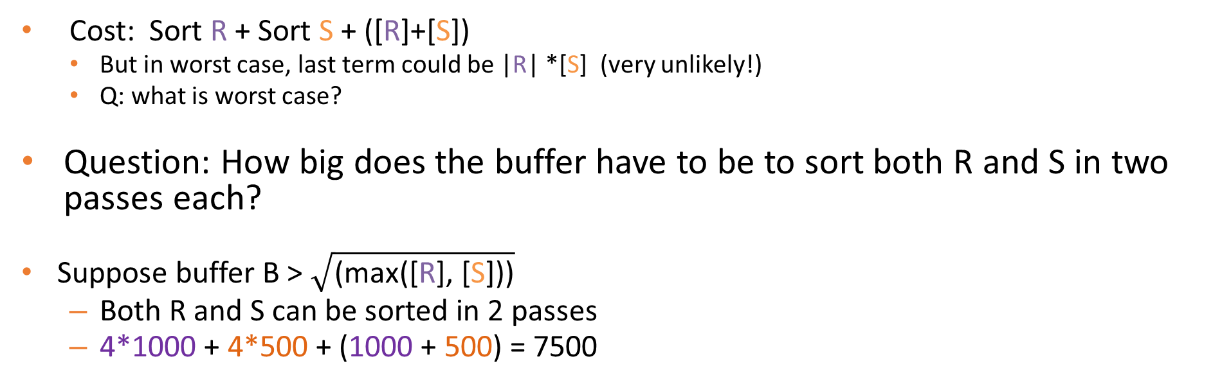
Cost of Sort-Merge Join
R
In Memory
Sort
Merge
Runs
Merge
Files
Read
Write
Read
Write
Read
Sorted
Runs
B – 1
Input
Buffers
Sorted
Files
B – 1
Input
Buffers
?
S
Read
B Buffers
Write
Read
Write
Read
Out Buffer
Out Buffer
Sorting Phase
Merging Phase
Cost: Sort R + Sort S + ([R]+[S])
But in worst case, last term could be |R| *[S] (very unlikely!)
Q: what is worst case?
Question: How big does the buffer have to be to sort both R and S in two passes each?
Suppose buffer B > $\sqrt{\text{(}\text{max}\text{([}\text{R}\text{], [}\text{S}\text{]))}}$
Both R and S can be sorted in 2 passes
4*1000 + 4*500 + (1000 + 500) = 7500
Notes:
现在，我们如何评估排序合并联接的成本。
我们将对R和S进行排序，然后我们将扫描R和S，并将它们合并到内存中
因此，成本基本上是对R进行分类，对S进行分类以及对R和S进行扫描的成本
现在，在最坏的情况下，实际上R的所有连接值和S的所有连接值都完全相同，这是最坏的情况。在这种情况下，输出是R和S中所有元组的叉积，因为所有匹配
因此，我们对标记进行了处理，它退化为嵌套循环字符串，实际上是简单的嵌套循环联接，即简单的嵌套循环联接。这样的代价可能会非常糟糕，
但这是极不可能的，这是一种事情，优化程序会密切注意并避免它
因此，您通常可以假设在排序合并联接中，联接列中有很多不同的值，以及那些小的微型叉乘积，其中我们在R上采用多个联接键，在S上采用多个联接键，而在我们形成了仅在少数元组上出现的所有对，如我们在示例中看到的
因此，假设是这种情况，那么我们就不会为这些重复的小小的交叉产品支付额外的I / O
缓冲区必须有多大，每个缓冲区要经过两次
假设缓冲区大于R和S中较大值的平方根，那么R和S都可以分两遍进行排序，
既然我们现在可以在输入上计算算法的成本，则R为1000页，并且我们知道排序是R的两次通过，因此是两次读/​​写通过，因此是4 x 1000
再次将S排序两次，两次读取/写入遍历，即4 x 500，
然后以流方式读取R，读取S并将它们合并的最后一遍是1000加500，此排序合并联接总共有7500个I / O。
Now how do we evaluate the cost of the sort-merge join.
We are going to sort R and S, and then we are gonna scan R and S, and merge them in memory
So the cost is basically the cost of sorting R, sorting S, and the scan of R and S
Now in the worst case, actually all the join values of R and all the join values of S are exactly the same, that is the worst case. And in that case, the output is the cross-product of all the tuples in R and S, because everything matches
So that thing we do with the mark, it degenerates into a nested loop string and actually a simple nested loop join, a naïve nested loop join. So that cost could be very bad,
But that is extremely unlikely, and it is the kind of thing, an optimizer would keep an eye out for and avoid it
So you can usually assume that in a sort-merge join, there is plenty of distinct values in the join columns, and those little mini cross products, where we take multiple join keys on R, multiple to the same join key on S, and we form all pairs that only happens on a handful of tuples like we saw in our example
So assuming that that is the case, and we don’t pay extra I/Os for those little mini cross-products of duplicates
How big does the buffer have to be, to do this in two passes each
Suppose that the buffer is bigger than the square root of the larger of R and S, so then both R and S can be sorted in two passes,
And given that we can now compute the cost of our algorithm on our inputs, R is 1000 pages and we know that sorting is two passes of R, so that is two read/write passes, so that is 4 x 1000
Sorting S again two read/write passes, so that is 4 x 500,
And then that final pass to read R, read S, and merge them in a streaming fashion is 1000 plus 500, for a total of 7500 I/Os for this sort-merge join
Assume memory is greater than Sqrt(R) and Sqrt(S) 1 read of input → 1 write of runs → 1 read for merge of runs so 3R + 3S
Worst case is due to nested loop

Slide 54
Sketch of Grace Hash Join
Divide (h_{p})
Conquer (h_{r})
1
B-2
Building Relation
…
B
B-1
Hash partitions hr
Fully hashed!
Probing Relation
1
…
Note: probing partitions stream, can be arbitrarily big!
B-1
Divide (h_{p})
Hash partitions hp of size ~N/(B-1)
Notes:
加上我们将具有探测关系，这将在我们继续处理这些哈希表的同时
探测关系也将通过相同的哈希函数hp进行分区，然后我们从构建关系中获取每个分区B，1、2，...，B-1，然后我们将以此构建一个哈希表
然后，我们将从探测关系中获取匹配的分区，并进行幼稚的哈希联接，我们将扫描该分区，在内存中查找匹配项并将其发送到输出
再次注意，就像天真的哈希联接中一样，探测分区可能真的非常大，因此我们真正关心的是，是否可以在不递归划分建筑关系的情况下完成R
With the addition that we are going to have a probing relation, that is going to work on those hash tables as we go
The probing relation is also going to be partitioned via the same hash function hp, and then we are going to take each partition, 1, 2, …, B-1, from the building relation, and we will build a hash table with it
And then we will take the matching partition from the probing relation, and do naïve hash join, we will scan that partition, looking for matches in memory and sending them to the output
Note again that the probing partitions just like in naïve hash join, can be really really big, and so all we really care about is whether R can be done without recursive partitioning the building relation

Slide 55
Summary of Grace Hash Join
R
S
B-1 Buffers
Hash Table (B-2) Buffers
1 Buffer
Read
Write
Read
1 Buffer
1 Buffer
?
Hash
New Hash Fn.
Partitioning Phase: B-1 partitions
Build & Probe Phase
Each partition of R of size B-2
Partitioning phase: read+write both relations
2([R]+[S]) I/Os
Matching phase: read both relations, forward output
[R]+[S]
Total cost of 2-pass hash join = 3([R]+[S])
Memory Requirements?
Build hash table on R with uniform partitioning
Partitioning Phase divides R into (B-1) runs of size [R] / (B-1)
Matching Phase requires each [R] / (B-1) < (B-2)
R < (B-1) (B-2) ≈ B²
Note: no constraint on size of S (probing relation)!
Notes:
因此，总结宽限哈希连接，需要进行分区，以将内容分解为B-1分区
然后进入构建和探测阶段，我们假设R的每个分区都适合B-2的存储空间
然后，我们进行简单的哈希联接，在此我们对S的分区进行流处理，并探查R，以寻找匹配
因此，让我们分析一下
So to summarize grace hash join, it is got partitioning phases to break things into B-1 partitions
And then it is got a build and probe phase, where each partition of R, we assume fits in a memory space of B-2
And then we do essentially naïve hash join, where we stream partitions of S, and probe R, looking for matches
So let’s analyze the cost of that

Slide 56
Recap
Nested Loops Join
Works for arbitrary Θ
Make sure to utilize memory in blocks
Index Nested Loops
For equi-joins
When you already have an index on one side
Sort/Hash
For equi-joins
No index required
Hash better if one relation is much smaller than other
No clear winners – may want to implement them all
Be sure you know the cost model for each
You will need it for query optimization!
Notes:
嵌套循环连接适用于任意theta，因此，例如，当我们没有等式时，必须使用嵌套循环连接
而且，如果我们要使用此嵌套循环联接，请使用内存或B-2大小的大块，使用块或块嵌套循环联接
索引嵌套循环联接仅适用于等联接，如果您在联接属性的一侧有一个索引，那就很好了，
当连接对输出的每个元组具有高度选择性，输入上只有一个或几个匹配项，或者索引是聚集的时，这特别好
请记住，尽管索引遍历是随机I / O，但有时如果您将随机I / O与顺序I / O进行比较，您甚至根本不想做随机I / O。
请记住，随机I / O通常位于磁盘上，比顺序I / O慢100倍，
因此，您必须对下一个嵌套循环的连接成本进行建模，并考虑到随机I / O成本
对等联接也进行排序和哈希处理，只是它们在某种意义上不需要索引，如果您需要特殊类型的联接索引，则哈希联接可以动态建立索引
散列效果更好，如果一个关系比另一个关系小得多，则不必对较大的关系进行排序或对较大的关系进行哈希处理，而对排序则必须对两种关系进行排序
在所有这些之中，没有明显的赢家，我们知道在嵌套循环联接算法中，块嵌套循环联接是最好的
但是在嵌套循环，索引嵌套循环以及排序和散列之间，尚不清楚可以丢弃其中一种，因此您可能要实现所有这些，许多系统都可以
最后，您将要了解这些算法中每一种的成本模型，如果您不使用它，则查询优化器应编写，
因此，您的查询优化器最终将是它会根据对连接关系的了解而在其中选择的算法
因此，您必须了解成本模型，才能了解我们将如何进行查询优化，这将很快在讲座中介绍
Nested loop join works for arbitrary theta, so when we don’t have an equality, for example, we must use nested loops join
And if we are gonna use this nested loops join, let’s use our chunk or block nested loops join, utilizing memory and big blocks of size B-2
Index nested loops join only works for equi-join, it is very nice, if you have an index on one side of the join attributes,
It is particularly good when the join is highly selective for each tuple of the output, there is only one or a few matches on the input, or if the index is clustered
Remember though that index walking is random I/O, and sometimes if you are comparing random to sequential I/O, you don’t really even want to do random I/Os
Remember random I/Os are often on magnetic disks, 100 times slower than sequential I/Os,
So you have to model your next nested loops join costs take into account the random I/O cost
Sorting and hashing work for equi-joins as well, only they don’t require an index in some sense hash join builds an index on the fly, if you will special kind of join index
Hashing is better, if one relation is much smaller than the other, you don’t have to sort the bigger relation or hash the bigger relation with hashing, whereas with sorting you have to sort of both relations
Amongst all of these, there are no clear winners, we don know among the nested loop join algorithms, that block nested loops join is the best
But between nested loops, index nested loops, and sorting and hashing, it is not clear that there is one of those that you can discard, and so you may want to implement all of them, and many systems do
Finally, you are going to want to know the cost model for each one of these algorithms, and if you don’t use it, then your query optimizer should write,
So your query optimizer eventually is the algorithm it is going to choose among these, based on what it knows about the input relations to be joined
So you have to understand the cost model, in order to understand how we are going to do query optimization, which is coming up in a lecture very soon

Slide 57
8. Query Optimization
SQL Client
Completed
You are here
Completed
Completed
Completed
Completed
Database Management
System
Query Parsing & Optimization
Relational Operators
Files and Index Management
Buffer Management
Disk Space Management
Database

Slide 58
Query Parsing & Optimization
Select *
From Blah B
Where B.blah = blah
Query Parser
Query Rewriter
Query Optimizer
Plan Cost Estimator
Catalog Manager
Plan Generator
Schema
& Stats
We’ll focus on “System R” (“Selinger”) optimizers
Query Executor
Notes:
因此，整个查询分析和优化的大盒子可以分解成小块，让我们现在仔细研究一下
我们从左上角的一个SQL查询输入开始，这里将其传递到查询解析器中，该查询解析器将查询的语法转换为某种抽象语法树，文本的内部表示形式，并将其传递给查询重写器，将查询转换为规范形式
然后，该查询重写器将重写后的抽象语法树传递到查询优化器中，现在，查询优化器的工作就是将查询的抽象表示形式转换为有效的计划
因此，工艺错误者可以用一部分来生成替代计划，用一部分来估算每个计划的成本，因为我们将要选择似乎最的计划。
该计划成本估算器将查看数据库的目录管理器，以获取有关查询中不同表的统计信息，以帮助计算成本，
计划生成器将使用目录管理器获取表的模式，以准确确定什么是合法的查询计划，什么不是
一旦查询优化器选择了一个最佳计划，它将把它传递给查询执行器，然后执行者使用迭代器和关系运算符执行该计划以及我们之前所看到的方式
So the whole big box of query parsing and optimization can be broken down into pieces, and let’s go through those pieces right now
We start with some input which is an SQL query up on the upper left, here it is passed into a query parser, that query parser turns the syntax of the query into some abstract syntax tree, internal representation of the text, and passes it to a query rewriter that put the query into canonical form
That query rewriter then passes the rewritten abstract syntax tree into the query optimizer, and it is the job of the query optimizer now to turn that abstract representation of the query into an efficient plan
And so the craft miser has a piece to generate alternative plans and a piece to estimate the cost of each plan, because we are going to want to pick the generated plan that seems to be the cheapest
That plan cost estimator is going to look at the catalog manager of the database to get statistics about the different tables in the query, to help compute what the costs are,
And the plan generator is going to use the catalog manager to get the schemas of the tables to figure out exactly what is a legal query plan, and what is not
Once the query optimizer has chosen an optimal plan, it passes it to the query executor, which then execute the plan and the way we have seen before, using iterators and relational operators

Slide 59
Query Optimization: The Components
Three beautifully orthogonal concerns:
Plan space:
for a given query, what plans are considered?
Cost estimation:
how is the cost of a plan estimated?
Search strategy:
how do we “search” in the “plan space”?
Notes:
2
查询优化的核心由三个组成部分组成，它们完美地正交，这些关注点彼此独立，
这意味着我们可以独立地创新和改善这些问题，并且随着我们不断完善，它不会影响我们做出的其他决定。
因此，这三个问题中的第一个是我们要考虑的是要搜索的计划空间是多少，以及实现此查询的所有可能方式是什么？
一旦我们列举了所有可能的方式，我们便可以实施它，然后在其中进行选择，
因此计划空间可能很大，例如，通过引入新的联接算法或组合运算符的新方法，我们可以增加计划空间
第二个问题是成本估算，如果我们有一个特定的计划，我们认为这可能是此查询的一个好选择，那么我们如何估算该计划的成本？我们如何才能弄清楚我们实际需要多长时间才能运行
当然，因为我们要做的是选择我们认为最快运行的计划，然后运行它
然后，我们的第三个关注点是搜索策略，因为我们有这么大的计划空间，并且鉴于我们可以估算每个计划的成本，我们如何有效地找到该计划空间中成本估算最低的计划
这就是查询优化的三个部分，在接下来的一系列讲座中，我们将逐一进行研究。
The core of query optimization consists of three components, that are beautifully orthogonal, each one of these concerns is separate from the other,
Which means that we can innovate and improve each of these concerns independently, and as we get better at one, it doesn’t affect our decisions on the other
So the first of these three concerns is our consideration of what is the space of plans that we are going to search, what are all the different possible ways to implement this query
And once we enumerate all the possible ways, we can implement it, we choose among them,
So that plan space can be very large, and by introducing, for example, new join algorithms or new ways to combine operators, we can increase that plan space
The second concern is cost estimation, if we have a particular plan, that we are thinking might be a good one for this query, how do we estimate the cost of that plan? How can we figure out how long we think it will actually take to run
Because of course what we are going to want to do is pick the plan that we think is going to be the fastest to run, and then run it
And then our third concern is a search strategy, given that we have this big plan space, and given that we can estimate the cost of each plan, how do we efficiently find the plan with the cheapest cost estimate in that plan space
So those are the three pieces of query optimization, and we are going to look through them one by one, as we go through this next sequence of lectures

Slide 60
Plan Space Review
For a SQL query, full plan space:
All equivalent relational algebra expressions
Based on the equivalence rules we learned
All mixes of physical implementations of those algebra expressions
We might prune this space:
Selection/Projection pushdown
Left-deep trees only
Avoid cartesian products
Along the way we may care about physical properties like sorting
Because downstream ops may depend on them
And enforcing them later may be expensive
Notes:
因此，让我们回顾一下计划空间，对于一个SQL查询，完整的计划空间就是所有等效的关系代数表达式，这是基于我们了解的等价规则以及将查询分解为查询块以及这些代数的物理实现的所有组合的表达式。
而且我们可能会使用启发式方法修剪空间，例如，我们可能总是尽可能地进行选择和投影下推，这是在系统R中完成的，这很典型
我们可能会使用仅在系统R中完成的仅左深树，并且可能会尽可能避免使用笛卡尔积，这又是在系统R中完成的事情
在此过程中，我们关心诸如排序之类的物理属性，因为下游运算符可能取决于上游运算符的物理属性，并且强制执行这些属性（例如，对输入进行显式排序可能会非常昂贵），因此，如果您对输入进行了排序是免费的，这是它的计算方式，您想利用它，我们将看到如何做到这一点
So let’s review the plan space, for a SQL query, the full plan space is all the equivalent relational algebra expressions, based on the equivalence rules we learned and the breakdown of queries into query blocks, along with all mixes of physical implementations of those algebra expressions.
And we might prune the space with heuristics, so for instance we might always do selection and projection pushdown as far as we can, that is done in system R, it is pretty typical
We might use left deep only trees, that is done in system R, and we might avoid Cartesian products as much as possible, again something that is done in system R
Along the way we are care about physical properties like sorting, because downstream operators may depend on the physical properties of upstream operators, and enforcing those properties, for example explicitly sorting an input can be pretty expensive, so if you have an input that is sorted for free, that is the way it was computed, you would like to take advantage of that, we will see how to do that along the way

Slide 61
Big Picture of System R Optimizer
Works well for up to 10-15 joins.
Plan Space: Too large, must be pruned.
Algorithmic insight:
Many plans could have the same “overpriced” subtree
Ignore all those plans
Common heuristic: consider only left-deep plans
Common heuristic: avoid Cartesian products
Cost estimation
Very inexact, but works ok in practice.
Stats in system catalogs used to estimate sizes & costs
Considers combination of CPU and I/O costs.
System R’s scheme has been improved since that time.
Search Algorithm: Dynamic Programming
Notes:
2
系统R优化器的概况，它运行良好，但最多只能进行10到15个连接
考虑到这一点，这可能是您可以想象的最大的SQL查询，而考虑编写一个包含15个以上表的查询很奇怪
但这确实会发生，并且通常会发生在工具，生成查询的可视化工具中，然后您会收到非常大的SQL查询，
因此，那时系统R优化器确实无法使用，那么您就不得不依靠启发式
但是今天，我们将重点讨论可使用System R优化器的方式，这是大多数情况下您在数据库中获得的基本工作负载
这些查询的计划空间甚至太大了，无法详尽搜索，我们现在需要修剪一下
我们要指出的第一件事是算法洞察力，这是系统R论文的关键，该论文指出，许多计划中可能包含相同的定价过高的子树。
该空间中可能存在子计划，这确实非常昂贵，并且有更好的方法可以执行该子计划
因此，任何包含该子计划的树本身就是一个坏计划，因此我们将忽略任何包含定价过高的子树的计划，即子计划
然后，在这种算法洞察力的顶部（这只是一个真实的陈述），有很多启发式方法，它们是启发式方法，有时它们是一个好主意，有时却发现它们不是
但是它们很常见，并且在大多数时间都起作用，因此一种常见的启发式方法是仅查看左侧的深层计划，我们将在今天讨论这意味着什么
另一个是只看我们上次谈到的笛卡尔乘积，今天我们将向您确切展示它们如何适合搜索策略
其次，我们需要研究成本估算，今天我们将花费大量时间，这在系统R优化器中是非常不精确的，特别是原始论文非常准确，
在实践中，它可以正常运行，尽管它经常使我们能够找到不错的计划，而避免真正糟糕的计划，因此它不一定是完美的
统计信息和系统目录通常很好，它们是使用的测试，它们确定了基表的大小，因此使这些表的操作成本
系统R论文中的成本估算同时考虑了CPU和I / O成本，
今天，为简单起见，我们将主要讨论I / O成本，而CPU成本通常只是其中的一小部分
我会说，随着时间的推移，用于成本估算的系统R方案已经得到改进，今天我们将沿着这些思路进行一次改进，即使用直方图而不是仅使用简单的统计数据，您会明白我的意思。我们到达那里
最终组件是搜索算法，系统R开发了基于动态编程的搜索算法来进行查询优化
您以前可能已经学习过动态编程，在这种情况下您可能没有学习过动态编程，那很好
我将指出动态编程，这是计算机科学中用于优化问题的一种典型技术，其中我们将在此处进行此类子组件的优化
它在现代AI中得到了广泛的使用，而且我猜想尽管查询优化器是在数据库社区中开发的，但它却是自动化智能代码生成的一个例子
The big picture of the system R optimizer, it works pretty well, but only up to 10 to 15 joins
And when you think about that, that is probably the biggest SQL query you can imagine, it is weird to think about writing a query with more than 15 tables in it
But it does happen, and it often happens from tools, from visual tools that generate queries, and then you get very large SQL queries,
So at that point the system R optimizer really can’t be used, then you have to fall back to heuristics
But today we will focus on the case of way we can use the system R optimizer, which is kind of a meat-and-potatoes workloads you get in databases most of the time
The plan space is even for these queries pretty much too big to search exhaustively, and we need to prune it now
The first thing we can point out is there is an algorithmic insight, that is key to the system R paper, which says that many plans could have the same overpriced subtree in them
There might be sub plan in the space, that is just really really expensive, and there is a better way to do that sub plan
So any tree that contains that sub plan is itself a bad plan, so we are gonna ignore any plan that contains an overpriced sub tree, sub plan
And then on the top of that algorithmic insight, which is just a true statement, there is a bunch of heuristics, which are heuristics, sometimes they are a good idea, and sometimes it turns out they are not
But they are common, and they work most of the time, so one common heuristic is to look only at left deep plans, and we will talk about what that means today
Another is to look only at Cartesian products as we talked about last time, and we will show you today exactly how that fits into the search strategy
Secondarily, we need to look at cost estimation, we will spend much time on this today, it is very inexact in that system R optimizer, in particular the original paper is quite an exact,
It works OK in practice, though it often allows us to find pretty good plans and avoid really bad ones, so it doesn’t have to be perfect
The statistics and system catalogs are usually fine, they are used tests, they make the sizes of the base table, and therefore the costs of operations on those tables
The cost estimation in the system R paper considered both CPU and I/O costs,
Today for simplicity we will mostly talk about I/O cost, and CPU cost are usually just a small fraction on the top of that
And I will say that system R schemes for cost estimation have been improved over time, and today we will look at one improvement along those lines, which is in terms of using histograms instead of just using simple statistics, you will see what I mean when we get there
The final component is search algorithm, and system R developed a dynamic programming based search algorithm for doing query optimization
You have probably learned dynamic programming before, you may not have in which case you will learn it here, and that is fine
I will point out the dynamic programming a typical technique used in computer science for optimization problem with sub components of the sort that we are going to do here
It is widely used in modern AI, and yet another connection I guess between the fact that query optimizers although developed in the database community are an example of sort of automated intelligent generation of code

Slide 62
Result Size Estimation
Result cardinality = Max # tuples * product of all selectivities.
Term col=value (given Nkeys(I) on col)
sel = 1/NKeys(I)
Term col1=col2 (handy for joins too…)
sel = 1/MAX(NKeys(I1), NKeys(I2))
Why MAX? See bunnies in 2 slides…
Term col>value
sel = (High(I)-value)/(High(I)-Low(I) + 1)
Note, if missing the needed stats, assume 1/10!!!
selectivity = |output| / |input|
Notes:
9

Slide 63
Upshot
Know how to compute selectivities for basic predicates
The original Selinger version
The histogram version
Assumption 1: uniform distribution within histogram bins
Within a bin, fraction of range = fraction of count
Assumption 2: independent predicates
Selectivity of AND = product of selectivities of predicates
Selectivity of OR = sum of selectivities of predicates - product of selectivities of predicates
Selectivity of NOT = 1 – selectivity of predicates
Joins are not a special case
Simply compute the selectivity of all predicates
And multiply by the product of the table sizes
=

Slide 64
9. Transactions & Concurrency Control
SQL Client
SQL Client
SQL Client
Database Management
System
Database Management
System
Query Parsing & Optimization
Query Parsing & Optimization
Database Management
System
Query Parsing & Optimization
Relational Operators
Relational Operators
Relational Operators
Files and Index Management
Files and Index Management
Files and Index Management
Buffer Management
Buffer Management
Buffer Management
Disk Space Management
Disk Space Management
Disk Space Management
Transaction Manager
You are here
Lock Manager
Logging & Recovery
Database
Notes:
两个子组件
锁管理器：处理并发控制问题
日志和恢复管理器：负责容错和恢复

Slide 65
ACID: High-Level Properties of Transactions
A tomicity: All actions in the Xact happen, or none happen.
C onsistency: If the DB starts out consistent, it ends up consistent at the end of the Xact
I solation: Execution of each Xact is isolated from that of others
D urability: If a Xact commits, its effects persist.
Note: This is a mnemonic, not a formalism. We’ll do some formalisms shortly.
Notes:
Atomicity, Consistency, Isolation, Durability (原子性，一致性，隔离性，耐久性)
现在我们知道了事务管理器可以看到的内容，即Xact将开始和结束，并进行读写
让我们谈谈Xact管理器需要保证的内容：四个基本属性，即ACID属性：A，C，I，D
在我们深入探讨它们之前，我想强调指出，它们共同记住我们需要了解的有关交易的方式，它们是一种助记符
实际上，它们绝不是某种形式的公式，因此，例如，它们不是某些公理系统中的公理，就像阿姆斯特朗所说的公理是
这些只是我们记住要通过交易担保的基本思想的一种方式，不久将对某些交易担保具有形式主义
通过这些过程，让我们从原子性开始。
原子性是全有或全无的属性，事务的所有动作应该发生，或者都不应该发生。至少这是该交易之外的任何人应该看到的样子
一致性是这样的属性：如果数据库以某种我们定义为一致的状态开始，，则它需要以我们定义为一致的另一种状态结束
隔离是每个Xact的执行与其他执行隔离的属性。如果您是为一个Xact编写代码的程序员，则不必考虑系统中正在运行的任何其他Xact。
基本上，我们向程序员隐藏了并发性，这就是隔离的想法
最后是持久性，如果提交了Xact，则其影响应保留在数据库中。因此，如果DBMS告诉您已提交，则可以保证在Xact中执行的操作将持续存在
让我们更详细地介绍每一个
Now that we know what the transaction manager can see, namely Xact will begin and end, and read and write
Let us talk about what the Xact manager needs to guarantee: four basic properties, which is known as the ACID properties: A, C, I, D
Before we go into each of them, I want to emphasize that together their way of remembering what we need to know about transactions, they are a mnemonic device
They are actually not in any way of formulism, so they are not for instance axioms in some axiom system, the way Armstrong said axioms were
These are just sort of ways for us to remember the basic ideas that we want to guarantee with transactions, will have formalisms for some of the transactional guarantees shortly
Going through these, let’s begin with Atomicity.
Atomicity is the all-or-nothing property, all the actions of a transaction should occur or none of them should occur. At least that is how it should appear to anyone who is outside of that transaction
Consistency is the property that if the DB starts out in some state, we define as consistent, it ends up in another state that we define is consistent at the end of the transaction
Isolation is the property that execution of each Xact is isolated from that of others. If you are a programmer who is composing the code for one Xact, you don’t have to think about any other Xact running in the system.
Basically we hide concurrency from the programmer and that is the idea of isolation
And finally durability, if a Xact commits, its effects should persist in the DB. So if the DBMS tells you that it commits, then you can be guaranteed that the actions you took in that Xact will persist
Let’s go through each of these in a bit more detail

Slide 66
Serial Equivalence
We need a “touchstone” concept for correct behavior
Definition: Serial schedule
Each transaction runs from start to finish without any intervening actions from other transactions
Definition: 2 schedules are equivalent if they:
involve the same transactions
each individual transaction’s actions are ordered the same
both schedules leave the DB in the same final state
Definition: Schedule S is serializable if:
S is equivalent to some serial schedule
Notes:
给定一个时间表的定义，我们仍然需要一个正确的行为的试金石概念，并且因为我们作为程序员很熟悉，所以我们可以使用的概念是串行调度的概念。
因此，串行时间表看起来像右图，其中每个Xact从头到尾运行，而其他Xact没有任何干预动作
这是我们早就知道如何在计算机中编程的行为。就像让自己的计算机完全隔离一样
得到了串行时间表的定义之后，我们来谈谈两个时间表的定义是等效的
因此，如果满足以下三个属性，我们将说两个计划是等效的
它们涉及相同的Xact，因此这两个不同的计划在同一列中具有相同的列，并且每个列中的操作相同，
而且每个Xact动作的顺序都相同，因此当您进入一列时，可以在两个不同的时间表中看到相同的动作序列
然后，这两个调度都使数据库处于相同的最终状态，因此在这两个不同的交错中以一种或另一种方式运行这些Xact，会使数据库处于相同的状态
如果是这样，我们将说两个时间表是相同的
Given a definition of a schedule, we still need a touchstone concept for correct behavior and the one that we can work with, because we are familiar with it as programmers, is the notion of a serial schedule
So a serial schedule looks something like this picture on the right, in which each Xact runs from start to finish without any intervening actions from other Xacts
This is the behavior that we have long know how to program in a computer. It is like having the computer to yourself complete isolation
Having gotten a definition of a serial schedule, let’s talk about a definition of two schedules being equivalent
So we will say the two schedules are equivalent, if they satisfy the following three properties
They involve the same Xacts, so these two different schedules have the same columns with the same actions in each column,
And each individual Xact actions are ordered the same, so as you go down a column, you see the same sequence of actions in the two different schedules
And then both schedules leave the DB in the same final state, so one way or another running these Xacts in these two different interleavings, leaves the DB in the same state
If that is true, we will say that the two schedules are equivalent

Slide 67
Conflict Serializable Schedules
Definition: Two schedules are conflict equivalent if:
They involve the same actions of the same transactions, and
Every pair of conflicting actions is ordered the same way
Definition: Schedule S is conflict serializable if:
S is conflict equivalent to some serial schedule
Implies S is also Serializable
Note: some serializable schedules are NOT conflict serializable
Conflict serializability gives false negatives as a test for serializability!
The cost of a conservative test
A price we pay to achieve efficient enforcement
Definition: Two operations conflict if they:
Are by different transactions,
Are on the same object,
At least one of them is a write.
Notes:
利用这种直觉，让我们对之前看到的事物进行一些重新定义，用稍微不同的名称
因此，如果两个计划以相同的顺序包含相同Xact的相同动作，并且在两个不同的计划中以相同的方式对每对冲突动作进行排序，那么我们将说两个计划是冲突等效的，不是等效的而是冲突等效的
我们将说，如果时间表S与某些串行时间表冲突，则它可以冲突串行化
如果S是可序列化的，那么我们就知道它也是可序列化的，因为如果可以证明它是冲突可序列化的，这意味着它与串行计划之间的唯一区别是非冲突操作的顺序，我们说过没有对最终状态的影响
因此，冲突可串行化性是对可串行化性的保守测试
请注意，这是保守的，这意味着某些可序列化的时间表不会冲突可序列化，因此冲突可序列化性可能会给我们带来一些假否定，以测试可序列化性
这就是保守测试的成本，这是我们为实现更容易实施而付出的代价，即冲突可序列化将为我们提供
Using this intuition, let’s do some redefinitions of the things we have seen before with slightly different names
So we will say two schedules are conflict equivalent, not equivalent but conflict equivalent, if they involve the same actions of the same Xacts in the same order, and every pair of conflicting actions is ordered the same way in the two different schedules
And we will say that a schedule S is conflict serializable if it is conflict equivalent to some serial schedule
And if S is serializable, then we know it is also serializable, because if it can be shown to be conflict serializable, that means the only difference between it and a serial schedule is the order of non-conflicting operations, which we said have no effect on the final state
So conflict serializability is a conservative test for serializability
Note that it is conservative, which means that some serializable schedules are not conflict serializable, so conflict serializability can give us some false negative as a test for serializability
That is the cost of a conservative test, the price we pay to achieve the easier enforcement that conflict serializability is going to give us

Slide 68
Conflict Dependency Graph
Ti
Tj
Dependency Graph:
One node per Xact
Edge from Ti to Tj if:
An operation Oi of Ti conflicts with an operation Oj of Tj and
Oi appears earlier in the schedule than Oj
Theorem: Schedule is conflict serializable if and only if its
dependency graph is acyclic.
Proof Sketch: Conflicting operations prevent us from “swapping” operations into a
serial schedule
Notes:
作为对冲突可序列化性的测试，我们将构建一个称为冲突依赖图的数据结构。
在此依赖关系图中，系统中每个Xact将有一个节点
如果存在Ti的操作Oi与Tj的操作Oj冲突，则从Xact Ti到Xact Tj会有一条边缘，即有序边缘
而且Oi在排程中的出现时间早于Oj
因此它是有序的边，按时间有序，并且在两个Xact之间具有冲突的动作
定理说，当且仅当它的依赖图是非循环的，它没有周期时，该调度才是可序列化的冲突
作为证明的草图，请考虑一下，无法对冲突的操作进行重新排序，请记住在上一张幻灯片中，我们可以交换非冲突的操作，但是不能对冲突的操作进行重新排序
这使我们无法将计划中的操作与非循环冲突依赖图交换来获取串行计划
因此，让我们看一个例子，以使这一点更加清楚
As a test for conflict serializability, we are going to construct a data structure called a conflict dependency graph
And in this dependency graph, there is going to be one node for every Xact in the system
And there is going to be an edge from Xact Ti to Xact Tj, an ordered edge, if there is an operation Oi of Ti that conflicts with an operation Oj of Tj
And Oi appears earlier in the schedule than Oj
So it is an ordered edge, it is ordered by time, and it is between two Xacts with conflicting actions
And the theorem says that the schedule is conflict serializable if and only if its dependency graph is acyclic, it has no cycles
As a sketch of a proof, think about this, conflicting operations can not be reordered, remember on the previous slide, we could swap non-conflicting operations, but conflicting operations cannot be reordered
That prevents us from swapping the operations in a schedule with acyclic conflict dependency graph to get a serial schedule
So let us see an example of that to make this point more clear

Slide 69
Two Phase Locking (2PL), Part 2
Rules:
Xact must obtain a S (shared) lock before reading, and an X (exclusive) lock before writing.
Xact cannot get new locks after releasing any locks
 | S | X
S | √ | –
X | – | –
acquisition phase
release phase
Lock
Compatibility
Matrix
# locks held
time
2PL guarantees conflict serializability
But, does not prevent cascading aborts
Notes:
两阶段锁定建立在两个规则上，第一个规则如下
Xact在读取对象之前必须获得S锁，这是共享锁，并且在写入该对象之前必须获得X锁或排他锁。
S锁和X锁具有一个看起来像此矩阵的兼容性规则，因此您可以将此表的行视为一个对象上一个Xact的可能请求，并且该表的列是另一个Xact对同一对象的可能请求
如果他们俩都希望获得一个S锁，那是可以的，那是兼容的，但是如果他们两个都想要X锁，那么一次只能有一个可以拥有它，因此不具有共享锁。 来自两个不同Xact的同一个对象的互斥锁
这就是两阶段锁定的第一条规则，并且在数据库中逐个对象地应用
两相锁定的第二条规则是两相部分, Xact释放任何锁后无法获得新锁 (如果一个transaction释放了它所持有的任意一个锁，那它就再也不能获取任何锁。)
明白了这一条规则我们也就明白two-phase locking名字的由来了：在2PL协议下，每个transaction都会经过两个阶段：
Two–phase locking is built on two rules, the first rule is as follows
A Xact must obtain a S lock, which is a shared lock, before it reads an object, and it must obtain an X lock, or an exclusive lock, before it writes that object
S lock and X lock have a compatibility rule that looks like this matrix, so you can think of the rows of this table as being the possible requests of one Xact on an object, and the column of this table as being the possible requests of another Xact on the same object
If they both want to get an S lock, that is OK, that is compatible, but if either of them wants an X lock, then only one of them can have it at a time, it is not compatible to have a shared lock in an exclusive lock on the same object from two different Xacts
So that is the first rule of two-phase locking, and that applied object by object in the DB
The second rule for two-phase locking is the two-phase part. A Xact cannot get new locks after it releases any lock

Slide 70
Strict Two Phase Locking
Same as 2PL, except all locks released together when transaction completes
(i.e.) either
Transaction has committed (all writes durable), OR
Transaction has aborted (all writes have been undone)
Notes:
因此，我们将使用称为严格2PL的方案来避免级联中止
严格的2PL与普通的2PL相同，不同之处在于，当事务完成时，所有锁将同时自动一起释放
提交Xact并将其提交记录写入磁盘时，或者Xact中止并且其所有影响都已撤消时
现在，当我们谈论恢复时，我们将了解提交记录和回滚，但是这里的基本思想是，Xact将立即释放所有的锁，无论是提交还是中止，Xact的效果将自动 在数据库中可见。
So we will avoid cascading aborts using a scheme called strict 2PL
And strict 2PL is the same as plain old 2PL with the exception that all locks will be released together at the same time automatically, when transaction completes,
Either when the Xact is committed and written its commit record to disk, or when the Xact has aborted and all of its affects have been undone
Now we will learn about commit records and rollback when we talk about recovery, but the basic idea here is that instantaneously, the Xact is going to release all of its locks, either at commit or abort, and the effects of the Xact will be automatically visible in the DB.

Slide 71
Lock Management
Lock and unlock requests handled by Lock Manager
LM maintains a hashtable, keyed on names of objects being locked.
LM keeps an entry for each currently held lock
Entry contains
Granted set: Set of xacts currently granted access to the lock
Lock mode: Type of lock held (shared or exclusive)
Wait Queue: Queue of lock requests
 | Granted Set | Mode | Wait Queue
A | {T1, T2} | S | T3(X) ← T4(X)
B | {T6} | X | T5(X) ← T7(S)
When lock request arrives:
Does any xact in Granted Set or Wait Queue want a conflicting lock?
If no, put the requester into “granted set” and let them proceed
If yes, put requester into wait queue (typically FIFO)
Notes:
这是基本思路
锁定和解锁请求将通过DBMS代码进行提示，并且将由锁定管理器处理
锁管理器将维护一个哈希表，该哈希表将被锁定在被锁定对象的名称上，只是查找表
LM为每个当前持有的锁保留一个条目
这些条目将包含三件事：
授予的集合：当前已授予对锁定的访问权限的xact的集合，因此这些是成功实现其锁定请求的Xacts
锁定模式：告知使用授权组当前持有的锁定类型（共享的或独占的）以及到目前为止我们已经了解的协议
等待队列：这是等待锁定该对象的Xact队列，以及它们尝试请求的锁定类型
因此，这里有一个示例，我们有一个对象A，它已在模式S下被授予Xacts T1和T2。
T3和T4都在等待对A的互斥锁定，并且T4在T3后面排队
同样，对于B，授予的集合为T6，它是互斥模式，当然，互斥模式在授予的集合中只能有一个Xact，因为它是互斥的
然后在等待队列中，我们有T5和T7，请注意T7在T5之后
Here is the basic idea,
Lock and unlock requests will be peppered through the code of DBMS, and they will be handled by the lock manager
The lock manager is going to maintain a hash table, that is going to be keyed on the names of the objects being locked, just the lookup table
LM keeps an entry for each currently held lock
The entries are going to contain three things:
Granted set: Set of xacts currently granted access to the lock, so these are the Xacts that have succeeded in getting their lock requests fulfilled
Lock mode: that tells use the type of lock currently held by the granted sets, either shared or exclusive, and the protocols we have learned so far
Wait queue: which is a queue of Xacts that are waiting to lock that object, and the type of lock that they are trying to request
So here is an example, we have an object A, it has been granted to Xacts T1 and T2 in mode S.
T3 and T4 are both waiting for an exclusive lock on A, and T4 is queued up behind T3
Similarly for B, the granted set is T6, it is an exclusive mode, and of course, an exclusive mode there can only be one Xact in the granted set, because it is exclusive
And then in the wait queue, we have T5 and T7, and note that T7 came after T5

Slide 72
Deadlocks, cont
Deadlock: Cycle of Xacts waiting for locks to be released by each other.
Three ways of dealing with deadlocks:
Prevention
Avoidance
Detection and Resolution
Many systems just punt and use timeouts
What are the dangers with this approach?
T1
T2
T4
T3
Deadlock Detection
Create and maintain a “waits-for” graph
Periodically check for cycles in a graph
Notes:
因此，死锁是Xacts的循环，等待彼此释放锁
这是计算机调度和并发控制中的经典问题
通常有三种处理死锁的方法：预防，避免，检测和解决
某些系统不执行任何这些操作，它们仅使用超时，因此它们只会让Xacts运行一段时间，如果Xact在一段时间内不执行任何操作，则假定它只是处于死锁状态 它中止了Xact
当然，这种方法的危险是您放弃不需要放弃的东西，也许它们长时间持有一个锁，因为他们正忙于进行一些计算，而您却放弃了它们，因为您认为 他们只是陷入僵局
所以这是一种草率的做事方式，我们将做一些更聪明的事
So the deadlock is a cycle of Xacts, waiting for locks to be released by each other
And it is a classic problem in computer scheduling and concurrency control
There are typically three ways of dealing with deadlocks: Prevention, Avoidance, Detection and Resolution
Some system don’t do any of these things, they just use timeouts, so they will just let Xacts run for a while, and if the Xact doesn’t do anything for a period of time, this assumes it is just in a deadlock and it aborts the Xact
And the danger of that approach of course is that you abort things that don’t need to be aborted, maybe they were holding a lock for a long time, because they were busy doing some computation, and instead you aborted them, because you thought they were just in a deadlock
So that is a sort of sloppy way of doing things, we are gonna do things that are a bit more intelligent

Slide 73
Multiple Granularity Locking Protocol
Database
Each Xact starts from the root of the hierarchy.
To get S or IS lock on a node, must hold IS or IX on parent node.
What if Xact holds S on parent? SIX on parent?
To get X or IX or SIX on a node, must hold IX or SIX on parent node.
Must release locks in bottom-up order.
2-phase and lock compatibility matrix rules enforced as well
Protocol is correct in that it is equivalent to directly setting locks at leaf levels of the hierarchy.
Tables
Pages
Tuples
Notes:
Gray的多粒度锁定协议的工作原理如下
每个Xact从层次结构的根开始。
要在节点上获得S或IS锁定，必须在父节点上保留IS或IX。
要在节点上获取X或IX或SIX，必须在父节点上保留IX或SIX。
因此，遵循此协议，它是自上而下锁定的，
然后运行Xact，最终以自下而上的顺序释放锁，以确保它以与锁定相反的顺序解锁。
因此，它在层次结构中锁定了自上而下的锁定，并在层次结构中自下而上的解锁
在所有这些过程中，我们将继续进行2PL，并且还将强制执行锁兼容性矩阵规则。我将在稍后展示给您这些意图锁的锁兼容性矩阵
协议在以下方面将是正确的，它等效于直接在层次结构的叶级别上设置锁定。
因此，这将使我们获得在层次结构的底部设置各种小锁的效果，但是当我们查看大量的小锁时，只需要设置这些较高的粒度锁即可。在一起的对象
Gray’s muti-granularity locking protocol works like this
Each Xact starts from the root of the hierarchy.
To get S or IS lock on a node, must hold IS or IX on parent node.
To get X or IX or SIX on a node, must hold IX or SIX on parent node.
So it is locking top-down, following this protocol,
And then the Xact runs, and eventually it releases its locks in bottom-up order, to make sure that it is unlocking in the reverse order than it locked
So it locks top-down in the hierarchy, and it unlocks bottom-up in the hierarchy
We are gonna have 2PL going on during all of this, and we are going to have our lock compatibility matrix rules enforced as well. And I will show you lock compatibility matrix for these intent locks in just a moment
Protocol is going to be correct in the following sense, it is equivalent to directly setting locks at leaf levels of the hierarchy.
So it is gonna allow us to get the effect that we would have gotten setting all sorts of little locks at the bottom of the hierarchy, but instead we are going to only have to set these higher granularity locks, when we look at large numbers of objects together

Slide 74
Lock Compatibility Matrix
IS – Intent to get S lock(s) at finer granularity.
IX – Intent to get X lock(s) at finer granularity.
SIX mode: Like S & IX at the same time.
Handy simple case to remember: Could 2 intent locks be compatible?
S
IS
Page P
Tuple t1
 | IS | IX | S | SIX | X
IS | true | true | true | true | false
IX | true | true | false | false | false
S | true | false | true | false | false
SIX | true | false | false | false | false
X | false | false | false | false | false
X
IX
Tuple t2
Database
Tables
Pages
Tuples
Notes:
完成后，您将获得一个如下所示的表
因此，我鼓励您在右侧拍摄一张照片，并仔细检查表格中的每个单元格，并说明为什么单元格中的值就是它的值
When you are done, you will get a table looks like this
So I encourage you take a picture on the right and go through every cell in the table, and justify why the value in the cell is what it is
考虑这个例子：
事务A锁住了表中的一行，让这一行只能读，不能写。
之后，事务B申请整个表的写锁。
如果事务B申请成功，那么理论上它就能修改表中的任意一行，这与A持有的行锁是冲突的。
数据库需要避免这种冲突，就是说要让B的申请被阻塞，直到A释放了行锁。
数据库要怎么判断这个冲突呢？
step1：判断表是否已被其他事务用表锁锁表 step2：判断表中的每一行是否已被行锁锁住。
注意step2，这样的判断方法效率实在不高，因为需要遍历整个表。 于是就有了意向锁。
在意向锁存在的情况下，事务A必须先申请表的意向共享锁，成功后再申请一行的行锁。
在意向锁存在的情况下，上面的判断可以改成
step1：不变 step2：发现表上有意向共享锁，说明表中有些行被共享行锁锁住了，因此，事务B申请表的写锁会被阻塞。

Slide 75
10. Recovery
SQL Client
SQL Client
SQL Client
Database Management
System
Database Management
System
Query Parsing & Optimization
Query Parsing & Optimization
Database Management
System
Query Parsing & Optimization
Relational Operators
Relational Operators
Relational Operators
Files and Index Management
Files and Index Management
Files and Index Management
Buffer Management
Buffer Management
Buffer Management
Disk Space Management
Disk Space Management
Disk Space Management
Transaction Manager
You are here
Lock Manager
Logging & Recovery
Database
Notes:
两个子组件
锁管理器：处理并发控制问题
日志和恢复管理器：负责容错和恢复

Slide 76
Preferred Policy: Steal/No-Force
Most complicated, but highest performance.
NO FORCE (complicates enforcing Durability)
Problem: System crash before dirty buffer page of a committed transaction is flushed to DB disk.
Solution: Flush as little as possible, in a convenient place, prior to commit. Allows REDOing modifications.
STEAL (complicates enforcing Atomicity)
What if a Xact that flushed updates to DB disk aborts?
What if system crashes before Xact is finished?
Must remember the old value of flushed pages
(to support UNDOing the write to those pages).
This is a dense slide … and the crux of the lecture. Read it over carefully, and return to it later!
Notes:
因此，我们首选的策略将是相反的，它将是Steal / No-Force，所以让我们在这里看看设计空间
这是最复杂但性能最高的选项。因此，我们将在这里努力做到更快
No-force策略将使持久性的实施复杂化，问题是在已提交的Xact的脏缓冲区页刷新到DB磁盘之前，系统崩溃
我们在缓冲池中有一个脏页，有一个已提交的Xact，但是该脏页尚未写入磁盘，我们如何获得持久性
解决方案是在某种程度上我们将在提交之前在方便的地方刷新尽可能少的信息的方法，这称为日志。
这将使我们能够在崩溃时重做Xact的动作，因此，如果我们说在侧面某个地方提交，我们会记下在该Xact期间所做的所有事情，以便我们可以重做它们
窃取策略具有复杂的强制原子性，如果刷新到数据库磁盘的更新的Xact异常终止，或者Xact完成之前系统崩溃，并且脏页面已刷新到数据库，该怎么办？
为此，我们必须记住刷新页面的旧值，以支持撤消对这些页面的写操作，因此我们需要在方便的地方写下页面的旧版本，以便我们可以撤消不应删除的更新。已经完成
因此，正如左下方的音符一直在说的那样，当我们进行此操作时，“这是一张密集的幻灯片……也是演讲的重点。请仔细阅读它，并在研究完所有机制后再返回阅读，并使用值得学习的协议说服自己使我们实现无力/隐匿政策。”
So our preferred policy is going to be the opposite, it is gonna be Steal/No-Force, so let’s look at the design space here
This is the most complicated but highest performance option. So we are gonna really go for it here to try to make things fast
The No-force policy is going to complicate the enforcement of durability, the problem is system crash before a dirty buffer page of a committed Xact is flushed to the DB disk
We have a dirty page in the buffer pool, we have a committed Xact, but that dirty page has yet to be written to disk, how do we get durability
The solution is somewhere somehow we are going to flush as little information as we can in some convenient place prior to commit, this is going to be called the log
And this is going to allow us to redo the actions of a Xact upon crash, so if we say commit, somewhere on the side, we have written down all the things we did during that Xact, so we can redo them
The Steal policy get a complicated forcing atomicity, what if a Xact that flushed updates to the DB disk aborts, or what if the system crashes before the Xact finished, and dirty pages have been flushed to the DB
For this we have to remember the old value of the flush pages, to support undoing the writes to those pages, and so we will need to write down somewhere convenient, the old versions of pages, so that we can undo updates that shouldn’t have been done
So as the note on the lower left has been saying, while we have been going through this, “This is a dense slide … and the crux of the lecture. Read it over carefully, and return to it after we go through all the mechanisms, and convince yourself of how we have achieved a No-force/Steal policy, using the protocol worth you are going to learn”

Slide 77


Write-Ahead Logging (WAL)
The Write-Ahead Logging Protocol:
Must force the log record for an update before the corresponding data page gets to the DB disk.
Must force all log records for a Xact before commit.
I.e. transaction is not committed until all of its log records including its “commit” record are on the stable log.
#1 (with UNDO info) helps guarantee Atomicity.
#2 (with REDO info) helps guarantee Durability.
This allows us to implement Steal/No-Force
Log: An ordered list of log records to allow REDO/UNDO
Log record contains:
<XID, pageID, offset, length, old data, new data>
DB
Log
Notes:
Write-Ahead Logging 预写日志记录协议
WAL有两个部分，人们倾向于记住第一个而忘记第二个
首先，必须在相应的数据页到达数据库磁盘之前，强制日志记录进行更新。 因此，我们每次写入数据库设备之前都要先写入日志设备
其次，同样重要的是，在将提交返回给用户之前，必须强制Xact的所有日志记录。 直到其所有日志记录（包括其“ commit”记录）都在稳定日志中后，事务才会提交。
这些属性中的第一个具有撤消信息，可确保原子性
这些属性中的第二个具有重做信息，可确保耐用性
这使我们能够实施盗窃/非强制
There are two parts to WAL, people tend to remember the first one and forget the second
First, you must force the log record for an update before the corresponding data page gets to the DB disk. So we write to the log device before we write to the DB device every time
Second and equally importantly, we must force all log records for a Xact before we return a commit to the user. Transaction is not committed until all of its log records including its “commit” record are on the stable log.
The first of these properties with undo information, guarantee Atomicity
The second of these properties with redo information, guarantee Durability
This allows us to implement Steal/No-Force

Slide 78




WAL & the Log
RAM
DB
LSNs
pageLSNs
flushedLSN
Log: an ordered file, with a write buffer (“tail”) in RAM.
Each log record has a Log Sequence Number (LSN).
LSNs unique and increasing.
flushedLSN tracked in RAM
Each data page in the DB contains a pageLSN.
The LSN of the most recent log record for an update to that page.
Buffer Pool
①
flushedLSN
time
Log tail
DB
WAL: Before page i is flushed to DB, log must satisfy:
pageLSN_{i} ≤ flushedLSN
pageLSN
Log records flushed to disk
time
①
Notes:
但是随着时间的流逝，我们将把日志尾写到磁盘上
现在您将看到该页面的pageLSN指向磁盘中的LSN，现在它小于或等于flushedLSN
But as time goes on, we will write that log tail to disk
And now you will see that the pageLSN of that page is pointing into an LSN that is in the disk, it is now less than or equal to the flushedLSN

Slide 79
ARIES Log Records
RAM
DB
LSNs
pageLSNs
flushedLSN
prevLSNs
Exactly how is logging (and recovery!) done?
The ARIES algorithm from IBM.
prevLSN is the LSN of the previous log record written by this XID
So records of an Xact form a linked list backwards in time
Possible log record types:
Update, Commit, Abort
Checkpoint (for log maintainence)
Compensation Log Records (CLRs)
(for UNDO actions)
End (end of commit or abort)
LogRecord fields:
LSN
prevLSN
XID
prevLSNs
type
pageID
update
records
only
length
offset
before-image
after-image
Notes:
让我们看看ARIES协议中日志记录的格式，
我们将希望能够回滚单个Xact，这意味着我们将能够获取单个Xact的所有日志记录并将它们连接在一起
为了实现这一点，我们将在ARIES日志记录中有一个字段，它代表它的名称，即prevLSN，即先前的LSN，它是此Xact编写的先前日志记录的LSN，
这将意味着Xact的记录通过日志在时间上向后形成一个链表，如下图所示
Let’s look at the format of log records in the ARIES protocol,
We are going to want to be able to rollback individual Xact, which means we are going to want to be able to get all the log records for a single Xact and get them connected together
In order to achieve that, we are going to have a field in our ARIES log records, called the prevLSN, previous LSN, is what it stands for, it is the LSN of the previous log record written by this Xact,
And it is going to mean that the records of a Xact form a linked list backwards in time through the log as in this picture

Slide 80
Other Log-Related State
Transaction Table
Two in-memory tables:
Transaction Table
One entry per currently active Xact.
removed when Xact commits or aborts
Contains:
XID
Status (running, committing, aborting)
lastLSN (most recent LSN written by Xact).
Dirty Page Table
One entry per dirty page currently in buffer pool.
Contains recLSN
LSN of the log record which first caused the page to be dirty.
XID | Status | lastLSN
1 | R | 33
2 | C | 42
Dirty Page Table
PageID | recLSN
46 | 11
63 | 24
Notes:
除了日志和日志记录中的内容之外，AIRES还将在内存中维护某些状态，因此，由于内存中的状态应该理解为我们可能会丢失它，并且一切都会从内存中重建而来。日志
从某种意义上讲，它是我们已经在日志中知道的信息缓存，但这将使我们的Xact协议或恢复协议的运行变得有意义
两个内存表：事务表和脏页表
事务表每个当前活动的Xact都有一行，它具有XID的键，因此可以将其视为哈希表，其中哈希值为XID
除了XID，我们还保留一个状态，即Xact是否正在运行，正在提交或正在中止，
Xact的lastLSN，它是Xact编写的最新LSN，可能在日志尾部仍在内存中，但这只是Xact的最后一个动作，它得到了一个LSN
这将允许我们从Xact的lastLSN开始向后浏览日志中的prevLSN，并向后工作
脏页表当前在缓冲池中每个脏页都有一个条目，因此哈希键或主键是pageID，在内存中，这又可能是由pageID哈希的哈希表
对于缓冲池中每个脏的页面，我们将保留一个recLSN，它代表恢复LSN，它是日志记录的LSN，这首先导致该页面变脏，因为它已被带入内存
因此，您可以想象缓冲池将一个页面带入内存，该页面当前与磁盘上的页面相同，因此很干净，
然后执行一些操作，生成日志记录更新，页面并进行设置，在脏页表中针对该pageID的recLSN，现在是脏页，具有recLSN
而且该页面可能会在内存中停留一段时间，随后的LSN结束可能还会有更多更新，但是recLSN将保持不变，这是第一个操作的结束，因为将页面带入了该页面而使页面变脏了
然后页面可能被刷新到磁盘中，不仅不在脏页表中，而且甚至不在页表中
然后该过程可能重新开始，另一个Xact可能读取该页面，将其带回到页面表中，另一个Xact可能更新该页面，然后LSN重置脏页面表中的recLSN
因此，当第一次在内存中更新页面时，该页面会进入脏页面表。当它刷新到磁盘时，它将离开脏页表，如果再次写入脏页表，它稍后可以返回到脏页表。
In addition to what is in the log and the log records, AIRES is going to maintain some state in memory, so because the states in memory you should understand that it is we could lose it, and things will be alright its reconstructed all from the log
In some sense it is a cache of information that we already know in the log, but it is going to make the running of our Xact protocol or recovery protocol makes sense
Two in-memory tables: Transaction Table and Dirty Page Table
Transaction Table has one row per currently active Xact, it is got a key of XID, so think of this as a hash table, where the hash value is XID
In addition to XID, we keep a status, which is whether the Xact is running, committing or aborting,
and the lastLSN for the Xact, it is the most recent LSN written by the Xact, it might be in the log tail still in memory, but it is just the last action of this Xact, it is got an LSN
This is going to allow us to go backwards through our prevLSN in the log, by starting with the lastLSN of the Xact, and working backwards
The dirty page table is going to have an entry per dirty page currently in the buffer pool, so the hash key or the primary key is the pageID, again in memory this is probably a hash table hashed by pageID
For each page in the buffer pool that is dirty, we are going to keep a recLSN, that stands for the recovery LSN that is the LSN of the log record, which first caused this page to be dirty, since it was brought into memory
So you can imagine a page is brought into memory by the buffer pool, it is currently the same as the page on disk, so it is clean,
And then some action which generates a log record updates, the page and that sets, the recLSN for that pageID in the dirty page table, it is now a dirty page, it has a recLSN
And that page might sit in memory for a while, there may be many more updates from subsequent LSN ends, but the recLSN will stay the same, it is the reckless end of that first action, that dirtied the page since it was brought into the memory
And then the page might be flushed into disk, and it will be not only not in the dirty page table, it won’t even be in the page table
And then the process might start over again, another Xact might read that page, it is brought back into the page table, yet another Xact might update the page, then that LSN resets the recLSN in the dirty page table
So a page goes into the dirty page table, when it is first updated in memory. It leaves the dirty page table when it is flushed to disk, and it can come back into the dirty page table later if it is written to again

Slide 81


Checkpointing
lastLSN(CLR)
undoNextLSN = 1234
Xact Table, DPT
Currently Undoing
PrevLsn=1234
Conceptually, keep log around for all time.
Performance/implementation problems…
Periodically, the DBMS creates a checkpoint
Minimizes recovery time after crash. Write to log:
begin_checkpoint record: Indicates when chkpt began.
end_checkpoint record: Contains current Xact table DPT
. A “fuzzy checkpoint”: Other Xacts continue to run;
So all we know is that these tables are after the time of the begin_checkpoint record.
Store LSN of most recent chkpt record in a safe place
(master record, often block 0 of the log file).
Notes:
从概念上讲，我们希望始终保留日志。您的数据库可以使用数十年，而我们将永久保留该数据库上所有操作的日志
但这存在性能和实现问题。想象一下，不得不通过重放过去十年中的所有动作来恢复数据库，那将是非常低效的
相反，我们要做的是定期检查数据库，这有点像在另一台设备上快照数据库的当前状态，因此将数据库的所有页面复制到另一台设备上。所以我们有一个检查点
然后我们可以从那里开始恢复，这是我们必须从一开始就重新开始恢复的想法，这种方案的问题是实际上占用数据库的物理检查点可能要花费非常长的时间。
如果您曾经备份过计算机上的磁盘，您会知道这非常耗时，通过一个很小的通道只是很多I / O。
因此，我们希望获得检查点的效果，而无需实际复制数据库的所有页面。
其中集成了一个非常聪明的方案，可以以最少的信息提供检查点，
ARIES的基本思想是我们已经将所有数据存储在数据库磁盘上的数据库中，崩溃时丢失的是那些我们拥有的内存表，例如Xact表和脏页表
这就是我们将如何做ARIES称为检查点的方法
我们将以下内容写入日志
首先，我们要编写一个开始检查点记录，这将成为日志中的标记，这是一个时间，表明检查点即将到来
在开始检查点记录之后，我们将开始将Xact表和脏页表复制到结束检查点记录中，然后将该结束检查点记录写入日志中
从本质上讲，这是一个模糊的检查点，因此，当我们将信息收集到该检查点记录中时，其他Xacts都在做他们的事情
因此，我们所知道的是，此结束检查点记录中的数据是Xact表的某些版本，脏页表的某些版本，它们位于开始检查点记录之后和结束检查点记录之前
然后，我们将把该结束检查点记录写入磁盘，因此该检查点实际上是两个开始的记录，这是时间上的标记，而结束检查点记录具有Xact表和脏页表的混合时间在开始检查点记录之后
我们将把数据库的最新检查点记录的LSN存储在一个安全的地方，我们将在主记录中调用该地方，将其放置在一个我们总能找到的物理位置，比如说块0的位置。日志文件
因此，在恢复时，我们可以找到主记录，该主记录会将我们指向最新的检查点，然后我们可以从那里进行恢复
Conceptually, we want to keep log around for all time. Your DB can last for decades, and we will have a log of all the actions on that DB forever
But that has performance and implementation problems. Imagine having to recover the DB by replaying all the actions over the last decade, that would be super inefficient
Instead, what we want to do is periodically checkpoint the DB, it is sort of like taking a snapshot of the current state of the DB on another device, so copying all the pages of the DB to another device. So we have a checkpoint of where it was,
And then we can just start recovery from there, it is the idea we’d have to restart recovery from the beginning of the time, the problem with that scheme is that actually take a physical checkpoint of the DB could take an incredibly long time.
If you have ever backed up a disk on your computer, you know it is extremely time consuming, it is just a lot of I/O to get through a small channel.
And so we want to get the effect of a checkpoint, without actually copying all the pages of the DB.
A very clever scheme integrated in it for checkpointing with minimal information,
And the basic idea in ARIES is we already have all the data in the DB on the DB disk, the thing we lose at the time of crash are those in-memory tables we have, like the Xact table and the dirty page table
So here is how we are going to do what ARIES calls a checkpoint
We are going to write the following to the log
First we are going to write a begin checkpoint record, and it is just gonna be a marker in the log, a place in time that says a checkpoint is coming
After that begin checkpoint record, we are gonna start copying the Xact table and the dirty page table into an end checkpoint record, and then we will write that end check point record to the log
In essence, this is a fuzzy checkpoint, so while we are gathering up the information into that checkpoint record, other Xacts are doing their thing
So all that we know is that the data that is in this end checkpoint record is some version of the Xact table, some version of the dirty page table, that comes after the begin checkpoint record, and before the end checkpoint record
Then we are going to write that end checkpoint record to disk, so the checkpoint is actually two records that begin, which is a marker in time, and the end checkpoint record which has the Xact table and dirty page table as of some mixture of times after the begin checkpoint record
We are going to store the LSN of the most recent checkpoint record for the DB in a safe place, we will call that place in the master record, we will put it in a physical location we can always find, let’s say block 0 of the log file
So then at recovery, we can find the master record, the master record will point us to the most recent checkpoint, and we can recover from there

Slide 82
Crash Recovery: Big Picture
Oldest log rec. of Xact active at crash
Smallest recLSN in dirty page table after Analysis
Start from a checkpoint
found via master record.
Three phases. Need to do:
Analysis - Figure out which Xacts committed since checkpoint, which failed.
REDO all actions.
(repeat history)
UNDO effects of failed Xacts.
Last chkpt
CRASH
A
R
U
Notes:
When the system crashes, the big picture is this. We are going to the master record, and we are gonna find a checkpoint from the master record
And then there is going to be three phases to our recovery protocol in ARIES
First is an analysis phase, which runs from that last checkpoint forward to the end of the log, and it figures out which Xacts committed since the checkpoint, and which failed since the checkpoint did not commit or aborted
We are then going to do a redo of all of history that isn’t in the DB, we are gonna start from the smallest recLSN and in the dirty page table that we find after analysis. We are gonna redo everything from there
We are even going to redo the CLRs, we are gonna redo our undos that we were doing when we crashed, we are going to redo everything
And a key aspect of ARIES that makes it understandable and keeps it correct is this notion of repeating history, during redo, we are gonna redo everything, we are going to redo the actions of uncommitted Xacts as well as redoing the CLRs of undone actions. And by the time we are done with redo, we have pretty much got the DB in the state it was at the time of crash
Finally at the point, we will undo the effect of failed Xacts, by working the log backwards from the end to the oldest log record of any Xact active at the time of crash
So three phases, analysis which is forward from last checkpoint, recovery which is forward from the smallest recLSN in the dirty page table, and undo which starts at the end it goes backward until we hit the oldest log record of the Xact active at the time of crash

Slide 83
Example: Crash During Restart!
Using pencil and paper, run the ARIES recovery algorithm on this log, assuming you have access to a master record pointing to LSN 05. Maintain all the state on the left as you go!
LSN LOG
00,05
10
20
30
40,45
50
60
70
80,85
90
begin_checkpoint, end checkpoint
update: T1 writes P5
update: T2 writes P3
T1 abort
CLR: Undo T1 LSN 10, T1 End
update: T3 writes P1
update: T2 writes P5
CRASH, RESTART
CLR: Undo T2 LSN 60
CLR: Undo T3 LSN 50, T3 end
CRASH, RESTART
CLR: Undo T2 LSN 20, T2 end
RAM
Xact Table
lastLSN
status
Dirty Page Table
recLSN
flushedLSN
undonextLSN
ToUndo
Notes:
在这里，我们看到了一个日志，它是上一张幻灯片的扩展，它已经被压缩了一些，有时我在一行中写了两个日志记录，只是为了适应某些情况，但这是相同的像以前一样记录它的扩展名，您会发现它在记录60后就崩溃了，并且恢复开始了，您实际上在CLR中看到一个undoNextLSN的示例，这是我们没有说明的一件好事在上一张幻灯片上
但是请注意，在完成恢复之前的日志记录85之后，系统再次崩溃，因此DB的恢复算法必须能够在恢复期间从崩溃中恢复，这实际上可能很丑陋，但是重复的历史记录ARIES的属性将使其变得非常简单，请记住我们进行了分析，然后进行了完全重做，在开始撤消操作之前重复了历史记录，并且CLRs将确保我们一次完全撤消操作
因此，重复历史记录和CLR的结合将确保我们完全撤消所有需要撤消一次的操作，并确保所有需要重做的Xact被重做。
Here we see a log that is an extension of the log from the previous slide, it has been compressed a little bit, sometimes I am writing two log records on a single row, just to kind of fit things in, but this is the same log as before with an extension to it, and you will see that it is crashed after log record 60, and recovery began, you actually see an example of an undoNextLSN here in a CLR, which is kind of a nice thing we did not illustrate on the previous slide
But notice that the system crashed again, after log record 85, which was before it finished recovering, so the recovery algorithm for a DB has to be able to recover from a crash, during recovery, which is really potentially ugly, but the repeating history property of ARIES is going to make it pretty easy, remember we do analysis, and then we do a full redo, we repeat history before we start undoing things, and our CLRS are going to make sure that we undo things exactly once
So the combination of repeating history and CLRs is going to make sure that we undo everything that needs to be undone exactly once, and that all Xacts that needed to be redone are redone

Slide 84
11. ER Modeling & FD
Notes:
两个子组件
锁管理器：处理并发控制问题
日志和恢复管理器：负责容错和恢复

Slide 85
ER Model Basics: Relationships
since
name
dname
ssn
lot
did
budget
Employees
Works_In
Departments
Entity:
A real-world object described by a set of attribute values.
Entity Set: A collection of similar entities.
Each entity set has a key (underlined)
Relationship: Association among two or more entities.
Relationships can have their own attributes.
Relationship Set: Collection of similar relationships.
An n-ary relationship set R relates n entity sets E1 ... En
Notes:
4
关系将以菱形表示，关系是两个或更多实体之间的关联。
例如，我们可能知道一个名叫Attishoo的人在药房工作，
关系可以具有属性，关系集也是相似关系的集合，就像实体集是相似实体的当前集合一样
因此，这里有一个Works_in关系集的示例，其具有属性’ Since’，我们可以想象Attishoo是员工实体集中的员工实体，而药房是部门实体集中的部门实体，并且存在关系在work_in关系集中，将Attishoo先生与药房部门联系起来
因此，n元关系集R与n个实体集E1 ... En有关，并且R中的每个关系都涉及每个实体集中的单个实体，因此特定关系涉及实体e1E1，...，enEn，它只是每个相关实体集中的实体之间的连接
Relationships will be represented by diamonds, a relationship is an association among two or more entities.
So for example, we might know that someone named Attishoo works in the Pharmacy department,
And relationships can have attributes, also a relationship set is a collection of similar relationships, much like an entity set was a current collection of similar entities
So here is an example of a works_in relationship set, which has an attribute Since, and we can imagine that Attishoo is an employee entity in the employee entity set, and pharmacy is a department entity in the departments entity set, and there is a relationship in the works_in relationship set, that connects Mr. Attishoo to the pharmacy department
So an n-ary relationship set R relates n entity sets E1 ... En, and each relationship in R involves a single entity from each entity set, so a particular relationship involves entities e1 ∈ E1, ..., en ∈ En, it is just a connection between an entity in each of the related entity sets

Slide 86
Key Constraints
name
since
dname
ssn
lot
did
budget
An employee can work in many departments; a dept can have many employees.
In contrast, each dept has at most one manager, according to the key constraint on Department in the Manages relationship set.
A key constraint gives a 1-to-many relationship.
Employees
Manages
Departments
Works_In
since
Many-to-Many
1-to-Many
Many-to-1
1-to-1
Notes:
6
语义约束：帮助我们更准确地建模
Arrow：每个部门最多只能参加一次“管理关系”，或者每个部门最多只能有一名员工作为经理
一对多：每个部门最多只能有一名员工作为经理，但是每个员工可以管理多个部门
术语：
椭圆形：实体集； 点：特定实体
多对多：左侧/右侧的每个点都可以连接到右侧/左侧的许多点
一对多：左侧的每个点只能连接到右侧的一个点，但是右侧的每个点可以连接到左侧的许多点
一对一：左/右每个点在右/左最多一个点
员工可以在多个部门工作； 一个部门可以有很多员工。
相反，根据“管理”关系集中对“部门”的键约束，每个部门最多只能有一位经理。
键约束给出一对多的关系。
Semantic constraints: help us more accurately model
Arrow: each department will participate at most once in Manages relationship, or each department has at most one employee as the manager
One-to-many: each department has at most one employee as the manager, but each employee may manage many department
Terminology:
oval: entity set; dot: a specific entity
Many-to-many: each dot on the left/right can be connected to many dots on the right/left
One-to-many: each dot on the left can be connected to only one dot on the right, but each dot on the right can be connected to many dots on the left
One-to-one: each dot on the left/right has at most one dot on the right/left

Slide 87
Participation Constraints
Does every employee work in a department?
If so: a participation constraint
participation of Employees in Works_In is total (vs. partial)
What if every department has an employee working in it?
Basically means at least one.
since
since
name
name
dname
dname
ssn
did
did
budget
lot
budget
Employees
Manages
Departments
Works_In
since
Notes:
8
每个员工都在部门工作吗？Each employee works at least one department (每位员工至少工作一个部门)
Total participation: each employee will participate that relationship, every entity in Employee has at least one entry in the works_in relationship set
Partial participation: ……
如果是这样：参与约束
Total participation of Employee: 员工全部（相对于部分）参与Works_In
Total participation of Department: 如果每个部门都有一名员工在工作，该怎么办？
Arrow edge: at most one participation
Bold edge: at least one participation (基本上是指至少一个)。
Arrow+bold edge: exactly one (EVERY department has exactly one manager)

Slide 88
Weak Entities
A weak entity can be identified uniquely only by considering the primary key of another (owner) entity.
Owner entity set and weak entity set must participate in a one-to-many relationship set (one owner, many weak entities).
Weak entity set must have total participation in this identifying relationship set.
Weak entities have only a “partial key” (dashed underline)
name
ssn
lot
cost
pname
age
Employees
Policy
Dependents
Notes:
10
我们要在此处引入的下一个概念是基于我们的约束而建立的，但实际上定义了一种新的实体集，称为弱实体
弱实体是一个实体，只能通过考虑其他所有者实体的主键来唯一地定义
例如，这里有一张弱的实体集依赖图，这些是雇员保险政策所涵盖的人，例如他们的子女或配偶
这些受抚养者不是雇员，因此不会在系统中，因此他们将没有社会保障号信息（例如，在系统中），因此我们如何仅通过将其与雇员相关联来很好地跟踪这些受抚养者，因此，我们要绘制的方法是所有者实体集和弱实体集，因此，在这种情况下，员工和受抚养者必须参与一对多关系集。
因此，对于许多弱势实体只有一个所有者，因此，例如，必须将一个孩子与该策略的雇员联系起来，而拥有该策略的雇员在该策略下可能有多个孩子，这很好
现在，弱势实体集必须完全参与此标识关系集，每个受抚养人必须具有与员工相关联的策略
弱实体绘制为带有粗体箭头，并在实体集和定义其与常规实体之间关系的对应关系集周围都带有粗体
因此，此依赖性策略对与它们之间的粗体箭头一起使用，粗体箭头表示每个依赖性对象都有一个被其覆盖的策略
政策独立性的大胆优势使我们记住，它们在一起构成了一个薄弱的实体
请注意，弱实体集也没有常规键，只有部分键。因此，例如，这里的pname可能是策略中人员的名称，因此假设您有一个孩子，孩子的名字是robot，在依赖集中可能需要有许多孩子将其命名为robot，因为您知道它是一个孩子的流行名称，因此区分机器人的方式是您是与您的SSN关联的机器人pname，因此不能很好地区分一个独立命名的机器人，即不是键，pname不是密钥，但是pname和SSN的串联是一个密钥，因此属于您的ssn的机器人是众所周知的，易于识别的依赖项
因此，弱实体集只有带有虚线下划线的部分键，并且为它们形成完整键的方式是采用部分键，然后遵循与弱实体集对应的关系集，直到到达另一端的密钥和一个不错的集合（在这种情况下为ssn）
The next concept we want to introduce here is built off of our constraints, but actually defines a new kind of entity set, it is called a weak entity
Weak entity is an entity that can only be defined uniquely by considering the primary key of some other owner entity
For example, here we have a picture of a weak entity set dependence, and what these are people who are covered by the insurance policy of employee, like their children or their spouses
These dependents are not employees and they wouldn’t otherwise be in the system, so they won’t have social security number information, for example in the system, so how do we keep track of these dependents well only by relating them to employees, and so the way we are gonna draw this is that the owner entity set and the weak entity set, so in that case employees and dependents must participate in a one-to-many relationship sets.
So there is one owner for many weak entities, so a child for example must be connected to an employee with the policy, and employee with a policy may have multiple children under that policy, and that is fine
Now the weak entity set has to have total participation in this identifying relationship set, each dependent must have a policy associated with an employee
Weak entities are drawn as having a bold arrow, as well as bold edging around both the entity set and the corresponding relationship set that defines how they are related to regular entities
So this dependence policy pair go together with that bold arrow between them, the bold arrow says that every dependent has exactly one policy that they are covered by
And the bold edges around policy independence help us remember that they go together to make a weak entity set
Note that weak entity set don’t have regular keys either, only have partial keys. So for example, pname here might be the name of the person on the policy, so suppose you have a kid, and the kid’s name is robot, there may need be many kids named robot in the dependent set, because you know it is a popular name for kids, and so the way will distinguish your robot is you are the robot pname, that is associated with your SSN, so a dependant named robot all by themselves is not well distinguished, that is not a key, pname is not a key, but the concatenation of pname and SSN is a key, so the robot that belongs to your ssn is a well known, well identified dependent
So weak entity set only have partial keys which are underlined with dotted lines, and the way you form a full key for them is you take the partial key, you follow the relationship sets that goes with the weak entity set, until you get to the key of the other side and a nice set, in this case, ssn

Slide 89
Important: key terminology
Question: How are FDs related to primary keys?
Primary Keys are special cases of FDs
K → {all attributes}
Superkey: a set of columns that determines all the columns in its table
K → {all attributes}. (Also sometimes just called a key)
Candidate Key: a minimal set of columns that determines all columns in its table
K → {all attributes}
For any L ⊂ K, L !→ {all attributes} (minimal)
Primary Key: a single chosen candidate key
Index/sort “key” : columns used in an index or sort.
Unrelated to FDs, dependencies.
Notes:
所以这张幻灯片上的一些关键术语很重要
这是我们现在要概括的符号，因此我们可以讨论不同类型首先让我们回答我们的函数依赖如何与主键相关的问题，因为我们以前见过主键并且它们看起来有点相关，
而事实是主键是函数依赖的特殊情况，它们在哪里表格 K 箭头表示表的所有属性，因此主键是函数依赖关系，其中右侧是表的所有属性，左侧是主键
的键。我们使用术语超级键来表示确定其表中所有列的列集，
因此，如果表单 K 确定所有属性，那么任何这样的 K 都是超级键。
现在候选键是一种特殊的超级键，它是确定其表中所有列的最小列集。我们所说的最小是什么意思？
首先，我们会说它确实确定了所有列，因此 K 确定了所有属性。
其次对于K,L的任意真子集，L并不能决定所有的属性，所以K尽可能的小，你不能去掉它的任何一个属性而保持它的敏锐度。所以这是一个候选键，这是一个最小的键
现在，主键，这就是我们到目前为止所讨论的，只是我们为关系选择的候选键作为主键。所以它只是一个主键，它是我们命名为主键的候选键。所有的候选键都可以是主键，我们就随便挑一个叫主键，所以这只是选择一个的问题，主键在本质上与任何其他候选键没有什么不同
最后还有一个细节，索引键或排序键与任何讨论都无关。索引和排序键只是用于排序的列。它们可能不涉及重复项，也可能不涉及任何约束。所以当我们谈论索引和排序键时，我们实际上是在谈论与今天的讲座非常不同的东西。所以请记住这一点
使用学号，邮箱，姓名，性别，课程，成绩的例子展示这一页
so some key terminology on this slide that's important
first of all let's answer the question how our functional dependency is related to primary keys, because we've seen primary keys before and they seem kind of related, and the truth is primary keys are special cases of functional dependencies, where they're of the form K arrow all the attributes of a table, so a primary key is a functional dependency where the right-hand side is all the attributes of the table, and the left-hand side is a primary key
and here's the notation that we're going to want to generalize now, so we can talk about different kinds of keys. we use the term super key to mean set of columns that determines all the columns in its table, so it's exactly if the form K determines all attributes, any such K is a super key.
now a candidate key is a special kind of super key, it's a minimal set of columns that determines all columns in its table. what do we mean by minimal? first of all, we would say that it does determine all the columns, so K determines all attributes. and secondarily for any proper subset of K,L, L does not determine all the attributes, so K is as small as it can be, you can't take out any of its attributes and keep its keenness. so that's a candidate key, it's a key that's minimal
now a primary key, which is what we've talked about up to now, is just a candidate key that we have chosen for the relation to be the primary key. So it's just a primary it's a candidate key that we named as the primary key. All candidate keys could be primary keys, we'll just pick one and call it the primary key, so it's just a matter of choosing one, the primary key is no different in any essential way than any other candidate key
finally one more detail, an index key or a sort key has nothing to do with any of this discussion. index and sort keys are just column used for sorting. they may not involve duplicates, they may not involve constraints whatsoever. so when we talk about index and sorting Keys, we're actually talking about something very different than today's lecture. so just keep that in mind

Slide 90
Rules of Inference
Armstrong's Axioms (X, Y, Z are sets of attributes):
Reflexivity: If X ⊇ Y, then X → Y
Augmentation: If X → Y, then XZ → YZ for any Z
Transitivity: If X → Y and Y → Z, then X → Z
Sound and complete inference rules for FDs!
using AA you get only the FDs in F+ and all these FDs.
Some additional rules (that follow from AA):
Union: If X → Y and X → Z, then X → YZ
Decomposition: If X → YZ, then X → Y and X → Z
See if you can prove these!
Notes:
好吧，我们将有一些推理规则，它们被称为阿姆斯特朗公理，它们实际上并不是以爵士小号先驱路易斯·阿姆斯特朗的名字命名的，而是以计算机科学家威廉·沃德·阿姆斯壮（William Ward Armstrong，加拿大，UBC）的名字命名的。而且只有三个，所以很容易记住。如果我们给定三组属性 x y&z，（举例说明：学号，邮箱，姓名，课程，成绩）
阿姆斯壮公理的第一个是自反性，如果 X 是 Y 的超集，那么 X 确定 Y，这看起来相当简单，我们已经在之前的幻灯片中看到了这样的例子
增广是第二条规则，如果 X 确定 Y，则 XZ 确定 YZ，对于任何 Z，
最后是传递性，如果 X 确定 Y 且 Y 确定 C，则 X 确定 Z。
所以可以证明这些是正确的，这些都是合理的规则，也可以证明它们是完备的，
所有可以从 F 导出的函数依赖都可以通过应用阿姆斯壮公理来导出。所以这是一套完善且完整的函数依赖推理规则，这是推理这些事情的一个非常好的简单基础
有一些额外的规则实际上只是阿姆斯特朗公理的宏，但它们很容易记住，因为它们很方便并且是证明。
联合规则说，如果 X 决定 Y，X 决定 Z，那么 X 决定 Y Z，我们在之前的幻灯片中也看到了这一点。
和分解规则，如果X确定YZ，则X确定Y，X确定Z
好吧，尝试直接使用阿姆斯特朗公理来证明这些是有用的，因为正如我所说，这些公理有一些宏，所以看看你是否可以证明它们
well we're going to have some rules of inference, they're called Armstrong's axioms, they're not actually named after Louis Armstrong, the pioneering jazz trumpet player, they're named after a William Ward Armstrong, a computer scientist
and there's only three of them, so they're easy to remember. if we're given three sets of attributes x y&z, the first of Armstrong's axioms is reflexivity, if X is a superset of Y, then X determines Y, and that seems fairly straightforward, we've seen examples of that in our previous slides
augmentation is the second rule, if X determines Y, then XZ determines YZ, for any Z,
and then finally transitivity, if X determines Y and Y determine C, then X determines Z.
so it can be shown that these are correct, these are sound rules, it can also be shown that they're complete that all of the functional dependencies that can be derived from F can be derived through application of Armstrong's axioms. so this is a sound and complete set of inference rules for functional dependencies, which is a really nice simple basis for reasoning about these things
there are some additional rules that are really just macros of Armstrong's axioms, but they're nice to remember because they're handy and proofs.
the Union rule says if X determines Y and X determine Z, then X determines Y Z, we saw this in the previous slides as well.
and the decomposition rule, if X determines YZ, then X determines Y and X determines Z
all right it's useful to try to prove these using Armstrong's axioms directly, because as I said there's sort of macros of those axioms, so see if you can prove them
Union: X->Y
XX->XY (aug) so X->XY
XY->YZ (aug)
X->YZ (transitivity)
Decomp: X->YZ
YZ->Y (reflex)
X->Y (trans)

Slide 91
Attribute Closure
Computing closure F+ of a set of FDs F is hard:
exponential in # attrs!
Typically, just check if X → Y is in F+. Efficient!
Compute attribute closure of X (denoted X+) wrt F. X+ = Set of all attributes A such that X → A is in F+
X+ := X
Repeat until no change (fixpoint): for U → V ⊆ F, if U ⊆ X+, then add V to X+
Check if Y is in X+
Approach can also be used to check for keys of a relation.
If X+ = R, then X is a superkey for R.
Q: How to check if X is a “candidate key” (minimal)?
A: For each attribute A in X, check if (X-A)+ = R
Notes:
计算一组函数依赖 F 的闭包 f+ 在计算复杂性意义上很难，
它是属性数量的指数
幸运的是，我们经常只想知道像 X 这样的特定 FD 是否确定 Y 在 F+ 中，而无需计算所有 F+，这可以有效地完成，
我们要做的方法是计算属性闭包左侧 X 的。
我们将其表示为 X+，它是关于 F 的一个属性或闭包，所以它是如何工作的
X+被定义为所有属性A的集合，使得X确定A在F+中。它是闭合件的所有部分，左侧是 X
所以我们要计算 X+的方法非常简单。我们将 X+初始化为 X，然后我们重复以下循环直到没有变化，有时称为固定点。
因为 U 确定 V 在 F 中，如果 u 已经在 X plus 中，则将 V 添加到 X plus 中。继续做这个循环，直到我们将所有属性添加到 X 加上我们可以
完成后，我们只检查 Y 是否在 X plus 中，如果是，则 X 确定 Y 在 F Plus 中
您可以使用这种方法来检查关系的键，
如果 X+等于 R，则关系的所有属性，下一个是 R 的超级键。
但是如何检查 X 是否是 R 的候选键，如果它是最小的。事实证明这相当简单。对于 X 中的每个属性 A，一次从 X 中删除一个属性，然后检查（X 减去 A）加是否等于 R。如果 (XA)+ 都不等于 R，则意味着每个属性in X 是形成 R 的密钥所必需的，并且 X 是最小的
computing the closure f+ of a set of functional dependencies F is hard in the computational complexity sense, it's exponential in the number of attributes
fortunately we often just want to know if some particular FD like X determines Y is in F+ without computing all of F+, and this can be done efficiently, the way we're going to do it is we're going to compute the attribute closure of the left-hand side X.
we denote this as X+, and it's an attribute or closure with respect to F, so here's how it works
X+ is defined as the set of all attributes A, such that X determines A is in F+. it's all the parts of the closure with X on the left hand side
so the way we're going to compute X plus is very simple. we initialize X plus to be just X, and then we repeat the following a loop until there's no change, sometimes called a fix point.
for U determines V that's in F, if u is in X plus already, then add V to X plus. just keep doing this loop until we've added all the attributes to X plus that we can
and when we're done, we just check to see if Y is in X plus, if so, then X determines Y is in F Plus
you can use this approach to check for keys of a relation, if X plus equals R, all the attributes of the relation, the next is a super key for R.
but what about checking if X is a candidate key for R, if it's minimal. this turns out to be fairly simple. for each attribute A that's in X, remove it from X one attribute at a time, and check to see if (X minus A) plus equals R. if none of the (X-A)+ is equal to R, that means that every attribute in X is necessary to form a key for R and X is minimal

Slide 92
Decomposition into BCNF
Consider relation R with FDs F.
If X → Y violates BCNF, decompose R into R - Y and XY (guaranteed to be loss-less).
Repeated application of this idea will give us a collection of relations that are in BCNF
Lossless join decomposition, and guaranteed to terminate.
e.g., CSJDPQV, key C, JP → C, SD → P, J → S
{contractid, supplierid, projectid,deptid,partid, qty, value}
To deal with SD → P, decompose into SDP, CSJDQV.
To deal with J → S, decompose CSJDQV into JS and CJDQV
So we end up with: SDP, JS, and CJDQV
Note: several dependencies may cause violation of BCNF.
The order in which we “deal with” them could lead to very different
sets of relations!
R is in BCNF if the only non-trivial FDs over R are key constraints
Notes:
考虑关系 R 与 FDs F。
如果X→Y违反BCNF，则将R分解为R-Y和XY（保证无损）。
重复应用这个想法会给我们一个 BCNF 中的关系集合
无损连接分解，并保证终止。
例如，CSJDPQV，键 C，JP → C，SD → P，J → S
{contractid、supplierid、projectid、deptid、partid、数量、价值}
处理SD→P，分解为SDP、CSJDQV。
处理J→S，将CSJDQV分解为JS和CJDQV
所以我们最终得到：SDP、JS 和 CJDQV
注意：几个依赖项可能会导致违反 BCNF。
我们“处理”它们的顺序可能会导致非常不同的套关系！

Slide 93
12. Parallel Query Processing
Notes:
两个子组件
锁管理器：处理并发控制问题
日志和恢复管理器：负责容错和恢复

Slide 94
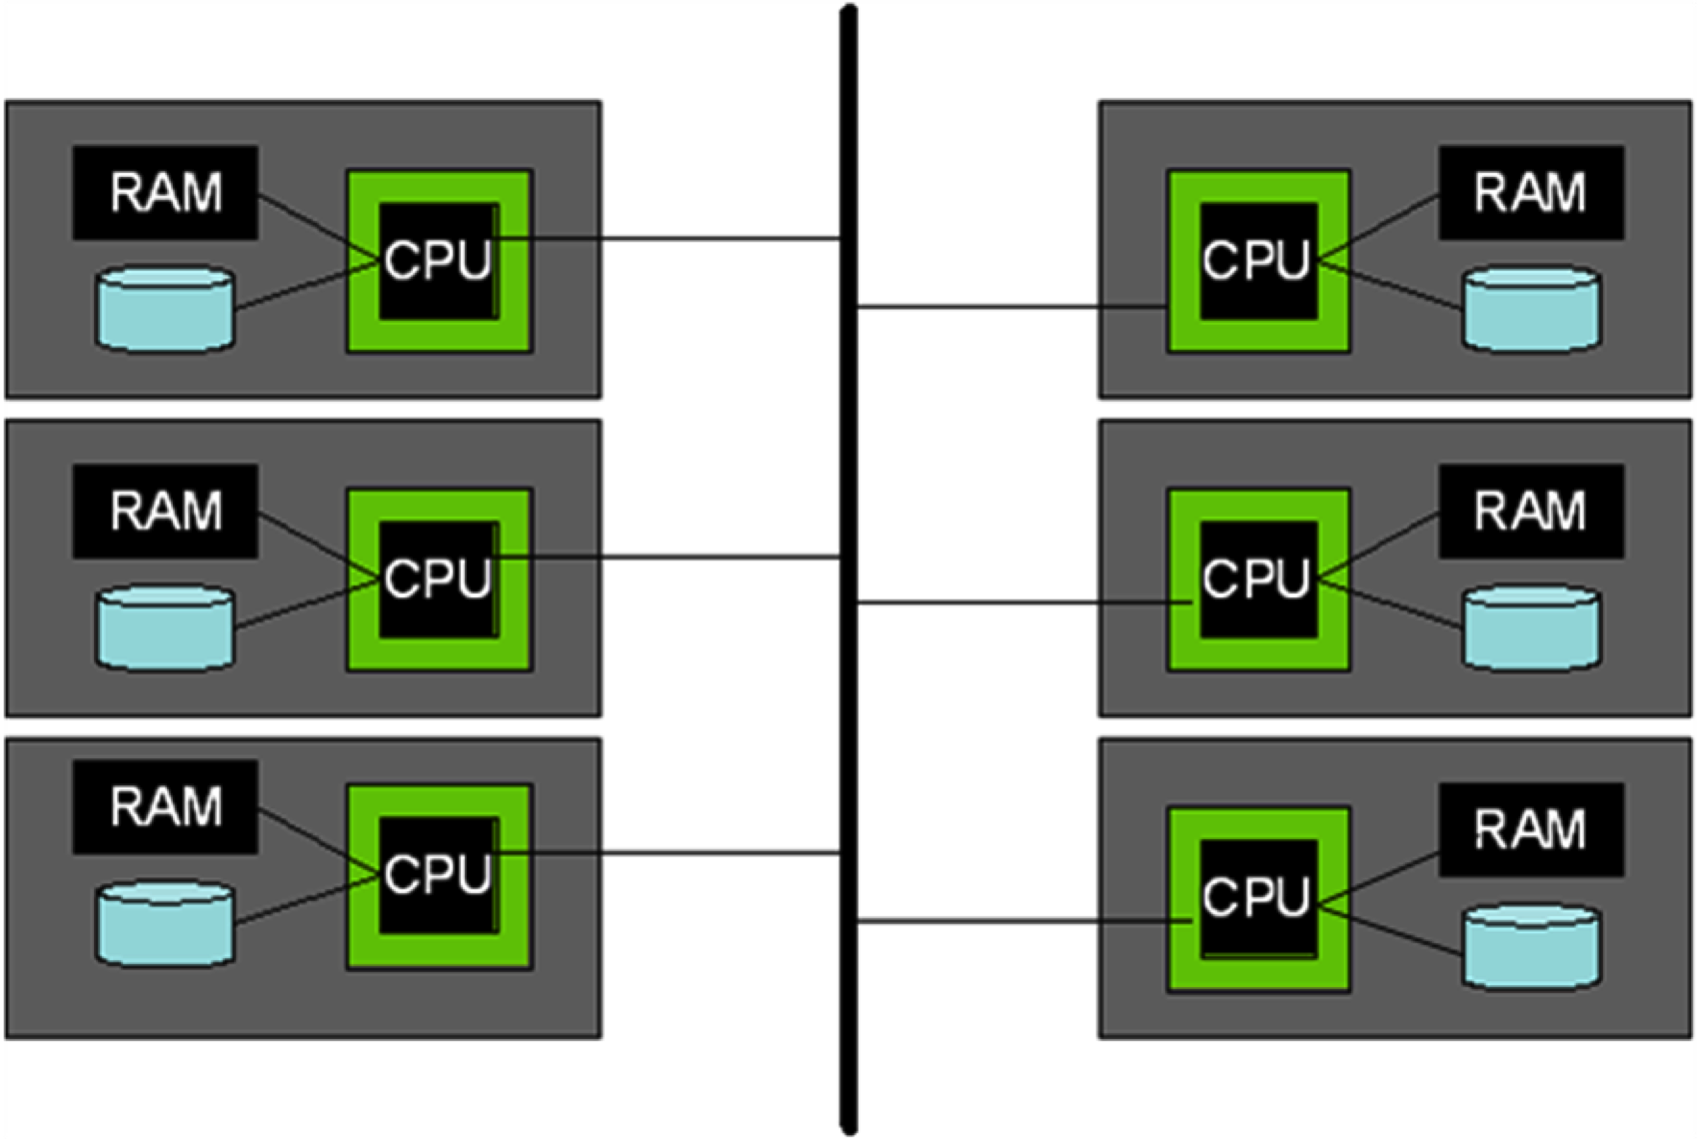
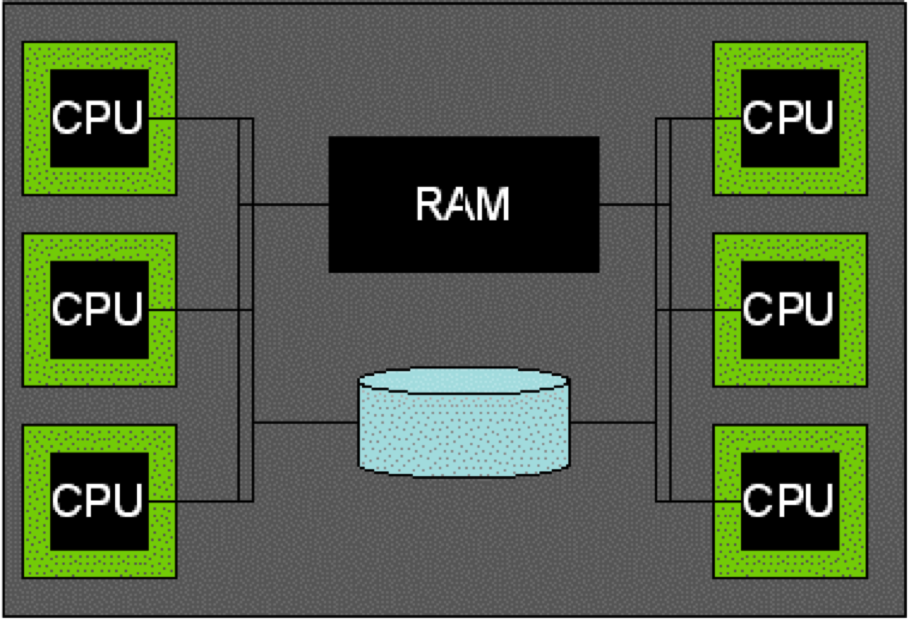
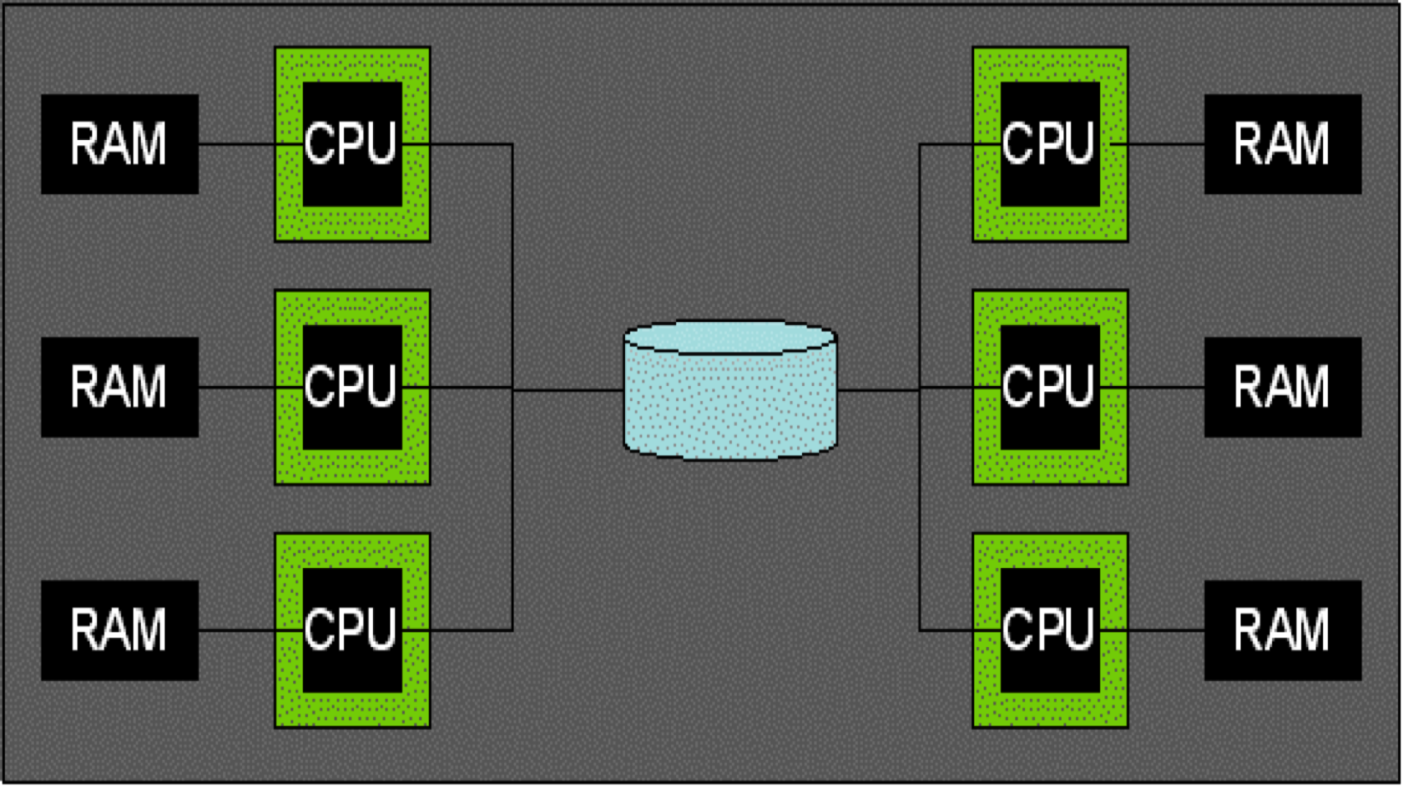
Parallel Architectures
Shared Disk
Shared Memory
Shared Nothing (cluster)
Notes:
人们谈论数据库系统的三种粗粒度并行架构
在左上角，我们有所谓的共享内存架构，其中有一堆 CPU 连接到共享 RAM 组和共享磁盘，所以当我们说共享内存时，我们说的是共享内存和磁盘，通常这就是今天在具有多核系统的单台计算机中提供的内容，在高端计算机上有许多这些内核或 CPU 共享内存和磁盘是很常见的
在右上角，我们有一个所谓的共享磁盘架构，其中每个CPU都有自己的RAM，而这个共享磁盘或共享磁盘抽象，可能是一个网络磁盘，所有CPU都可以访问，因此单独的Ram但共享磁盘
最后在最底层的是有时称为无共享架构或集群架构，其中我们有一堆商品计算机，每个计算机都有 CPU RAM 和磁盘，它们仅通过网络连接，所以当我们在这里说不共享时，我们只是真的意味着共享网络他们可以互相传递消息，但他们不能直接访问彼此的数据
there are three coarse-grained parallel architectures that people talk about for database systems
on the upper left we have what's called a shared memory architecture, where you have a bunch of CPUs that are connected to a shared RAM Bank and to shared disks, so really when we say shared memory we said mean shared memory and disk, and typically this is what is delivered in a single computer today with a multi-core system, and it's very common on high-end computers to have lots of these cores or CPUs sharing ram and disk together
on the upper right, we have what's called a shared disk architecture, in which each CPU has its own RAM, and this one shared disk or shared disk abstraction, maybe it's a network disk, that all of the CPUs can access, so separate Ram but shared disk
and then finally on the bottom is what sometimes called a shared nothing architecture or a cluster architecture, where we have a bunch of commodity computers each with CPU RAM and disk, that are connected only by a network, so when we say shared nothing here we just really mean shared network they can pass messages to each other, but they cannot access each other's data directly

Slide 95
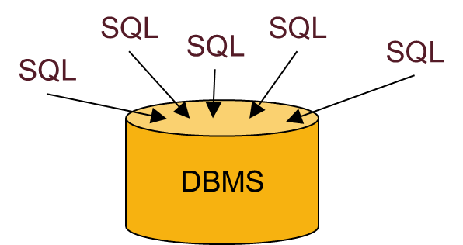
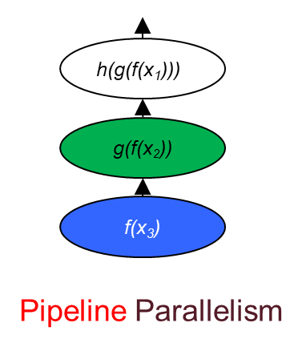
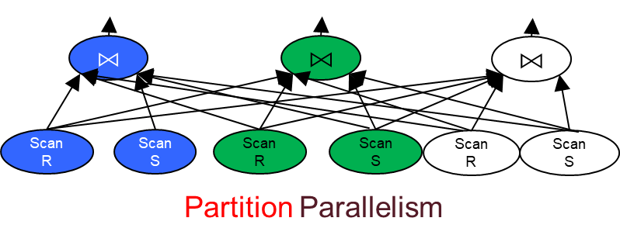
Summary: Kinds of Parallelism
Inter-Query
Intra-Query
Inter-Operator
Intra-Operator (partitioned)
Notes:
所以让我们总结一下到目前为止我们所看到的
在高层次上，我们有查询间并行性，其中多个 SQL 查询并行运行，
然后我们有各种查询内并行，我们进入了算子并行，包括管道和浓密并行
并且我们有操作符内并行性，其中单个操作符通常通过分区进行并行化
我们现在将更深入地探讨这个问题
so let's summarize what we've seen so far
at a high level we have inter query parallelism, where multiple SQL queries run in parallel,
and then we have various kinds of intra-query parallelism, we've entered operator parallelism, including pipeline and bushy parallelism
and we have intra operator parallelism, in which a single operator is parallelized typically via partitioning
and we're going to go into that in more depth now

Slide 96
Data Partitioning
How to partition a table across disks/machines
A bit like coarse-grained indexing!
Shared nothing particularly benefits from "good" partitioning
Range
Hash
Round-Robin
Loaded and partitioned
Before loading into database
A...E
F...J
K...N
O...S
T...Z
A...E
F...J
K...N
O...S
T...Z
A...E
F...J
K...N
O...S
T...Z
Good for equijoins,
range queries
group-by
Good for equijoins, group-by
Good for spreading load
Notes:
77
为了开始讨论内部操作符并行性，我们要做的第一件事是讨论我们的数据如何跨磁盘驱动器分区，因为我们将并行读取多个磁盘驱动器
那么我们如何为多台机器跨多个磁盘对表进行分区。它真的很像一个粗粒度的索引方案，我们将分离出一些数据并在一台计算机上启动，并分离出存储在另一台计算机上的一些其他数据，可能看起来有点像这样
在左侧，我们进行范围分区，因此对于某些属性或某些属性键，我们将根据值的范围对事物进行分区。所以在这个例子中，A 到 E 在第一台机器上，F 和 J 在第二台机器上，依此类推。正如我们将要看到的，这对我们来说适用于 equi-join、范围查询、分组。因为我们将能够将具有相同价值的东西放在一起。现在当然只有分区键上的等值连接、范围查询和分组可以从中受益
基于散列的分区是类似的，但我们将使用散列函数而不是使用范围，因此我们将获取我们正在分区的键的每个值，我们将运行散列函数并决定将它发送到哪台机器基于该键的哈希值。所以你可以在这里看到值 A 到 E 分散在许多机器上，因为有一个散列函数来散列这些值，与 F 到 J 等相同。所以所有匹配的值都在一台机器上，但两个按字母顺序彼此接近的值可能在非常不同的机器上
最后另一种选择是将 Records 循环分配给机器，因此我们可能以循环方式将每个元组转到下一台机器，并且再次将我们的值任意分散到机器上，但是其中一个它的好处是它可以非常均匀地分配负载，因此您可以确保每台机器上的记录数量完全相同
现在，无共享计算将特别受益于良好的分区，因为当我们开始时，任何不在正确计算机上的东西都必须通过网络传送到正确的计算机上。因此，如果您预先进行了良好的分区，那么您就可以开始处理数据所在的位置，而不必将其运送到其他地方，接下来我们将看到它的样子
To begin the discussion of intra operator parallelism, the very first thing we have to do is talk about how our data gets partitioned across disk drives, because we're gonna be reading from multiple disk drives in parallel
so how do we partition a table across many disks for many machines. it's really a lot like a coarse grained indexing scheme, we're gonna separate out some data and start on one computer and separate out some other data stored on another computer, might look a bit like this
on the left hand side, we do range partitioning, so on some attribute or some key of attributes, we're going to partition things based on ranges of values. so in this example, A through E on the first machine, F and J on the second machine and so on. and this is going to work well for us for equi-join, for range queries, for group-bys, as we're going to see. because we're going to be able to keep things that are the same value together
now of course it's only equi-joins, range queries and group-bys on the partitioning key that benefit from this
hash based partitioning is similar, but instead of using ranges we'll use a hash function, so we'll take every value of the key that we're partitioning on, we'll run a hash function and decide which machine to send it to based on the hash of that key. and so you can see here that the values A through E are scattered across many machines, because there's a hash function that hashes those values, same with F through J and so on. so all values that match are on a single machine but two values that are close to each other in alphabetical order could be on very different machines
and then finally another option is to do round-robin assignment of Records to machines, so we might have every tuple go to the next machine in a round robin fashion, and again that sort of scatters our values across the machines arbitrarily, but one of the good things about it is it spreads load very uniformly, so you can ensure that there's exactly the same number of Records on every machine
Now shared-nothing computing is going to particularly benefit from good partitioning, because anything that's not on the right computer when we start is going to have to get shipped across the network to get to that right computer. so if you have a good partitioning upfront, then you can start working on the data where it lives, rather than having to ship it somewhere else, and we'll see what that looks like next

Slide 97
Parallel Grace Hash Join
Pass 2 is local Grace Hash Join per node
Complete independence across nodes
h_{p}
R
h_{n}
R
h_{r}
S
R ⨝ S
S
R
R
S
R ⨝ S
S
R
R
S
R ⨝ S
S
Notes:
现在在grace hash join的前两个现在都是本地机器，不再需要通信，
所以这些节点是完全独立的，每个节点都尽可能快地运行，为过去两个做本地grace hash join
now in past two of grace hash join everything now is local to the individual machines, there's no more need to communicate, so these nodes are completely independent, each one runs as fast as it can, doing a local grace hash joint for past two

Slide 98
Parallel Sort-Merge Join (with optimization)
Pass 0 .. n-1 are like parallel sorting above
But do it 2x: once for each relation, with same ranges
Pass n: merge join partitions locally on each node
R
range
R
S
R ⨝ S
S
R
R
S
R ⨝ S
S
R
R
S
R ⨝ S
S
Notes:
然后在本地，现在我们已经对数据范围进行了分区，我们只需在本地进行排序合并连接的剩余传递，合并每个节点上的联合分区
这是在没有任何通信的情况下完成的，在这张图片中，我们正在做我们的小优化，其中最后一次合并 R 也是与 S 连接的一部分
所以我们同时合并 R 和 S，我们在合并时将它们连接在一起
and then locally now that we've got the data range partitioned, we simply do the remaining pass of sort merge join locally, merging the joint partitions on each node
and that's done without any communication, and in this picture here,we're doing our little optimization, where the last pass of merging R is also part of the join with S
so we merge R and S at the same time, and we join them together while we're merging

Slide 99
Parallel Aggregates
Hierarchical aggregation
For each aggregate function, need a global/local decomposition:
sum(S) = Σ Σ (s)
count = Σ count (s)
avg(S) = (Σ Σ (s)) / Σ count (s)
etc...
2,3
Σ=5
Σ=6
1,5
Σ=17
Σ=6
4,2
Notes:
88
并行聚合是我们还没有谈论太多的东西，但事实证明它非常简单
它首先了解我们如何计算跨多个节点的单个聚合，这通常使用称为分层聚合的方案完成
它的工作方式是，对于每个聚合函数，我们需要知道该函数的某种全局局部分解，因此我们在本地进行一些局部聚合，然后最后我们为全局进行一些聚合全局聚合
所以例如对于 SUM，如果我们在一个节点上有一些数据，在第二个节点上有一些数据，第一个节点对它的数据求和，第二个节点对它的数据求和，他们每个人都可以把他们的本地和放在一起全局总和以获得总和，所以有些实际上只是一些部分总和的总和
COUNT另一方面，每个节点都做一个本地计数，然后你从两个节点中获取计数，然后将它们相加得到总计数，因此对于COUNT，全局函数是SUM，本地函数在哪里数数。
现在，对于 AVERAGE，当然我们要分别计算总和，从计数开始，
对于 MIN，您可以计算出它是什么；对于 MAX，您可以计算出它是什么，
但总的来说，对于聚合你有局部分解，开始局部聚合，然后我们会有一些全局最终聚合。这将把本地聚合放在一起
parallel aggregation is something we haven‘t talked about much, but it turns out to be pretty simple
it starts by having an understanding of how we compute an individual aggregate across multiple nodes, and this is usually done with a scheme called hierarchical aggregation
and the way this works is that for each aggregation function, we need to know a sort of global local decomposition of that function, so there's some aggregation that we do locally, and then finally at the end there's some aggregation that we do for the global final aggregate
so for example for SUM, if we have some data on one node and some data on a second node, the first node sums its data, the second node sums its data, and they can each take their local sums and put them together with a global sum to get the total sum, so some is really just the sum of some partial sums
COUNT on the other hand, each node does a local count and then you take the counts from the two nodes, and you sum those together to get the total count, so for COUNT, the global function is SUM, where is the local function is COUNT.
now for AVERAGE, of course we're going to do the sums separately, from the counts, for MIN you can figure out what it would be, and for MAX you can figure out what it would be, but in general, for aggregates where you have local decompositions, starting local aggregates, and then we're gonna have some global finalisation aggregate. that's going to put the local aggregates together

Slide 100
13. Distributed Transactions
Notes:
事务分布式数据库的并发控制和恢复
两个子组件
锁管理器：处理并发控制问题
日志和恢复管理器：负责容错和恢复

Slide 101
What Could Go Wrong? #1
Deadlock detection
Notes:
那么在这个分布式系统中死锁检测会出什么问题呢？
想象一下，我们有五台机器，在这五台机器上有五种不同的等待图
您可以在最左边的机器上看到 t1 正在等待 t2 拥有的锁，而 t2 正在等待 t3 拥有的锁，但第一台机器上没有循环
在第二台机器上，t1 正在等待 t3 拥有的锁，而 t2 没有等待任何东西。 在第三台机器上，t3 正在等待 t2，仅此而已。 在第四台机器上 t2 正在等待 t3。 在第五台机器上 t3 正在等待 t1
所以在每台单独的机器上，没有循环，但是如果你查看这些交易的颜色和字母，你会发现这里实际上有一个循环的等待图。
so what can go wrong with deadlock detection in this distributed system?
imagine here we have our five machines, and in on those five machines there are five different wait-for graphs
you can see on the leftmost machine t1 is waiting for a lock that t2 has, and t2 is waiting for a lock of t3 has, but there's no cycle on the first machine
on the second machine t1 is waiting for a lock that t3 has, and t2 is not waiting for anything. on the third machine t3 is waiting for t2 and that's all. on the fourth machine t2 is waiting for t3. on the fifth machine t3 is waiting for t1
so on each individual machine, there is no cycle but if you look at the colors and letters of these transactions, you can see that there is actually a wait-for cycle going on here.

Slide 102
2-Phase Commit
A.k.a. 2PC. (Not to be confused with 2PL!)
Like a wedding ceremony!
Phase 1: “do you take this man/woman...”
Coordinator tells participants to “prepare”
Participants respond with yes/no votes
Unanimity required for yes!
Phase 2: “I now pronounce you...”
Coordinator disseminates result of the vote
Need to do some logging for failure handling....
Notes:
好的，我们将使用一种称为两阶段提交的方案，它也称为 2pc。不要与两相锁定或 2pl 混淆，这是完全不同的事情
当你说话时错误地说一个而不是另一个是很常见的，但请记住，两阶段锁定是一种锁定协议，它甚至可能是一台计算机，两阶段提交是一种分布式提交协议
两阶段提交的工作方式与婚礼非常相似，Jim Gray 在早期关于分布式事务的论文中使用了这个类比。
在两阶段提交协议的第一阶段，就像婚礼的主礼人说你接受这个男人吗？你带这个女人吗？等等，成为你合法结婚的配偶。所以在第一阶段事务的协调者，记住每个事务都有一个协调者，协调者可以告诉所有参与者准备提交。参与者将就他们是否愿意承诺投赞成票或反对票，这必须是一致的，一旦收到所有这些选票，第一阶段就结束了。协调器现在知道事务的命运。
如果所有参与者都投票提交，那么第二阶段就是协调员说，我现在宣布你提交了事务，基本上协调员将把投票结果传播给第二阶段的所有参与者，然后他们可以做正确的事情要么提交要么中止。
但是需要做一些日志记录来处理这些参与者甚至协调器在此提交协议期间可能失败的可能性。
所以两阶段提交涉及在协调者和参与者之间来回发送的一堆消息，以及在此过程中将这些消息记录在事务日志中。所以我们接下来会详细介绍
okay we're going to use a scheme called two-phase commit, it's also known as 2pc. not to be confused with two-phase locking or 2pl, it's a completely different thing
it's very common when you're speaking to mistakenly say one instead of the other, but please keep in mind two-phase locking is a locking protocol for it possibly even a single computer, two-phase commit is a distributed commit protocol
two-phase commit works very much like the wedding ceremony, and Jim Gray famously use this analogy in an early paper on distributed transactions.
in the first phase of the two-phase commit protocol, it's like when the officiant at the wedding says do you take this man? do you take this woman? Et cetera to be your lawfully wedded spouse. so in phase one the coordinator of the transaction, remember that every transaction had a coordinator, the coordinator can tells all the participants to prepare to commit. the participants will respond with yes or no votes as to whether they want to commit, it has to be unanimous, and once all those votes are received, that's the end of phase one. the coordinator now knows the fate of the transaction.
if all of the participants voted to commit, then phase two is that the coordinator says, I now pronounce you committed transaction, basically the coordinator is going to disseminate the results of the vote to all of the participants in Phase two, and then they can do the right thing either commit or abort.
but will need to do some logging to deal with the possibility that these participants or even the coordinator might fail during this commit protocol. so two-phase commit involves both a bunch of messages being sent back and forth between coordinator and participants, and logging of those messages in the transaction log along the way. so we'll go through the details next

Slide 103
2PC In a Nutshell
NOTE
asterisk*: wait for log flush
before sending next msg
Participant Log
Coordinator
Log
Time
Prepare
prepare* or abort* (with coord ID)
Vote Yes/No
commit* or abort* (commit includes all participant IDs)
Commit/Abort
commit* or abort*
Ack on commit
end (on commit)
Notes:
所以简而言之，这是两阶段提交协议
在这张幻灯片中时间从上到下，协调员在右边，参与者在左边，消息在箭头上
你可以看到这是一个两轮协议，两阶段协议，每一轮在每个方向都有一个消息
并且您还可以看到正在生成的日志记录，这些日志记录上有星号，如果它们必须等待日志刷新才能发送下一条消息
你会在我们目前学到的协议中看到，在发送消息之前，所有这些日志记录都需要刷新，
我会告诉你我们不会在这门课上学习，但是这个协议有一些优化，我们可以避免刷新一些日志记录，我们可以懒惰地把它们放在日志尾部，然后发送我们的消息，而无需等待flush。
但是我们还没有在这个类中学习那些优化，所以你可以假设所有这些日志记录都必须刷新才能使协议工作
唯一例外的是，最后的结束日志记录不需要在将事务返回给用户之前刷新，就像我们在单个笔记数据库中一样
so in a nutshell, this is the two-phase commit protocol
time is going from top to bottom in this slide, the coordinator is on the right, the participant is on the left, and the messages are on the arrows
and you can see it's a two-round protocol, two-phase protocol, each round has a message in each direction
and you can also see the log records that are being generated, and these log records have asterisks on them, if they have to wait for the log flush before sending the next message
and you'll see in the protocol we've learned so far, all of those log records need to be flushed before a message is sent,
and I'll tell you we will not learn in this class, but there are optimizations to this protocol, where we can avoid flushing some of these log records, we can lazily put them in the log tail and send our message afterwards without waiting for a flush. but we haven't learned those optimizations in this class, so you can assume that all these log records have to be flushed for the protocol to work
the only one that is an exception is that the very end the end log record doesn't need to flush for the transaction to return to the user, that's just like we have in a single note database

Slide 104
Recovery: Think it through, cont
What happens when coordinator recovers?
With “commit” and “end”? Nothing
With just “commit”? Rerun Phase 2!
With “abort”? Nothing (Presumed Abort)
What happens when participant recovers:
With no prepare/commit/abort? Nothing (Presumed Abort)
With “prepare” & “commit”? Send Ack to coordinator.
With just “prepare”? Send inquiry to Coordinator
With “abort”? Nothing (Presumed Abort)
Commit iff coordinator logged a commit
Notes:
那么当协调器通过日志中的提交和结束记录恢复时会发生什么
在这种情况下，交易得到了充分处理。协调员完成了所有工作，参与者完成了所有工作并确认协调员收到了确认并写入了结束日志记录。所以这次交易没有什么可做的
如果协调器恢复并且在事务日志中看到提交但没有看到结束记录会发生什么
我们不知道所有参与者是否已经完成了他们的提交处理，所以我们重新运行事务的第 2 阶段，我们将提交状态的事务的状态发送给所有参与者，我们收集确认，然后最终写一个结束日志记录。只提交我们不知道参与者是否已经完成，所以我们重新运行第二阶段
我们在协调器的日志中看到一个事务的中止记录，
我们什么都不做，因为这个假定中止，我们假设各个参与者已经中止
如果他们没有中止，他们会询问我们的状态之后的交易，我们可以说我们不记得它然后会发生中止
当参与者在没有日志记录、没有准备、没有提交、没有中止的情况下恢复时会发生什么，
答案是参与者只会做 ARIES 所做的通常的事情，所以它不会做任何特别的事情，我们假设中止和ARIES 协议将执行该事务的本地中止
如果参与者的日志中有准备和提交记录，
那么参与者完成了该事务的所有工作，但我们不知道协调器是否收到参与者的回音，因此参与者将其行为重新发送到协调器，以便协调器可以确保为该事务写入结束记录
如果参与者已经准备好了，
这意味着它同意提交这个事务，但它不知道事务发生了什么，它实际上是提交还是中止了。因此，在这种情况下，它必须向协调器发送以了解事务是否已提交或是否需要撤消，是否已中止
最后，如果参与者只有一个中止日志记录，
那么它应该什么都不做。假定的中止协议意味着 ARIES 也将在本地全部撤消此事务查询
so what happens when the coordinator recovers with a commit and end record in the log
in that case the transaction was fully handled. the coordinator did all its work, the participants did all their work and acknowledged the coordinator received the acknowledgments and wrote an end log record. so there's nothing more to do for this transaction
what happens if the coordinator recovers and it sees a commit in the transaction log but it doesn't see an end record
We don't know if all the participants have done their commit processing yet, so we rerun phase 2 of the transaction, we send the status of the transaction that committed status to all the participants, and we collect acknowledgments and then eventually write an end log record. with just commit we don't know if the participants have finished, so we rerun phase two
we see an abort record in the log for a transaction at the coordinator, we do nothing, because of this presumed abort, we assume that the individual participants have already aborted, and if they haven't aborted they'll ask us about the status of the transaction later, and we can say that we don't remember it and then abort will happen
what happens when the participant recovers with no log records, no prepare, no commit, no abort, the answer is the participants just going to do the usual thing that ARIES does, so it'll do nothing special, we have presumed abort and the ARIES protocol will do a local abort of that transaction
if the participant has both the prepare and a commit record in their log, then the participant finished doing all the work for this transaction, but we don't know if the coordinator heard back from the participant, so the participant will resend its act to the coordinator, so that the coordinator can be sure to write an end record for this transaction
if the participant has prepared, that means it agreed to commit this transaction, but it doesn't know what happened to the transaction, did it in fact commit or did it abort. so in this case it must send an inquiry to the coordinator to find out if the transaction committed or if it needs to be undone, it was aborted
finally if the participant has just an abort log record, then it should do nothing. the presumed abort protocol means that ARIES will do the undo of this transaction locally in all as well

Slide 105
14. NoSQL
Notes:
Needed: very large scale OLTP workloads
Give up on consistency, give up OLAP
NoSQL: reduce functionality
Simpler data model
Very restricted updates

Slide 106
Two Classes of Relational Database Apps
OLTP (Online Transaction Processing)
Queries are simple lookups: 0 or 1 join E.g., find customer by ID and their orders
Many updates. E.g., insert order, update payment
Consistency is critical: we need transactions
OLAP (Online Analytical Processing)
aka “Decision Support”
Queries have many joins, and group-by’s
E.g., sum revenues by store, product, clerk, date
No updates
Notes:
要了解 nosql 是如何产生的，首先了解数据库应用程序的类型以及它们的组织方式对我们来说很重要
在数据管理中，习惯上将应用程序分为两大类
第一个在线事务处理或简称 OLTP，
这包括倾向于运行短事务查询的应用程序，例如银行交易、查找学生记录或客户信息等
在这些应用程序中，保持我们的资产属性很重要，因此它们也被称为事务应用程序
简单查找，极少涉及连接，大量的更新
另一种称为在线分析处理或简称OLAP，
这些包括倾向于运行复杂读取查询的应用程序，
涉及许多绘图和聚合，例如，计算季度收入或其他类型的数据分析查询
这些应用程序倾向于运行只读查询，不会真正修改数据，因此您可以想象它们实际上不需要是事务性的
只读，为了支持决策需要大量的连接和聚合
在许多情况下，OLTP 和 OLAP 工作负载由不同的数据库提供服务。
数据必须每隔一段时间通过一个称为提取-转换-加载 (ETL) 的过程从 OLTP 系统迁移到 OLAP 系统。
to understand how nosql came about, it is important for us to first understand the types of database applications and how they are organized
in data management, it is customary to organize applications into two broad categories
first online transaction processing or OLTP for short,
this includes applications that tend to run short transactional queries, such as banking transactions, looking up a student record or customer information, etc
in these applications it is important to keep our asset properties, and therefore they are also known as transactional applications
the other one is called online analytical processing or OLAP for short,
these include applications that tend to run complex read queries, involving many drawings and aggregates, for instance, computing quarterly revenues or other kinds of data analytic queries
these applications tend to run read-only queries, that don't really modify data, so as you can imagine they do not actually need to be transactional

Slide 107
Scale Through Partitioning
Partition the database across many machines in a cluster
Database now fits in main memory
Queries spread across these machines
Can increase throughput
Easy for writes but reads become expensive!
Application updates here
May also update here
Three partitions
Notes:
第一个想法是跨多台机器对数据进行分区
数据现在适合每台机器的主内存，
查询现在也可以分布在这些机器上
这里的优点是我们现在可以同时为更多客户提供服务，也就是增加系统吞吐量
然而问题是，虽然写入数据很容易，只要我们知道哪台机器保存着我们想要更新的数据，但现在读取数据变得昂贵，为什么？
考虑运行连接查询，其中要连接的数据实际上位于三个不同的分区，要完成连接，我们需要等待所有三台不同的机器返回数据，这可能需要一段时间
此外，如果我们想要在连接中读取的数据发生写入，那么我们需要在每个分区上获取本地块并等待，否则我们可能会被杀死并需要重新启动整个事务，如果是死块
所有这些使得保持数据一致性非常困难
性能提高有两个原因：
如果查询涉及数据库的不同部分，可以在多台机器上并行执行；
对数据库进行分区可以让每个分区都进入内存，这可以减少磁盘 I/O 执行查询的成本。
the first idea is to partition the data across multiple machines
the data now fits within the main memory of each machine and queries can now be spread across those machines as well
the advantage here is that we can now serve more clients at the same time, otherwise known as increasing system throughput
the problem however is that while writing data is easy as long as we know which machine is holding the data that we want to update, but reading data now becomes expensive, why?
consider running a join query where the data to be joined, actually sits across three different partitions, to complete the join we need to wait for data to be returned from all three different machines, and that can take a while
also if there are writes that are happening to the data that we want to read as part of the join, then we need to grab local blocks on each of those partitions and wait, or we might get killed and need to restart the entire transaction, in case for instance of a dead block
all of these make keeping data consistency really hard

Slide 108
Scale Through Replication
Create multiple copies of each database partition
Spread queries across these replicas
Can increase throughput and lower latency
Can also improve fault-tolerance
Easy for reads but writes become expensive!
App 1 updates here only
App 2 updates here only
Three replicas
Notes:
第二个想法是制作数据的副本，而不是跨多台机器对其进行分区
查询可以再次分布在所有这些不同的副本上，因此吞吐量也可以增加
运行查询所需的时间也将减少，因为客户端可以转到其中的另一台机器执行他们的读取查询
我们也有更好的容错能力，因为如果其中一台机器死机，我们就去另一台机器进行查询
然而，问题在于，虽然执行读取查询很容易，但现在写入变得非常昂贵。
那是因为对于每次写入我们都需要接触所有副本，否则数据将不再一致
the second idea is to make copies of the data instead of partitioning it across multiple machines
the queries again can be spread across all these different replicas, and throughput can also be increased as a result
time needed to run queries will also be lowered, because a client can go to another one of these machines to execute their read query
we also have better fault tolerance, because in case if one of the machines is dead, we just go to another one for our query purpose
the problem with this however is that while it is easy to execute read queries, writes now becomes very expensive.
that is because for every write we need to touch all the replicas, or otherwise data will no longer be consistent

Slide 109
Relational Model   NoSQL
Relational DB: difficult to replicate/partition. E.g.,
Supplier(sno,…),Part(pno,…),Supply(sno,pno)
Partition: we may be forced to join across servers
Replication: local copy has inconsistent versions
Consistency is hard in both cases (why?)
NoSQL: simplified data model
Given up on functionality
Application must now handle joins and consistency
Basic Availability
Application must handle partial failures itself
Soft State
DB state can change even without inputs
Eventually Consistency
DB will “eventually” become consistent
Notes:
现在我们明白了为什么很难扩展关系数据库，
在分区的情况下，我们可能需要跨多个服务器连接数据，我们需要处理其他事务对它们的并发写入
在复制的情况下，我们可能需要处理不一致的数据，以防其他机器尚未更新
所以在这两种情况下都很难保持一致性，
所以 nosql 出现了一个简单的数据模型，
我们只是放弃了一些功能，例如我们不再处理连接或提供任何类型的一致性
这样做的基本原理是，因为并非所有应用程序都需要这些功能，因此实际上没有理由在单个 dbms 中实现所有这些功能并使扩展变得困难
所以让我们尝试依赖应用程序来根据需要实现这些功能，这就是 nosql 背后的哲学
now that we understand why it is difficult to scale relational databases,
in the case of partition we might need to join data across multiple servers and we need to deal with concurrent writes to them from other transactions
and in the case of replication we might need to handle inconsistent data, in case it has not been updated yet from other machines
so again consistency is hard in both of these cases,
so nosql came about with a simple data model, where we simply give up some of the functionalities, for instance we no longer handle joins or provide any kind of consistency whatsoever
the rationale for this is that well, since not all applications need these functionalities, so there's actually no reason to implement all of that inside a single dbms and make scaling difficult
so let's try to rely on applications to implement these functionalities as needed, and that is the philosophy behind nosql

Slide 110
Data Models
Taxonomy based on data models:
Key-value stores
☞
e.g., Amazon Dynamo, Voldemort, Memcached
Extensible Record Stores
e.g., HBase, Cassandra, PNUTS
Document stores
e.g., SimpleDB, CouchDB, MongoDB
Notes:
现在让我们谈谈 nosql 的数据模型，
在本课中我们将介绍三种不同类型的数据模型：键值存储、可扩展存储和文档存储
now let‘s talk about data models for nosql, in this class we will cover three different types of data models: key value stores, extensible stores and document stores

Slide 111
JSON vs Relational
Relational data model
Rigid flat structure (tables)
Schema must be fixed in advanced
Binary representation: good for performance, bad for exchange
Query language based on Relational Algebra
Semistructured data model / JSON
Flexible, nested structure (trees)
Does not require predefined schema ("self-describing”)
Text representation: good for exchange, bad for performance
Most common use: Language API; query languages emerging
Notes:
正如您所记得的，所有关系都必须由行和固定数量的列组成，每行必须具有相同的模式。
由于所有行都具有相同的模式，我们可以以二进制格式存储整个关系，正如我们在本学期早些时候讨论的那样以提高性能
但这使得跨不同数据库发送数据变得困难，因为每个数据库二进制格式可能不同
json和半结构化数据一般比较灵活，
不需要每个存储的对象都具有相同的模式，我们将json数据存储在文本中，这对于在多个数据库之间发送数据很好，
因为它们都可以读取text 文本格式，但它现在对性能不利，因为您可以想象以文本格式存储数据与二进制相比占用更多空间
正如我们将看到的，查询 json 数据通常是通过调用一堆函数来完成的，这与编写独立的 sql 查询不同，
尽管目前也正在开发针对 json 和半结构化数据的新语言
so as you recall, all relations must consist of rows and a fixed number of columns, each row must have the same schema.
since all rows have the same schema, we can store the entire relation in binary format as we discussed earlier in the semester for performance purposes
but this makes it hard to send data across different databases, since each database binary format might differ
json and semi-structured data in general is instead more flexible, it doesn't require each stored object to have the same schema, and we store json data in text, this is good to send data among multiple databases, since they can all read text textual formats, but it is now bad for performance, because as you can imagine storing data in textual format takes up more space compared to binary
and as we will see querying json data is done usually by calling a bunch of functions, unlike writing a standalone sql query,
although new languages targeting json and semi-structured data in general are also being developed right now

Slide 112
15. MapReduce & Spark
Notes:
Needed: very large scale OLTP workloads
Give up on consistency, give up OLAP
NoSQL: reduce functionality
Simpler data model
Very restricted updates

Slide 113
Distributed File System (DFS)
For very large files: TBs, PBs
Each file is partitioned into chunks, typically 64MB
Each chunk is replicated several times (≥3), on different racks, for fault tolerance
Implementations:
Google’s DFS: GFS, proprietary
Hadoop’s DFS: HDFS, open source
Notes:
2000 年代初，Google 的工程师需要一种方法来有效管理和处理公司正在生成、存储和索引的大量数据（PB 级及以上）。
我们已经了解如何在一台机器上存储非结构化和半结构化数据
我们还讨论了在多台机器上分片和复制它们，
mapreduce 假设数据存储在类似的数据模型中，它旨在存储 TB 到 PB 的数据，并将数据组织成几兆字节大小的块（通常64mb）
这些块中的每一个都被复制以跨多台机器进行容错，就像我们之前讨论的那样
google 首先实现了其分布式 mapreduce 文件系统，称为 google 文件系统或简称 gfs，
随后是一个名为 hadoop 文件系统或 hdfs 的开源实现
we already learned about storing unstructured and semi-structured data on a single machine
and we also talked about sharding and replicating them across multiple machines,
mapreduce assumes data is stored in a similar data model, it aims to store terabytes to petabytes of data, and organizes data into chunks of a few megabytes in size
each of these chunks is replicated for fault tolerance across multiple machines, just like what we have discussed before
google first implemented its distributed mapreduce file system called google file system or gfs for short, and this was followed by an open source implementation called hadoop file system or hdfs

Slide 114
Typical Problems Solved by MR
Read a lot of data
Map: extract something you care about from each record
Shuffle and Sort
Reduce: aggregate, summarize, filter, transform
Paradigm stays the same,
Write the results
change map and reduce functions for different problems
Fault handling: MapReduce handles fault tolerance by writing intermediate files to disk
Stragglers: pre-emptive backup execution of the last few remaining in-progress tasks
Notes:
所以mapreduce最初是为了解决需要读取大量数据的问题，例如阅读网络中的所有网页，在谷歌的情况下
它在读取数据后将问题分解为三个步骤
第一个map，它从我们读过的每个记录或文档中提取信息
然后根据提取的信息，我们在机器之间打乱这些记录和文档（按照map输出的键值进行分组）
然后我们reduce打乱的数据，这里的reduce意味着某种形式的聚合或汇总。最后我们最终将结果写回磁盘
这里的想法是让这三步范式对所有问题保持相同，但我们可以为每个不同的问题改变map 和reduce的实现
这实际上和sql非常相似，我们将每个查询分解为'select'、;from'和'where'，每个查询在结构上保持不变，但它的“select from where”子句会发生变化
用户只需定义 Map 和 Reduce 任务，其余的由 MapReduce 负责，类似于 SQL 从查询创建执行计划的方式。
so mapreduce is originally designed to solve problems that require reading a lot of data
for instance reading all the web pages out there in the web, in the case of google
it breaks down the problem into three steps after data has been read
first map which extracts information from each record or document that we have read
then based on the extracted information, we shuffle those records and documents across the machines
and then we reduce the shuffled data, where reduce here means some form of aggregation or summary
and we finally write the results back to the disk at the end
the idea here is to keep this four step paradigm the same for all problems, but we change the implementation of map and reduce for each of them
this is actually very similar to sql, where we decompose each query into ‘select’, ;from’ and ‘where’, each query remains structurally the same, but it's “select from where” clause would change

Slide 115
Relational Operators in MapReduce
Given relations R(A,B) and S(B,C) compute:
Selection: σ_{A=123}(R)
Group-by: γ_{A,sum(B)}(R)
Join: R ⋈ S
Notes:
为了说明，我们将使用mapreduce来实现选择、分组和加入
to illustrate, we will use mapreduce to implement selection, group by and join

Slide 116
Data Model: Resilient Distributed Datasets
RDD = Resilient Distributed Datasets
A distributed, immutable relation, together with its
lineage
Lineage = expression that says how that relation was computed (e.g., a relational algebra plan)
Spark stores intermediate results as RDD
If a server crashes, its RDD in main memory is lost. However, the driver (=master node) knows the lineage, and will simply recompute the lost partition of the RDD
Notes:
像mapreduce spark也使用了半结构化数据模型
然而，与 mapreduce 不同的是，这些对象可以是从键值对到某种类型的对象的任何对象，它们被组织成 rdds 或弹性分布式数据集
您可以将每个 rdd 视为一个不可变的数据集，一旦创建就无法更改
每个rdd可以分布在多台机器上，并且还记得它的血统
谱系是一个表达式，它说明了 rdd 本身是如何计算的，例如，您可以将其视为关系代数计划
为什么我们要跟踪每个 rdd 的谱系？
好吧，虽然 spark 中的所有中间结果也作为 rdds 存储在内存中，但如果服务器崩溃，它们将丢失
但是由于我们知道每个 rdd 是如何计算的，我们可以从其谱系重新计算 rdd，而不是从头开始整个程序
这意味着在执行生成输出的 rdd 的程序之前，我们必须将谱系存储在持久性存储中，例如将其写入磁盘
实际上，这可以通过写入日志文件并将日志刷新到磁盘来完成，就像我们之前在恢复讲座中学到的一样
like mapreduce spark also uses a semi-structured data model
unlike mapreduce however, these objects which can be anything from key value pairs to just objects of a certain type are organized into rdds or resilient distributed data sets
you can think of each rdd as an immutable data sets that cannot be changed once created
each rdd can be distributed multiple machines, and it also remembers its lineage
a lineage is an expression that states how the rdd itself was computed, you can think of it as a relational algebra plan for example
why do we keep track of each rdd's lineage?
Well while all intermediate results in spark are also stored in memory as as rdds, they will be lost if the server crashes
but since we know how each rdd was computed, we can recompute the rdd from its lineage, rather than starting the entire program from scratch
this means that we must have stored the lineage in persistence storage like writing it out to the disk, before executing the program that generates the output's rdd
in practice this can be done by writing to a log file and flushing the log to the disk, just like what we learned earlier in the recovery lecture

Slide 117



Programming in Spark
A Spark program consists of:
Transformations (map, reduceByKey, join…). Lazy
Actions (count, reduce, save...). Eager
Eager: operators are executed immediately
Lazy: operators are not executed immediately
A operator tree is constructed in memory instead
Similar to a relational algebra tree
What are the benefits of lazy execution?
Notes:
现在不像 mapreduce 由 mapper 和 reducer 组成，spark 中的每个程序都由操作符组成
和运算符分为转换和操作
操作是在调用时立即执行的急切操作符
另一方面，转换是惰性的，它们不会立即执行，但会被记录在血统当中
这意味着什么？ 这意味着我们只是在谱系日志中记录，我们还没有真正执行该功能
我们为什么要做这个？ 好处之一是我们可以将多个运算符组合在一起并将它们融合在一起
转换以这种方式设计以优化运算符执行，类似于 SQL 优化一组查询计划的方式。
例如，如果我们有两个连续的选择，一个接一个，那么我们可以将它们组合在一起作为一个选择，这样我们就不需要多次遍历整个 rdd 并节省一些 ios
now unlike mapreduce that consists of mappers and reducers, each program in spark consists of operators
and operators are categorized into transformations and actions
Actions are eager operators that are executed immediately when called
Transformations on the other hand are lazy, and they are not executed immediately
what does that mean? that means we just recorded in the lineage log and we don't actually carry out the function just yet
why do we do this? well one of the benefits is that we can group together multiple operators and fuse them together
for instance if we have two consecutive selections, one after another, then we can combine them together as a single selection, so that we don't need to iterate through the entire rdd multiple times and save some ios

Slide 118

























Example
SELECT count(*) FROM R, S
WHERE R.B > 200 and S.C < 100 and R.A = S.A
R(A,B)
S(A,C)
R = s.read().textFile(“R.csv”).map(parseRecord).persist(); S = s.read().textFile(“S.csv”).map(parseRecord).persist();
RB = R.filter(t -> t.b > 200).persist(); SC = S.filter(t -> t.c < 100).persist(); J = RB.join(SC).persist();
transformations
J.count();
action
R
S
filter((a,b)->b>200)
filter((b,c)->c<100)
RB
SC
join
J
Notes:
然后我们通过调用过滤器运算符来实现对 b 的选择，如下所示
与 c 上的选择类似
最后我们调用 join 操作符，默认情况下，它连接所涉及的两个 rdds 之间的公共属性
请注意，在转换时过滤和连接意味着它们不会立即执行，因此为了容错目的而保存输出，我们在此处添加了持久成本，如幻灯片所示
最后我们计算一个动作并立即执行的计数
然后最后我们可以将结果写入磁盘，这在幻灯片中没有显示
we then implement the selection on b by calling the filter operator as shown here
and similarly with the selection on c
finally we call the join operator and by default it joins on the common attributes between the two rdds involved
notice that filter and join at transformations which means they are not executed immediately, so to save the outputs for fault tolerance purposes, we add the persist cost here as shown in the slide
and finally we compute the count which is an action and that gets carried out immediately
and then finally we can write the results to the disk and that is not shown here on the slide

Slide 119
16. Data Mining and Machine Learning Part I – Data Warehouse/Lake
Notes:
两个子组件
锁管理器：处理并发控制问题
日志和恢复管理器：负责容错和恢复

Slide 120
Data Warehouse
Sales
(Asia)
ETL
Collects and organizes historical data from multiple sources
Sales
(US)
ETL
ETL
Inventory
Data is periodically ETLed into the data warehouse:
Extracted from remote sources
Transformed to standard schemas
Loaded into the (typically) relational system
ETL
Advertising
Online Transaction Processing (OLTP) v.s. Online Analytics Processing (OLAP)
Notes:
数据库DB vs. 数据仓库DW
数据库：传统的关系型数据库的主要应用，主要是基本的、日常的事务处理，例如银行交易。
数据仓库：数据仓库系统的主要应用主要是OLAP（On-Line Analytical Processing），支持复杂的分析操作，侧重决策支持，并且提供直观易懂的查询结果。
基本每家电商公司都会经历，从只需要业务数据库到要数据仓库的阶段。
电商早期启动非常容易，入行门槛低。找个外包团队，做了一个可以下单的网页前端 + 几台服务器 + 一个MySQL，就能开门迎客了。这好比手工作坊时期。
第二阶段，流量来了，客户和订单都多起来了，普通查询已经有压力了，这个时候就需要升级架构变成多台服务器和多个业务数据库（量大+分库分表），这个阶段的业务数字和指标还可以勉强从业务数据库里查询。初步进入工业化。
第三个阶段，一般需要 3-5 年左右的时间，随着业务指数级的增长，数据量的会陡增，公司角色也开始多了起来，开始有了 CEO、CMO、CIO，大家需要面临的问题越来越复杂，越来越深入。高管们关心的问题，从最初非常粗放的：“昨天的收入是多少”、“上个月的 PV、UV 是多少”，逐渐演化到非常精细化和具体的用户的集群分析，特定用户在某种使用场景中，例如“20~30岁女性用户在过去五年的第一季度化妆品类商品的购买行为与公司进行的促销活动方案之间的关系”。信息化
ETL是将业务系统的数据经过抽取、清洗转换之后加载到数据仓库的过程，目的是将企业中的分散、零乱、标准不统一的数据整合到一起，为企业的决策提供分析依据
数据的抽取是从各个不同的数据源抽取到ODS(Operational Data Store，操作型数据存储)中——这个过程也可以做一些数据的清洗和转换)，在抽取的过程中需要挑选不同的抽取方法，尽可能的提高ETL的运行效率。ETL三个部分中，花费时间最长的是“T”(Transform，清洗、转换)的部分，一般情况下这部分工作量是整个ETL的2/3。数据的加载一般在数据清洗完了之后直接写入DW(Data Warehousing，数据仓库)中去。
这类非常具体，且能够对公司决策起到关键性作用的问题，基本很难从业务数据库从调取出来。原因在于：
业务数据库中的数据结构是为了完成交易而设计的，不是为了而查询和分析的便利设计的。
业务数据库大多是读写优化的，即又要读（查看商品信息），也要写（产生订单，完成支付）。因此对于大量数据的读（查询指标，一般是复杂的只读类型查询）是支持不足的。
需要建立一个数据仓库了，公司也算开始进入信息化阶段了。数据仓库的作用在于：
数据结构为了分析和查询的便利；
只读优化的数据库，即不需要它写入速度多么快，只要做大量数据的复杂查询的速度足够快就行了。
前一种业务数据库（读写都优化）的是业务性数据库，后一种是分析性数据库，即数据仓库。
数据库 比较流行的有：MySQL, Oracle, SqlServer, Postgre等 数据仓库 比较流行的有：AWS Redshift, Greenplum, Hive等
这样把数据从业务性的数据库中提取、加工、导入分析性的数据库就是传统的 ETL 工作。
数据库(Database)的特点是：
相对复杂的表格结构，存储结构相对紧致，少冗余数据。
读和写都有优化。
相对简单的read/write query，单次作用于相对的少量数据。
数据仓库(Datawarehouse)的特点是：
相对简单的(Denormalized)表格结构，存储结构相对松散，多冗余数据。
一般只是读优化。
相对复杂的read query，单次作用于相对大量的数据（历史数据）。
Open Source ETL technologies:
Apache Nifi
Pentaho
Almost every database vendor has an ETL solution…

Slide 121
Multidimensional Data Model
Sales Fact Table
Locations
pid | timeid | locid | sales
11 | 1 | 1 | 25
11 | 2 | 1 | 8
11 | 3 | 1 | 15
12 | 1 | 1 | 30
12 | 2 | 1 | 20
12 | 3 | 1 | 50
12 | 1 | 1 | 8
13 | 2 | 1 | 10
13 | 3 | 1 | 10
11 | 1 | 2 | 35
11 | 2 | 2 | 22
11 | 3 | 2 | 10
12 | 1 | 2 | 26
12 | 2 | 2 | 45
12 | 3 | 2 | 20
13 | 1 | 2 | 20
13 | 2 | 2 | 40
13 | 3 | 2 | 5
locid | city | state | country
1 | Omaha | Nebraska | USA
2 | Seoul |  | Korea
5 | Richmond | Virginia | USA
Dimension
Tables
Products
Multidimensional “Cube” of data
pid | pname | category | price
11 | Corn | Food | 25
12 | Galaxy 1 | Phones | 18
13 | Peanuts | Food | 2
Location Id
8
10
10
1
2
5
8
10
10
8
30
20
50
10
10
Time
13
30
20
50
30
25
8
15
timeid | Date | Day
1 | 3/30/16 | Wed.
2 | 3/31/16 | Thu.
3 | 4/1/16 | Fri.
20
50
Product Id
25
8
15
12
25
8
15
11
1
2
3
Time Id
Notes:
• 多维数据模型：为了满足用户从多角度多层次进行数据查询和分析的需要而建立起来的基于事实和维的数据库模型，其基本的应用是为了实现OLAP（Online Analytical Processing） • 立方体：它是由维度构建出来的多维空间，包含了所要分析的基础数据，所有的聚合数据操作都在它上面进行 • 维度：观察数据的一种角度，比如在上图中address、item、time都可以被看作一个维度，直观上来看维度是一个立方体的轴，比如三个维度可以构成一个立方体的空间 • 维度成员：构成维度的基本单位，比如对于time维，包含Q1、Q2、Q3、Q4四个维度成员 • 层次：维度的层次结构，它存在两种：自然层次和用户自定义层次。比如对于时间维，可以分为年、月、日三个层次，也可以分为年、季度、月三个层次。一个维可以有多个层次，它是单位数据聚集的一种路径 • 级别：级别组成层次，比如年、月、日分别是时间维的三个级别 • 度量：一个数值函数，可以对数据立方体空间中的每个点求值；度量值自然就是度量的结果 • 事实表：存放度量值的表，同时存放了维表的外键，所有分析所用得数据最终都来自事实表 • 维表：对于维度的描述，每个维度对应一个或多个维表，一个维度对应一个表的是星型模式，对应多个表的是雪花模式
数据立方体只是多维模型的一种形象的说法，它只有三维，但多维数据模型不仅限于三维，它可以是n维的
n维数据立方体看做是（n-1）维立方体的序列，比如可以将4-D立方体看做是3-D立方体的序列

Slide 122



Data Lake / Warehouse
ETL
OLAP & Reporting
Save
Data Mining
Text Data
Photos & Videos
Machine
Learning
It isTerrible!
Notes:
数据挖掘: “一门从大量数据或者数据库中提取有用信息的科学”
机器学习(Machine Learning，ML)是一门多领域交叉学科，涉及概率论、统计学、逼近论、凸分析、算法复杂度理论等多门学科。其专门研究计算机是怎样模拟或实现人类的学习行为，以获取新的知识或技能，重新组织已有的知识结构，使之不断改善自身的性能。
机器学习: 在重合部分的分类、聚类和回归上，机器学习有高层次的理论分析，有高效的训练方法；在非重合部分，机器学习有很多数据挖掘没有的东西，比如学习理论和强化学习。
数据挖掘并没有机器学习探索人的学习机制这一科学发现任务，数据挖掘中的数据分析是针对海量数据进行的，等等。
从某种意义上说，机器学习的科学成分更重一些，而数据挖掘的技术成分更重一些。
机器学习加数据库等于数据挖掘
数据挖掘 是偏数据分析师干的活 机器学习 是偏算法工程师干的活

Slide 123
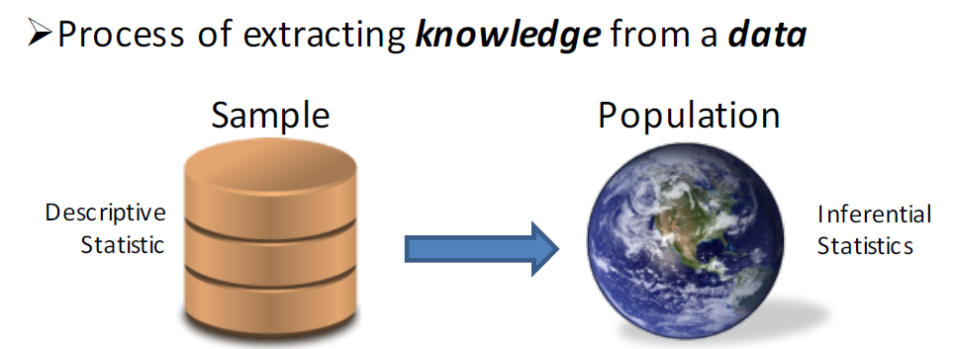
Knowledge Discovery in Databases (KDD)
Data Selection: What data do I need for a given task?
Data Cleaning: Preparing the data for a given task
Data Mining & ML: Running algorithms to infer patterns
Evaluation: Verifying that patterns are significant
Notes:
数据选择：给定任务我需要什么数据？
如果已经收集了数据，该如何收集数据？
为什么我们问如何收集数据？ 例如，假设您正在查看轮询数据。 知道何时收集它，或许知道通过电话与网络收集的方法，可能会对推断的含义产生重大影响。
数据清理：为给定任务准备数据
通常是最具挑战性（耗时）的部分。
为什么ETL不够？
有时我们可能想施加其他限制。 例如，再次轮询数据时，某些用户可能选择跳过问题。 我们可能希望从分析中删除这些用户，或将其划分为不同的群组。
数据挖掘和ML：运行算法以推断模式
有趣的部分！ 许多工具，许多选择，复杂的权衡。
评估：验证模式是否重要
算法通常会找到模式，尤其是当模式不存在时。
Why do we ask how was the data collected? For example suppose you were looking at polling data. Knowing when it was collected and perhaps by what means phone versus web may could have substantial impact on the implications that may be inferred.
Why is ETL not enough. Sometimes we might want to impose additional restrictions. For example, again in polling data some users may have opted to skip questions. We may want to drop these users from the analysis or partition them into separate cohorts.

Slide 124
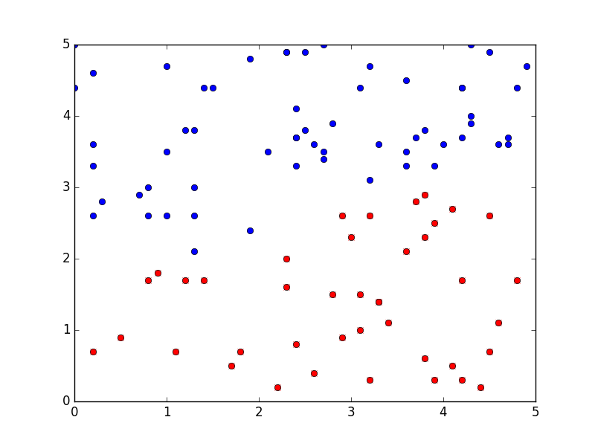
Learning: Fitting the Model
Training Data
X: Features
Y: Label/Obs.
Learn a function that generalizes the relationship between X and Y
X |  | Y
x₁ | x₂
3.9 | 3.1 | T
0.2 | 0.1 | F
4.2 | 0.9 | F
1.1 | 2.9 | T
X₂
X₁
Features
Best f_{𝜃}
Function class /
Model Family
Labels /
Observations
Best
Function
f_{𝜃} for all 𝜃
Model Parameters
All possible functions h(X) → Y
Notes:
学习一个泛化X和Y之间关系的函数

Slide 125
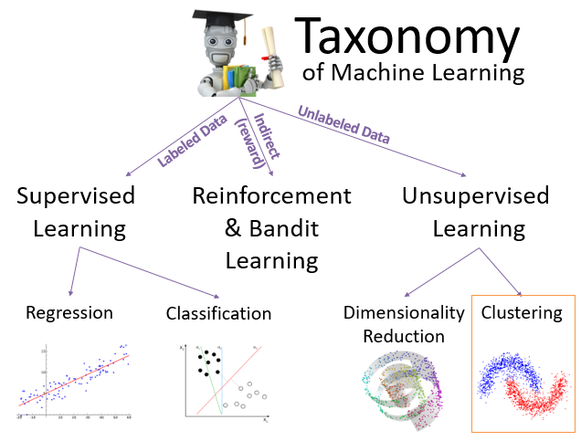
16. Data Mining and Machine Learning Part II -- Clustering
Notes:
两个子组件
锁管理器：处理并发控制问题
日志和恢复管理器：负责容错和恢复

Slide 126
K-Means Algorithm: Details
centers ← pick k initial Centers
while (centers are changing) {
// Compute the assignments (E-Step)
asg ← [(x, nearest(centers, x)) for x in data]
// Compute the new centers (M-Step)
for i in range(k):
centers[i] =
mean([x for (x, c) in asg if c == i])
}
Compute the “Expected” Assignment
Find centers that maximize the data “likelihood”
Guaranteed to converge!
To a local optimum. ☹
Depends on Initial Centers
… to what?

Slide 127
Picking the Initial Centers
Better Strategy: kmeans++
Randomized approx. algorithm
Intuition select points that are not near existing centers
(3) Pick the final center not near previous two
centers
(2) Pick the next center not near the previous center
(1) Suppose I pick this center first
Notes:
O(Log K) approx. factor

Slide 128
K-Means in Map-Reduce
MapFunction(old_centers, x)
Compute the index of the nearest old center
Return (key = nearest_centers, value = (x, 1))
ReduceFunction combines values and counts
For each cluster center (Group By)
Data system returns aggregate statistics:
ML algorithm computes new centers:

Slide 129
16. Data Mining and Machine Learning Part III – Regression
Notes:
两个子组件
锁管理器：处理并发控制问题
日志和恢复管理器：负责容错和恢复

Slide 130
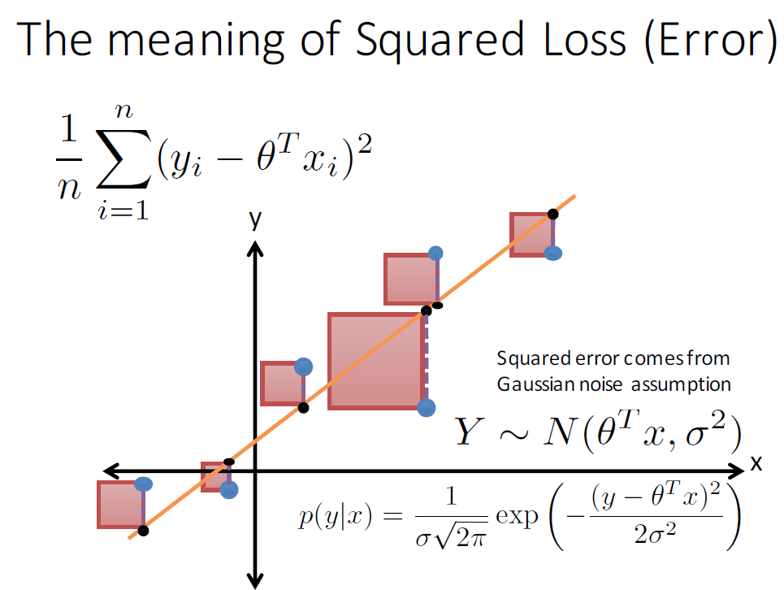

Slide 131
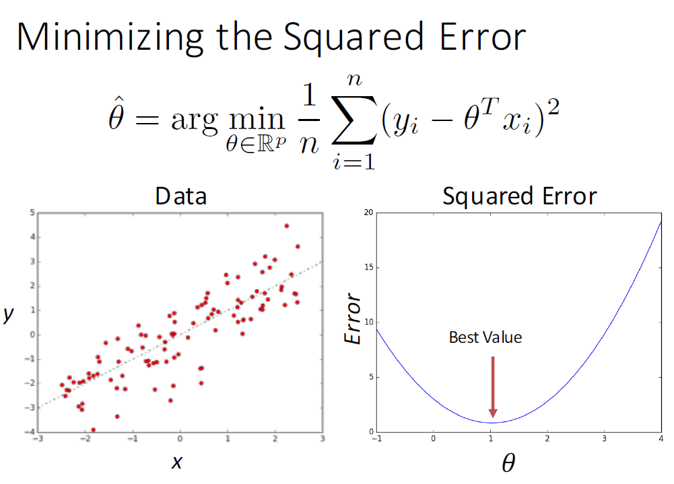

Slide 132
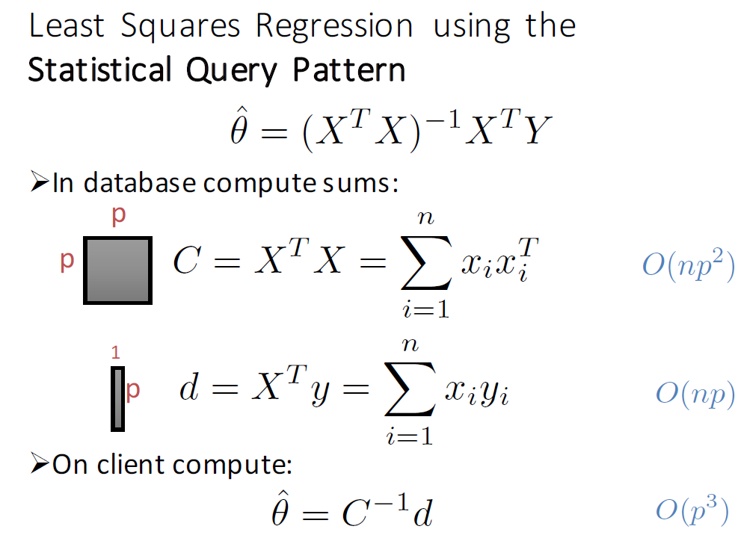

Slide 133
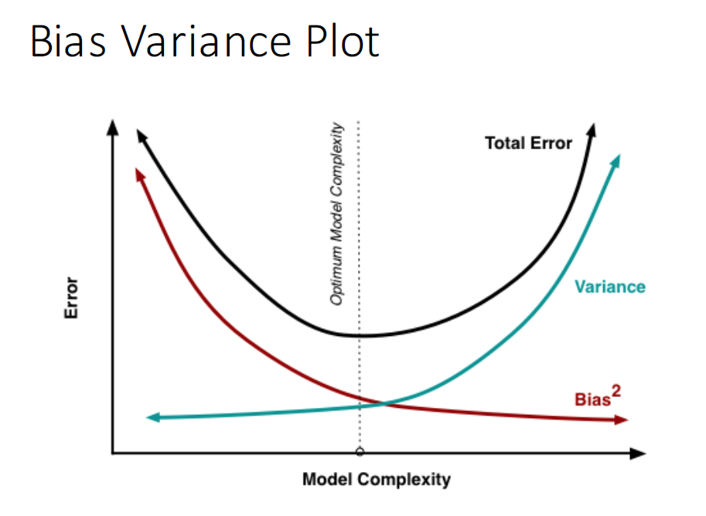
Underfitting
Overfitting
Test Error = Noise + Bias² + Variance

Slide 134
